Slide 1

  Amping Up: New NSF U-I Research Center to Transform Power Management Electronics
  2020
Prof. Charles R. Sullivan, Director
Prof. Jason T. Stauth, Co-Director
February 13, 2020
The webinar will begin momentarily

Slide 2

Webinar Logistics
You should be able to hear me talking now.
If you have trouble connecting to audio with your computer, or if you prefer to use your phone, select "Use Telephone" after joining the webinar and call in using: +1 (213) 929-4232. Access Code: 428-605-577. Webinar ID: 561-955-131.
Ask questions using the Questions Panel on your screen at any time.
The recording and slide deck will be available after the webinar is completed.
Please take time at the end to complete the survey.

Slide 3
Disclaimer
UIDP materials, which include publications, webinars, videos, and presentations, reflect an amalgamation of the experiences and knowledge of those who participate in UIDP activities. The views and opinions expressed in UIDP materials do not necessarily reflect the official policy or position of any individual organization or the UIDP. At no time should any UIDP materials be used as a replacement for an individual organization’s policy, procedures, or legal counsel. UIDP is not a lobbying organization and UIDP materials are not intended to be used to influence government decisions.

Slide 4
Amping Up: New NSF U-I Research Center to Transform Power Management Electronics
Prof. Charles R. Sullivan, Director
Prof. Jason T. Stauth, Co-Director

Slide 5
Outline
The need for Power Management Integration
Center capability and focus
Center structure and opportunities for companies to engage

Slide 6
Increasing needs and opportunities
Power Electronics: Electronics that processes energy.
Growing importance:
  Efficient use of energy across all sectors.
  Maximize battery life: from smartphones to grid storage.
  To enable advanced information processing electronics.
  To interface and optimize renewable energy sources.
Integration in power electronics.
  Higher levels of integration and new types of integration.
  High power density, high efficiency, low cost, and extreme miniaturization.

Slide 7
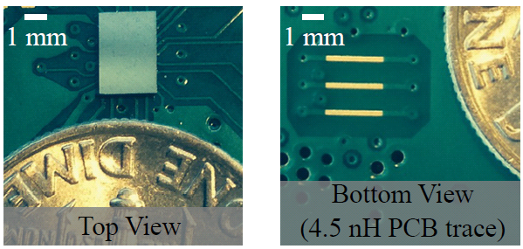
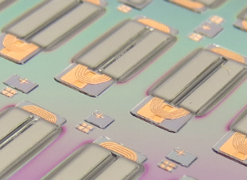
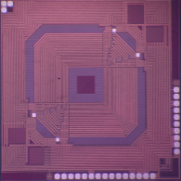
Why Power Management Integration?
To achieve higher efficiency, smaller size, and reduced cost.
Integration includes
  Monolithic integration—Power system on chip (PwrSOC), and ICs for larger systems.
  Package integration—power system in package (PwrSIP)
  Integrated design including passives, packaging, EMC, thermal, control, reliability.
  Integrated passives:
    Integrated on Si, in package, or in a system.
    Multi-function passives: LC, LT, LCT, etc.
Scope includes a wide range of power levels and scales: mW to 100s of kW
  Integrated system design including passive components
  Advanced topologies enabled by integration of drivers and control apply broadly

Slide 8
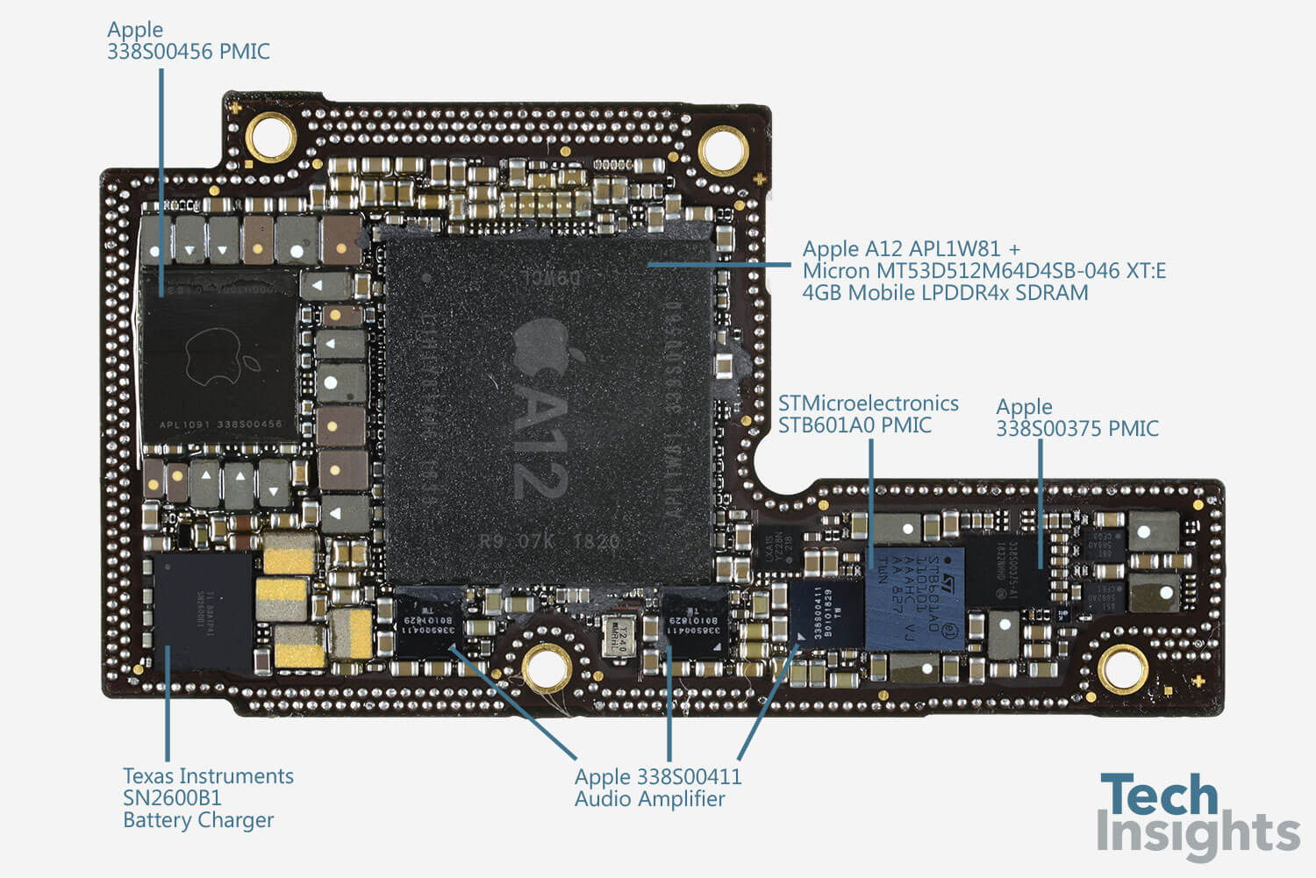
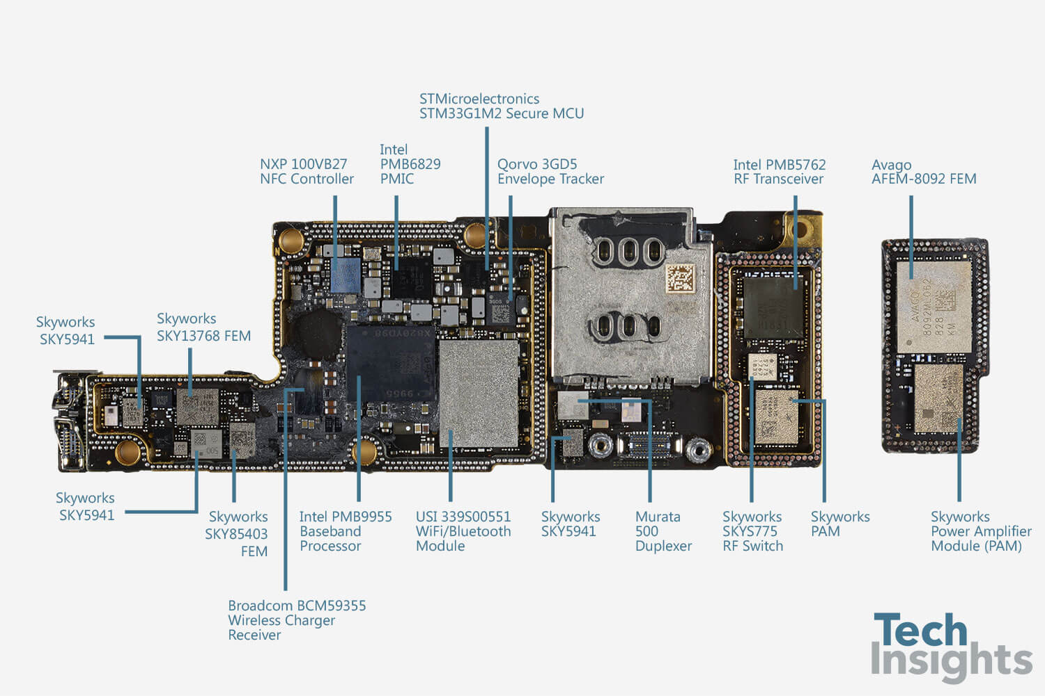
Example: iPhone Xs Max
Major area on both boards.
In addition to battery.
ICs from 6 different companies.
Components from many more.

Slide 9
Key Challenges and Opportunities
Power Management Components and Circuits
  Strong industry sector, yet few engineers are trained in
  both power electronics & integrated circuits.
  Shifting industry needs: size, cost, functionality, robustness
Next Generation Technologies
  New topologies – switched capacitor & hybrid-resonant converters
  Active & passive components, packaging and integration
New Design Paradigms
  Maximum utilization of active and passive components
  Higher switching frequencies
    Simple theory says that this enables smaller, more efficient passives.
    Excellent design and materials needed to achieve this.

Slide 10
Key Challenges and Opportunities
Power Management Components and Circuits
  Strong industry sector, yet few engineers are trained in
  both power electronics & integrated circuits.
  Shifting industry needs: size, cost, functionality, robustness
Next Generation Technologies
  New topologies – switched capacitor & hybrid-resonant converters
  Active & passive components, packaging and integration
New Design Paradigms
  Maximum utilization of active and passive components
  Higher switching frequencies
    Simple theory says that this enables smaller, more efficient passives.
    Excellent design and materials needed to achieve this.
Leading expertise in key areas

Slide 11

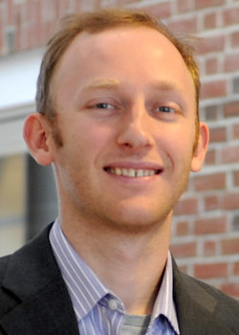
Team: Faculty Leadership
Leadership with unique power electronics expertise:
Charles Sullivan, PMIC Director
  Leading work in magnetics design and modeling,
  microfabricated power magnetics on silicon,
  nanogranular magnetic materials.
  IEEE Fellow,
  IEEE PELS Modeling and Control Technical Achievement Award.
Jason Stauth, PMIC Co-Director
  Leading work in high-power density highly integrated power converters and hybrid-resonant switch capacitor circuit modeling and design.
  NSF Career Award, Associate Editor for IEEE Transactions on Power Electronics and IEEE Solid State Circuit Letters, ISSCC TPC.

Slide 12
Team: Complementary faculty expertise
Christopher Levey, Assoc. Prof. and
Director, Thayer Microengineering Laboratory.
  Microfabrication: MEMS, microrobots, micro-inductors.
William Scheideler, Asst. Prof.
  Materials and nanomanufacturing for high-performance printed and flexible devices, including low power wireless sensing and energy harvesting.
Ulrike Wegst, Assoc. Prof.
  Materials scientist and leader in freeze-casting processes, multifunctional hybrid materials
  and biomaterials.

Slide 13


Thayer School of Engineering at Dartmouth
Oldest professional school of engineering in the US, founded by Sylvanus Thayer in 1867.
Interdisciplinary structure fosters collaboration between engineering
disciplines and attracts innovators.
Growing enrollment, growing faculty and growing facilities
New Arthur L. Irving Institute for Energy and Society:
building will include two new research labs for power electronics.
New buildings under
construction: Irving Institute building
New engineering building

Slide 14
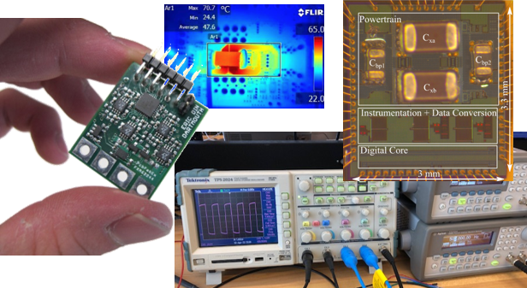
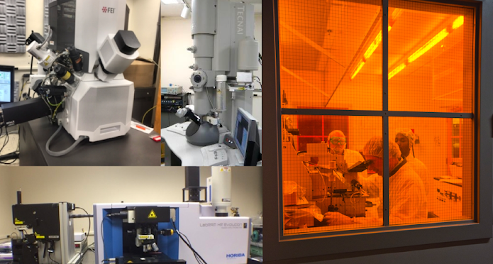
Facilities and Capabilities
Specialized capabilities in
each PI’s lab, e.g.,
  Power and Integrated Electronics Research (PIER) Lab.
  Power passives lab with commercial and custom impedance and magnetics characterization capability.
Shared facilities
  Microengineering Lab
  Materials characterization
PIER Lab
Electron Microscopy Facility
Microengineering Lab

Slide 15
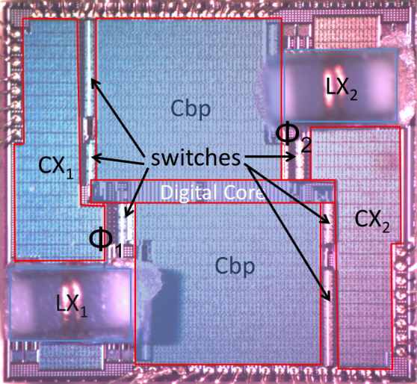
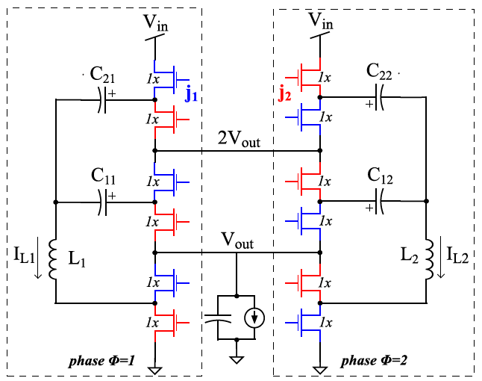
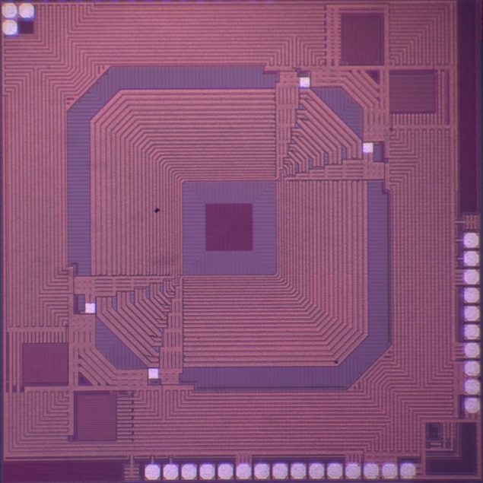
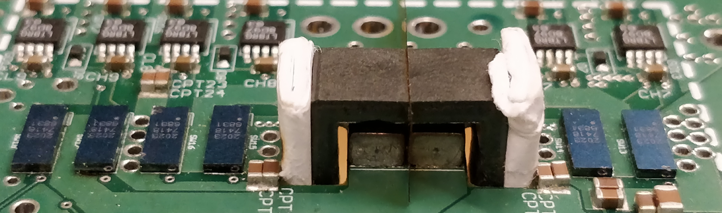
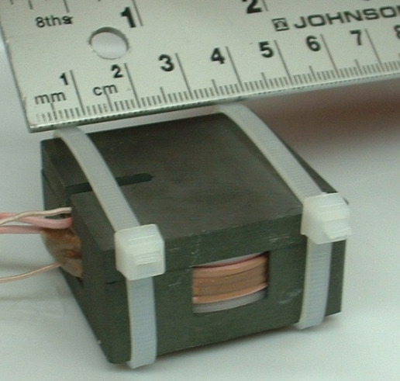
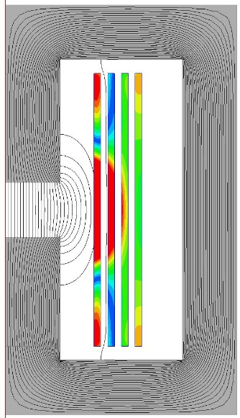
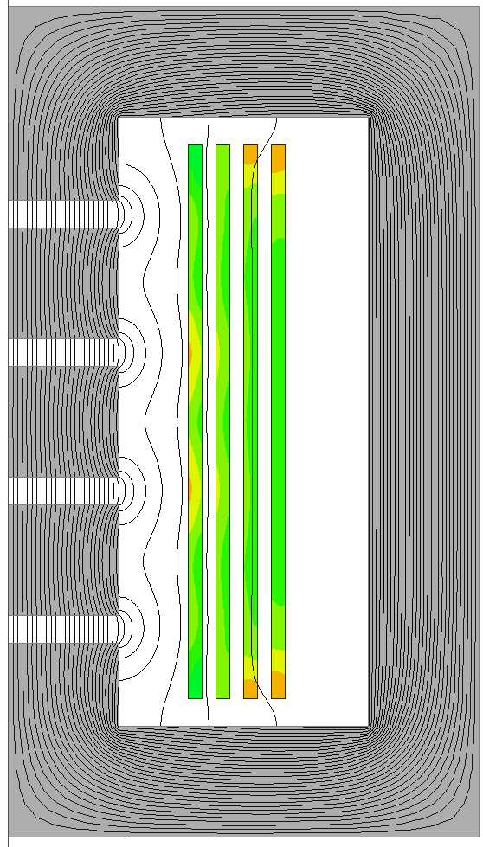
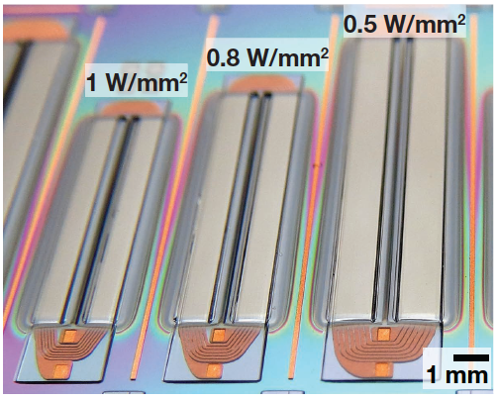
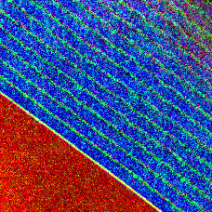
Solutions from Prior Work
New classes of circuits
with high power density and efficiency.
More highly integrated:
all on one chip.
Integration of passive
components: inductors
on silicon.
New materials.
Integrated design optimization.
Co
O
Si
100 nm

Slide 16
What is an I/UCRC?
National Science Foundation (NSF)
Industry/University Cooperative Research Center (I/UCRC)
Highly competitive selection process chose Dartmouth for the PMIC program. Opportunity to apply to add sites in spring 2020.
Industry members not only gain access but drive the center focus.
  Specific research projects funded are selected by the industry advisory board (IAB).
  Industry input guides individual projects and overall research directions.
  Close contact through in person meetings twice a year, monthly conference calls and more.

Slide 17
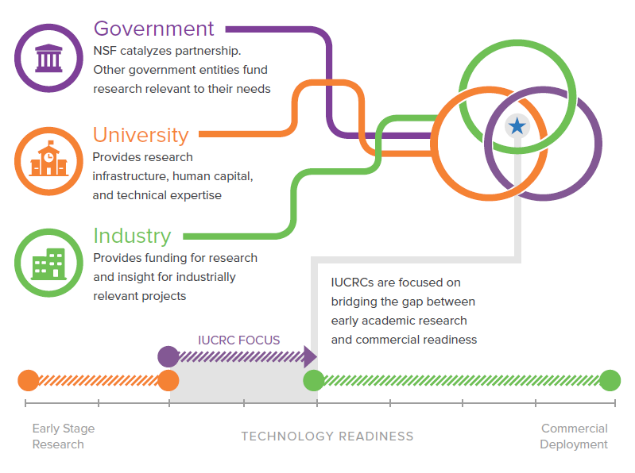
I/UCRC
Concept
Industry gets access to:
Portfolio of research at low cost
IP: royalty-free non-exclusive license
Students with specialized skills.
Seat on the advisory board and a vote on project selection.
Faculty expertise

Slide 18
Why I/UCRC?
NSF mandates a better deal for industry than universities typically offer:
  Overhead reduced from 64% to 10%.
  Royalty-free non-exclusive license to all center IP, not just what your research funding supported.
  Leverage funding from NSF and over members to support a larger, more comprehensive research program.
Guided by the Industry Advisory Board: project selection, new project ideas, and overall center direction.
Access: to students, pre-publication research, IP, expertise, high-level contacts at other member companies.

Slide 19

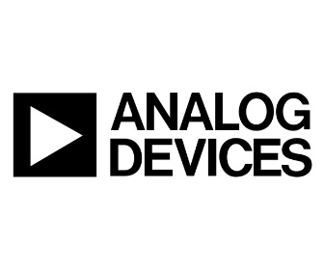
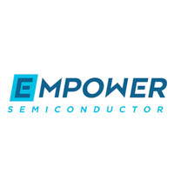

PMIC launch and trajectory
Launched with first Industry Advisory Board meeting in July, 2019
  Second meeting was in Dec. 2019.
3 projects chosen by IAB have begun
Next meeting July 23-24 at Dartmouth in New Hampshire:
open to members and new prospective members.
Four member companies now; Expansion to include new university site(s), new projects and new industry members.

Slide 20
Current projects
Integrated 5V:1V Step-Down Hybrid-Cascaded SC DC-DC Converter (Stauth)
  Tape-out this week.
Low-Loss Magnetic Composites for High Frequency Power Conversion (Wegst and Sullivan)
  New approach controls orientation of magnetic flakes in a low-cost bulk process.
Performance Limits for Air-Core and Magnetic-Core Inductors on Silicon and in Advanced Packaging Technologies (Sullivan and Levey)
  Modeling and design optimization across a range of geometries, technologies and applications.

Slide 21
Membership opportunities
Membership open to interested companies and other organizations.
Access to students, faculty and research.
Join the IAB to choose the next projects:
  Examples include higher power applications, EMC, battery management.
Expected expansion over the next year: more universities and more companies.
Power management is critical and becoming more important across many sectors.
Many types of integration offer advantages for higher efficiency, smaller size, and reduced cost.
Learn more at https://pmic.engineering.dartmouth.edu/

Slide 22

Interested in university-industry partnerships?
Sign up for information about UIDP news, webinars, projects, and more at uidp.org/newsletter-signup.
www.uidp.org
info@uidp.net
(803) 807-3679

