Slide 1

  Collaboration Opportunities in Water Research: How Scientists Can Partner with Baxter
  2020
Matthew Muller, PhD, Baxter
Kevin Leland, Halo
January 23, 2020
The webinar will begin momentarily

Slide 2

Webinar Logistics
You should be able to hear me talking now.
If you have trouble connecting to audio with your computer, or if you prefer to use your phone, select "Use Telephone" after joining the webinar and call in using: +1 (415) 655-0052. Access Code: 933-544-279. Webinar ID: 547-149-659.
Ask questions using the Questions Panel on your screen at any time.
The recording and slide deck will be available after the webinar is completed.

Slide 3
Disclaimer
UIDP materials, which include publications, webinars, videos, and presentations, reflect an amalgamation of the experiences and knowledge of those who participate in UIDP activities. The views and opinions expressed in UIDP materials do not necessarily reflect the official policy or position of any individual organization or the UIDP. At no time should any UIDP materials be used as a replacement for an individual organization’s policy, procedures, or legal counsel. UIDP is not a lobbying organization and UIDP materials are not intended to be used to influence government decisions.

Slide 4



Partnering with Baxter to Serve Home Dialysis Patients
March 4, 2020
A NEW WAY TO FUND CRITICAL BIOMEDICAL RESEARCH
Proprietary and Confidential

Slide 5
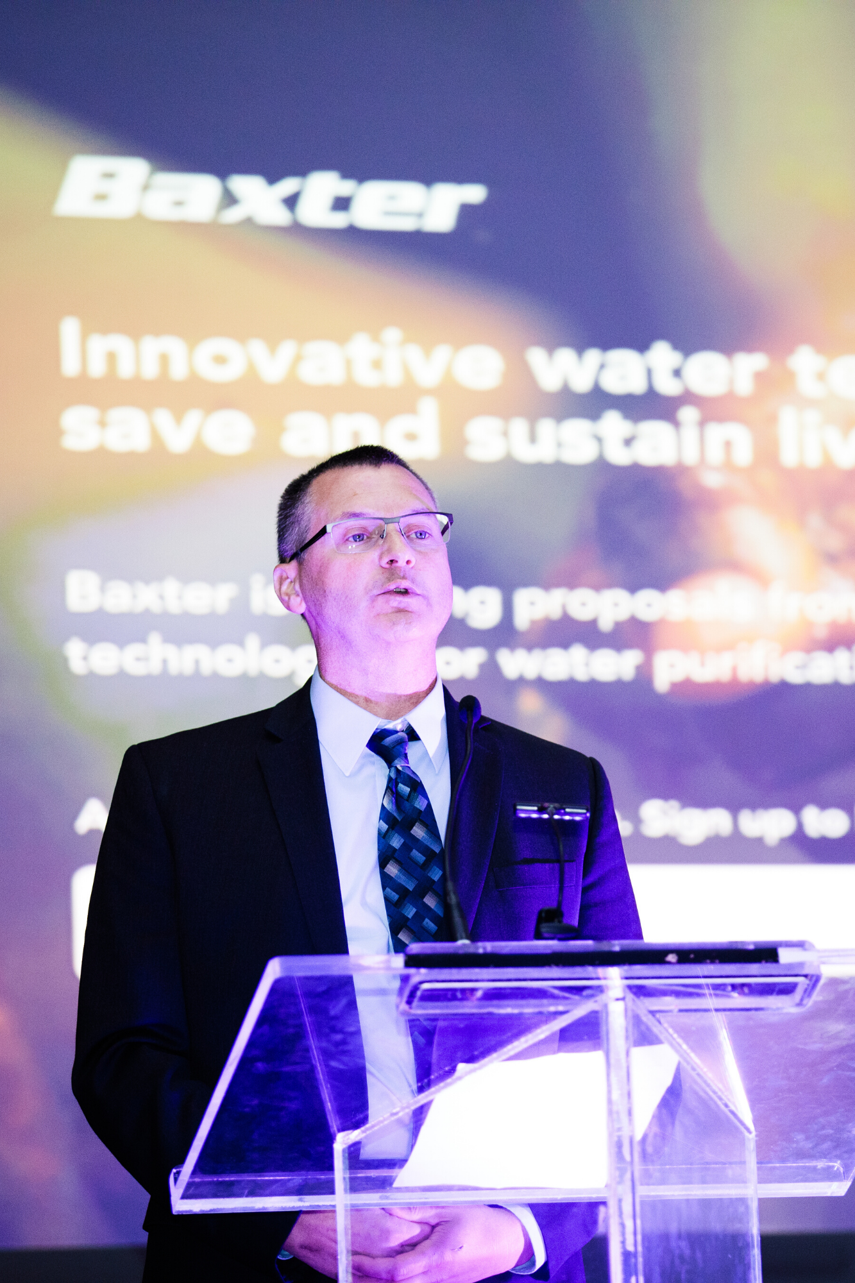
Agenda
Company Backgrounds
Challenge Overview
RFP Details
Demo Proposal
Q&A
Notes:
What are you hoping to learn during this webinar? Or what specific questions do you have?
There will be some quiz questions later so pay attention!

Slide 6
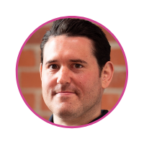
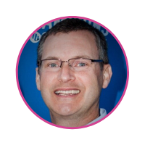
Presenters
Kevin Leland
CEO & Founder
Halo
Matt Muller, PhD
Director of R&D
Baxter
Notes:
Kevin to cover

Slide 7





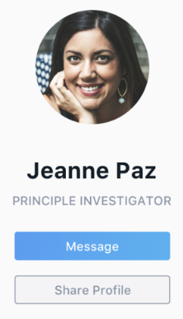

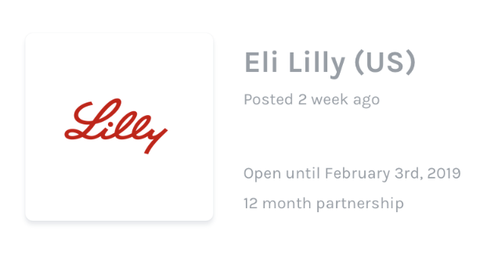




What is Halo
Halo is an online marketplace that connects research-driven companies directly with research proposals from scientists
Marketplace
Network
RFPs from research-driven industries
Scientist Profiles & Company Pages

Slide 8
Halo Highlights
Both university officials and scientists can join
Pre-proposal takes about an hour
Non-confidential information
Every proposal gets a response with feedback
Engage directly with industry partner
Notes:
Halo was designed from the bottom to make to make it much easier for scientists and companies to work together.
What are you hoping to learn during this webinar? Or what specific questions do you have?
There will be some quiz questions later so pay attention!

Slide 9
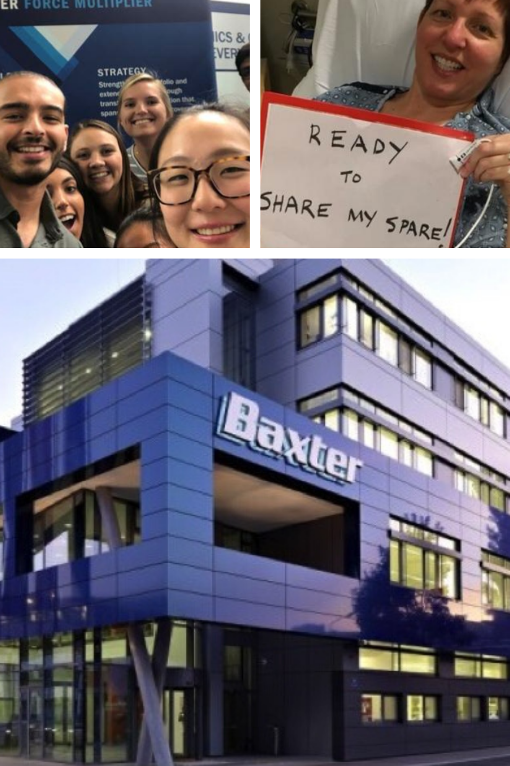
Who is Baxter
Baxter is a Fortune 200 healthcare and med device company based outside Chicago
Spends $650M on R&D
Largest business is renal care and home dialysis
Current academic collaborators include Mayo Clinic, USC, Tel Aviv University and Johns Hopkins
Notes:
Matt to cover:
11.4 billion sales in 2019
Largest business is Renal Care (~160M R&D spend)
Largest segment is peritoneal dialysis where Baxter is market leader
AAKHI expected to significantly grow the pd segment over the next 5 years

Slide 10

Patients with Chronic Kidney Disease
Patients Worldwide
$2 million
1in 10 Americans have some form of CKD
Patients receive dialysis treatment at service clinics 3x per week for 4-hour sessions
Feel sick before and after
Annual Medicare Costs
$33 billion
Notes:
One in ten people have some form of chronic kidney disease
The primary therapy modality in the US for those patients that progress to end stage renal disease is hemodialysis with over 2 Million patients treated on in-center hemodialysis in the US. This number is increasing at a 7% annual growth rate
In 2010, the annual Medicare cost for ESRD was $33B or 7% of the overall Medicare budget.
With hemodialysis, you typically receive treatment at a clinic 3x per week for 4 hours a session for a total of 12 hours per week. In contrast, your kidneys which work 24/7. You feel sick the day before dialysis because due to the toxins and fluid that have accumulated in your body. You also feel sick for the remainder of the day after your dialysis session due to the large volumes of fluid (up to 4L) removed during relatively short dialysis session.

Slide 11

What does clean water have to do with dialysis?
Notes:
Large volumes of purified and sterile water needed to perform dialysis. For hemodialysis, this can amount to over 150L of purified water per therapy.

Slide 12
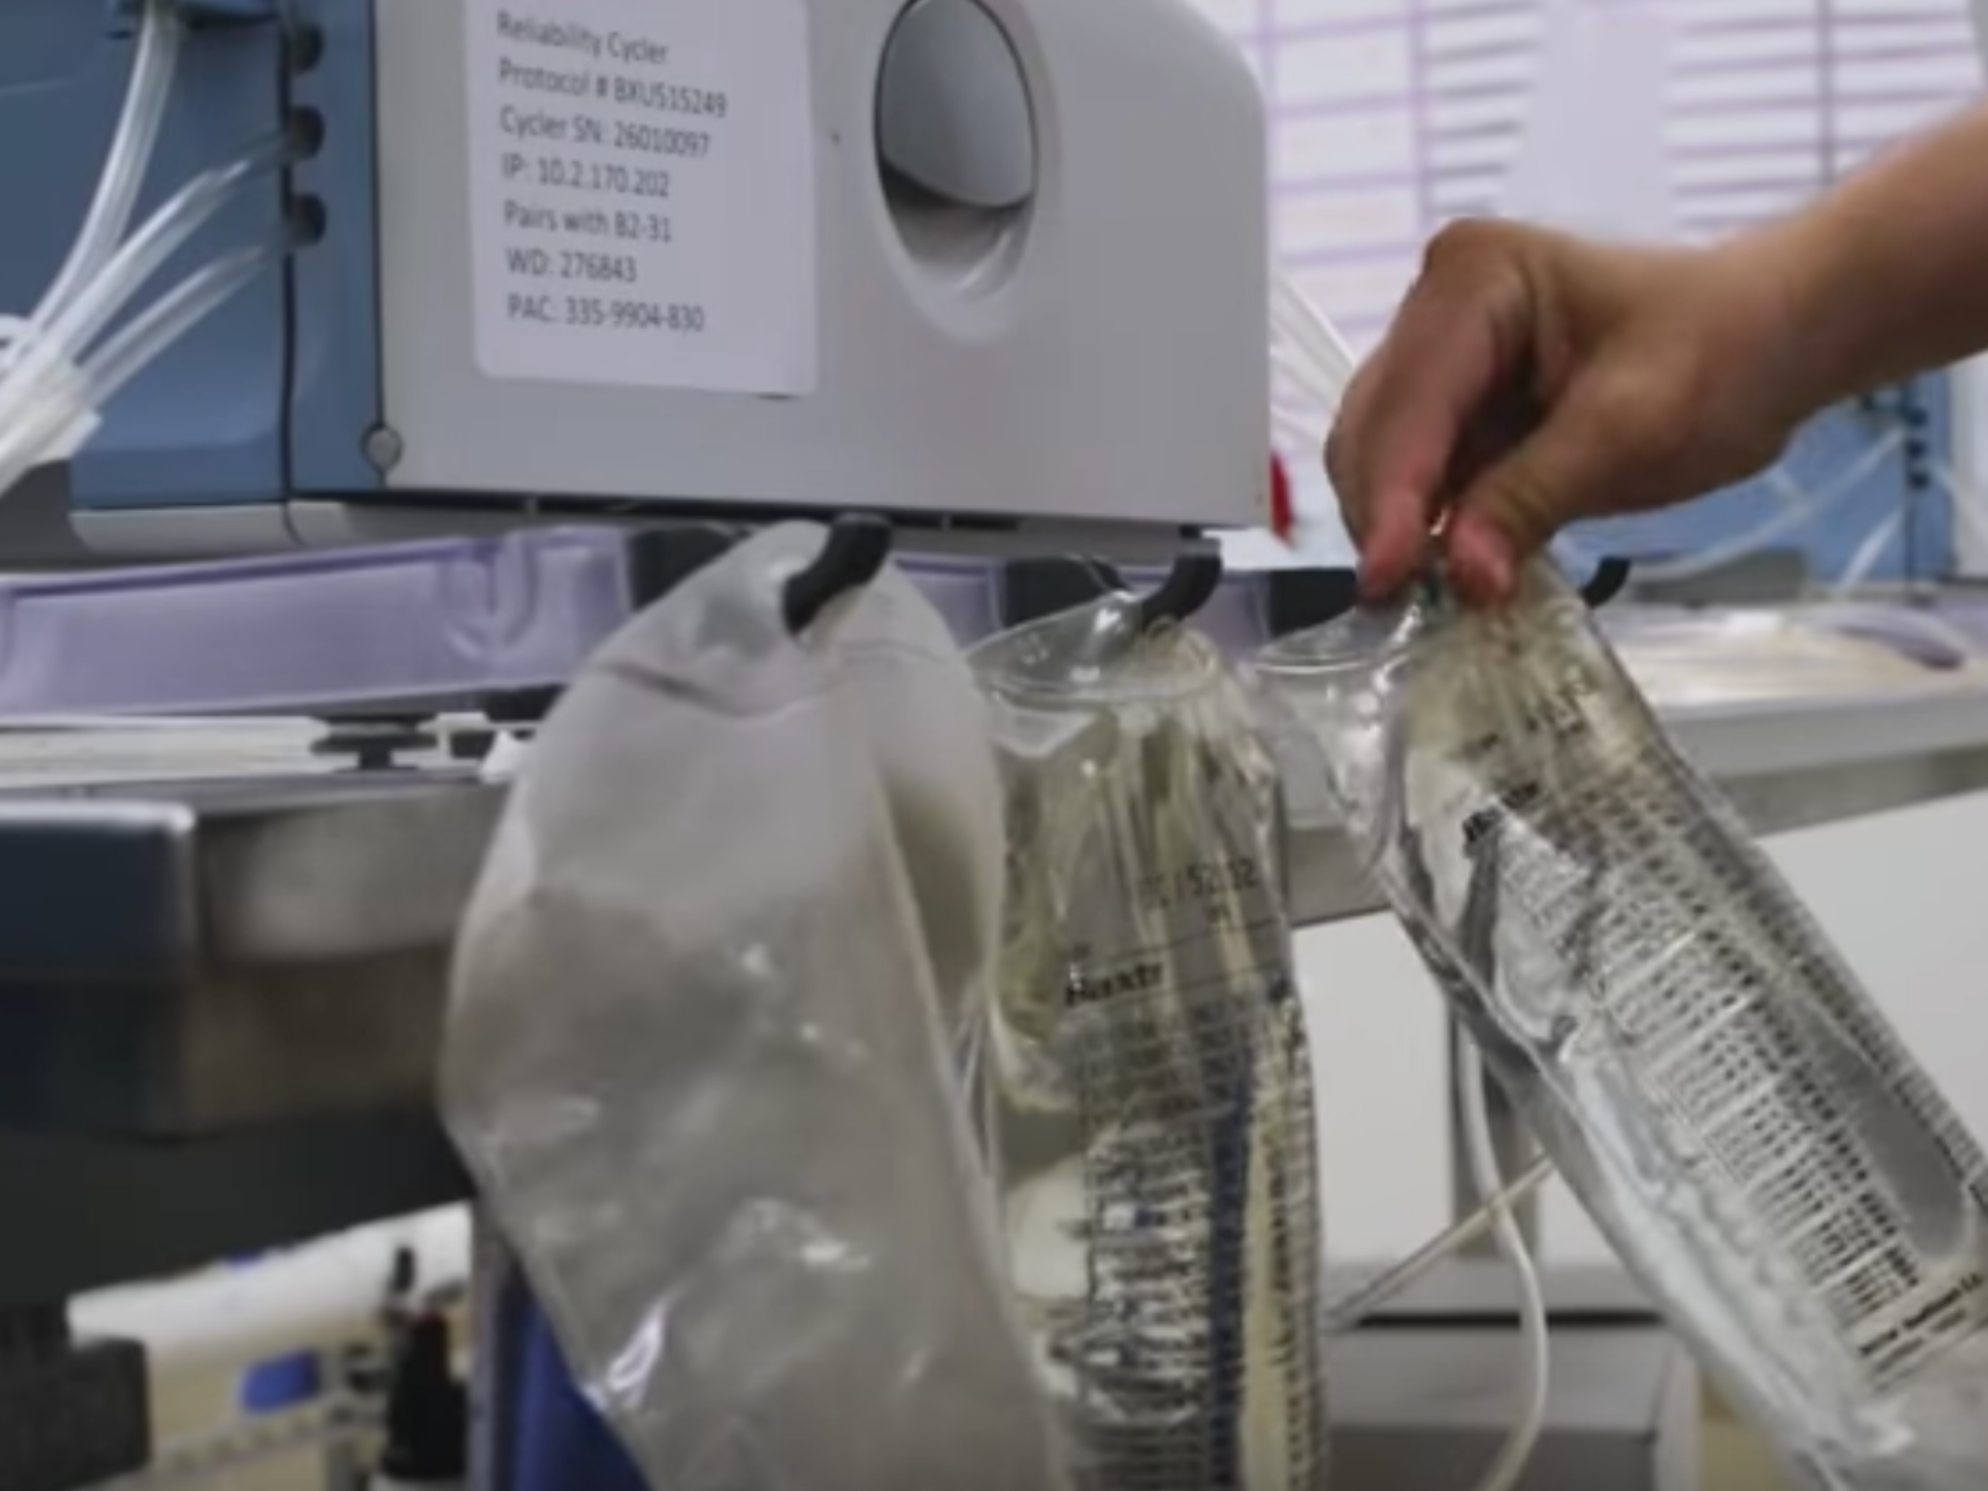
Notes:
The amount of sterile dialysis solution needed to perform a PD treatment is less than HD, only approximately 15L. As a result, Baxter provides the solution in bags and all the solution needed to support therapy is delivered to the patient’s home 1x/month.

Slide 13
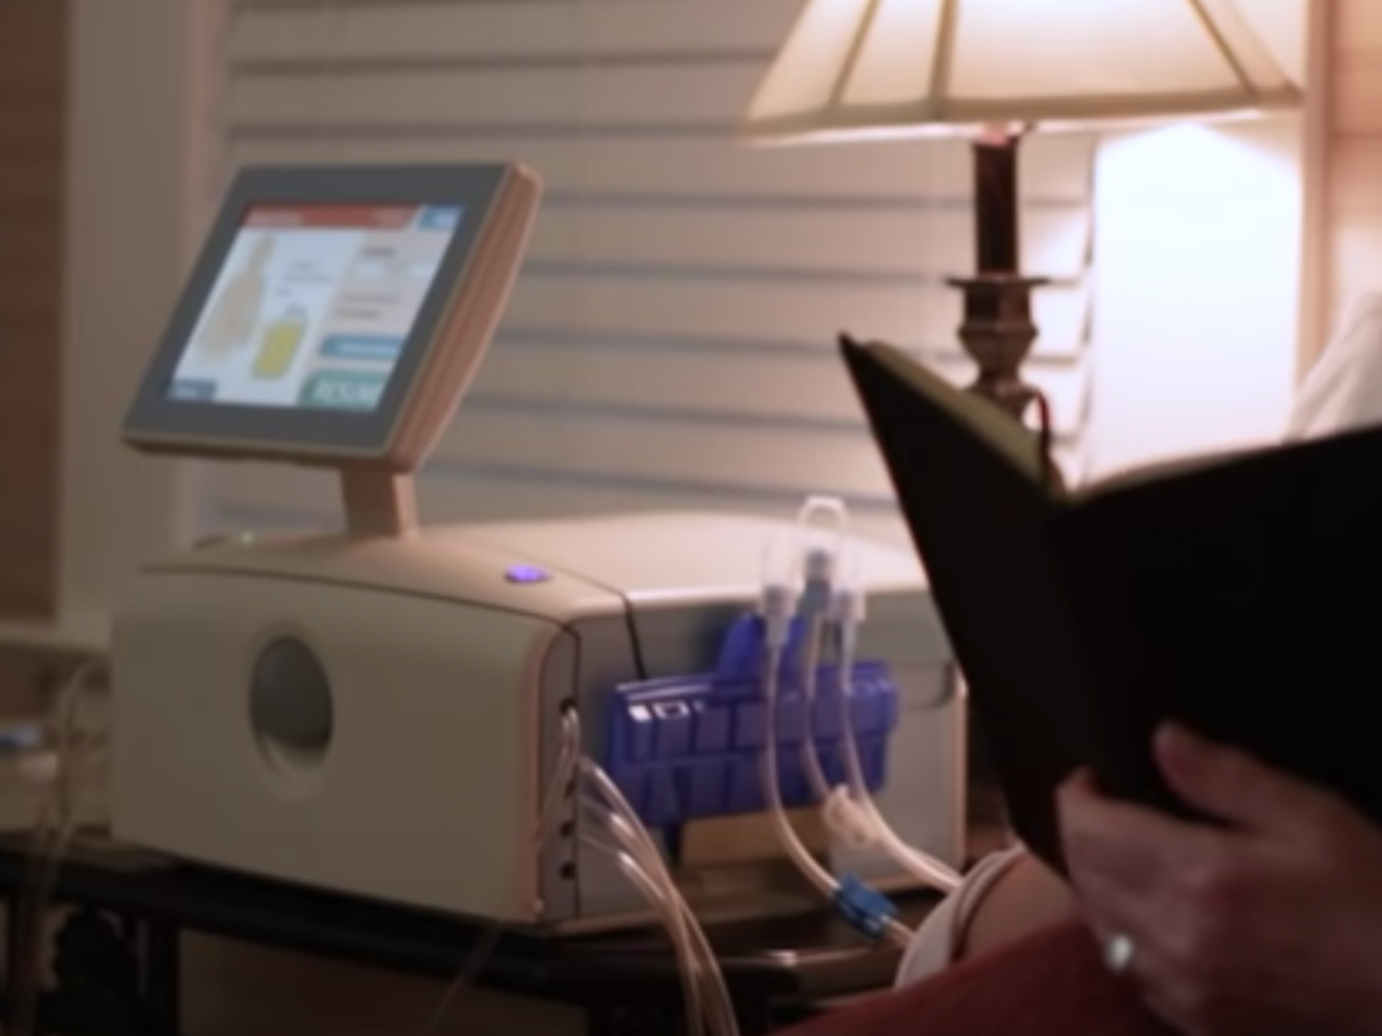
Notes:
This is a picture of Baxter’s Amia peritoneal dialysis device. This device delivers sterile dialysis solution from bags to and from the patient’s peritoneum. Peritoneal dialysis is typically performed at home while the patient sleeps. The therapy is performed in cycles where one cycle consists of delivered to the patient’s peritoneum, dwells in the peritoneum for a period of time (~1hr), and then draining this solution to the toilet or a drain. Typically 4 cycles are performed per treatment.

Slide 14
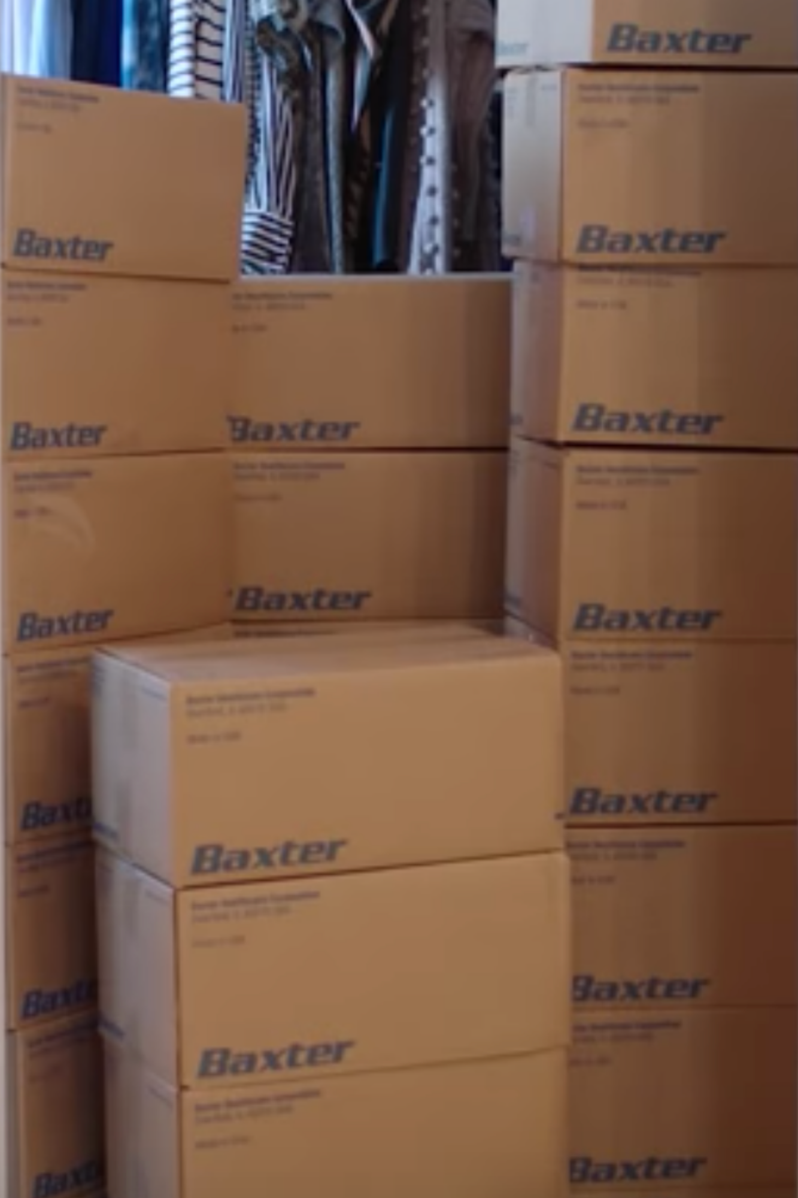
Benefits and Challenges of Home Dialysis
Longer and more frequent dialysis dramatically improves patient outcomes and quality of life
900 pounds of water delivered monthly to each patient’s home
Notes:
So…while performing PD therapy at home provides patients with the benefits of longer and more frequent dialysis therapy and has lower water requirements than HD, it still requires significant storage space in the home. In addition, the patient must move the solution from the storage location to the treatment location and also dispose of all the waste.
This is why Baxter is interested in making pd solution in the home from tap water and concentrates.

Slide 15
How might we turn tap water into dialysis solution?
Notes:
There are three critical challenges to producing dialysis solution in the home from tap water. 1) how to soften the water, 2) how to remove chloramine and 3) how to measure to ensure that the chloramine has been removed.

Slide 16
Removing Water Hardness
Opportunity #1
Solution Requirements:
Hardness below 2 mg/L
Efficient, low-maintenance technologies suitable for daily home use that reduce calcium carbonate (hardness)
Waste flow less than 5% of feed water flow
Treated water remains stable
No additional chemicals for maintenance
Patient-operated without need for assistance
Notes:
Describe why removing hard water minerals is important (e.g. reduction in lifespan of downstream components and decreased performance). Describe how done to day and limitations of these approaches (e.g. softening and resin cartridges).

Slide 17
Removing Total Chlorine
Opportunity #2
Solution Requirements:
Total chlorine below .1 mg/L
Small technologies that can reduce reduce total chlorine (mono-di-tri-chloramine, free chlorine) levels in household water to 0.1mg/L for use in home dialysis
No waste produced
No chemical de-chlorination additives
Activated carbon is not of interest
UV from mercury lamps is not of interest
Notes:
Describe how down today and limitations (e.g. carbon packs that need to be replaced by user and cost $$)

Slide 18
Chlorine Sensor
Opportunity #3
Solution Requirements:
Accuracy of +/- 20%
Seeking an in-line sensor smaller than 10 cm3 that measures total chlorine (mono-di-tri-chloramine, free chlorine) in feed water with an accuracy of +/- 20%
No larger than 10cm3
Eliminates need for patient testing
Calibration once at installation
No waste flow or additional reagents
Notes:
Describe how down today and limitations (e.g. user must take a sample and measure with a dip stick)

Slide 19
Demo
How to submit a proposal on Halo

Slide 20
Questions

Slide 21
Thank You!
A NEW WAY TO FUND CRITICAL BIOMEDICAL RESEARCH
Sign up at halocures.com

Slide 22

Interested in university-industry partnerships?
Sign up for information about UIDP news, webinars, projects, and more at uidp.org/newsletter-signup.
www.uidp.org
info@uidp.net
(803) 807-3679

