Slide 1
The Importance of Proximity to Successful U-I Alliances/Partnerships
Moderator: Tony Boccanfuso, UIDP
Speaker: Mark Ortiz, Sony Corporation of America
Professor Jonathan Fan, Stanford University
Credit: Sony
July 15, 2020 | The webinar will begin momentarily

Slide 2
How to Participate
Webinar Logistics
Audio
If you have trouble connecting to audio with your computer, or if you prefer to use your phone, select "Use Telephone" after joining the webinar and call in using:
+1 (631) 992-3221 Access Code: 623-266-653
Webinar ID: 209-541-987
Polls & Questions
Set your Questions box to send to Organizers & Panelists.
In the event this webinar shuts off due to connection issues, do NOT close webinar the window. The webinar room will reopen in less than a couple minutes.

Slide 3
Disclaimer
UIDP materials, which include publications, webinars, videos, and presentations, reflect an amalgamation of the experiences and knowledge of those who participate in UIDP activities. The views and opinions expressed in UIDP materials do not necessarily reflect the official policy or position of any individual organization or the UIDP. At no time should any UIDP materials be used as a replacement for an individual organization’s policy, procedures, or legal counsel. UIDP is not a lobbying organization and UIDP materials are not intended to be used to influence government decisions.
Notes:
Presenter Andrew
Welcome
Ask participants to enter name and affiliation in chat box

Slide 4
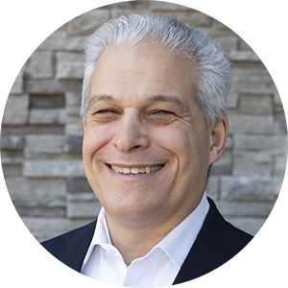
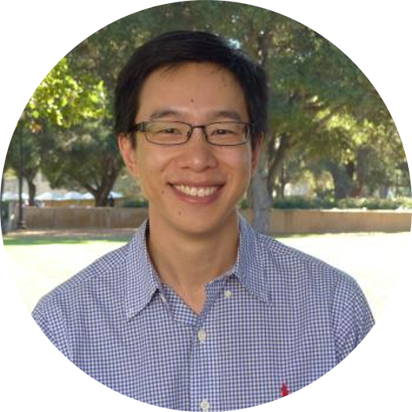
JULY 15
12-12:45 p.m. ET
Sony Research Award Program Webinar (2020)
Tony Boccanfuso,
President
UIDP
Mark Ortiz
Manager, Strategy & Planning Office
Sony Corporation of America
Professor Jonathan Fan
Assistant Professor, Department of Electrical Engineering
Stanford University
2018 Sony Research Award Program Winner
Moderator
Panelists

Slide 5
Sony Research Award Program
2020
Professor Jonathan Fan – Assistant Professor of Electrical Engineering and, by courtesy, of Materials Science and Engineering
2018 Sony Research Award Program Winner
Stanford University
Mark V. Ortiz - Manager, Strategy & Planning Office
Sony
R&D Center U.S., San Jose Laboratory
UIDP Webinar – Wednesday, July 15, 2020
Notes:
Hello everyone and thank you Tony for your introduction. I am Mark Ortiz, Manager of the Strategy and Planning Office at Sony’s U.S. Research Center, here in the heart of Silicon Valley in San Jose, California and I am here, as Tony mentioned, with one of my Sony colleagues Matsuyama-san who has been invaluable in assisting me with the Sony Research Award Program. We are certainly very excited about this year’s research award program and we hope that you will be too, by the time we are done telling you about it. %

Slide 6
Webinar Agenda
Welcome and Introduction
The Sony Research Award Program (RAP) & how it is Different?
Description of Both Awards and their Subject Categories & Topics
Submission Guidelines
Q & A
Notes:
First, I would like to briefly review today’s webinar agenda. After a brief introduction to Sony, I will discuss what the Sony Research Award Program, or RAP, is and how it differs from other research award programs. I will then describe both of the Sony Research Award Program awards along with their subject categories or topics, followed by a brief review of some key points in the Research Award Program’s Submission Guidelines, after which we will close with a question and answer session. %

Slide 7
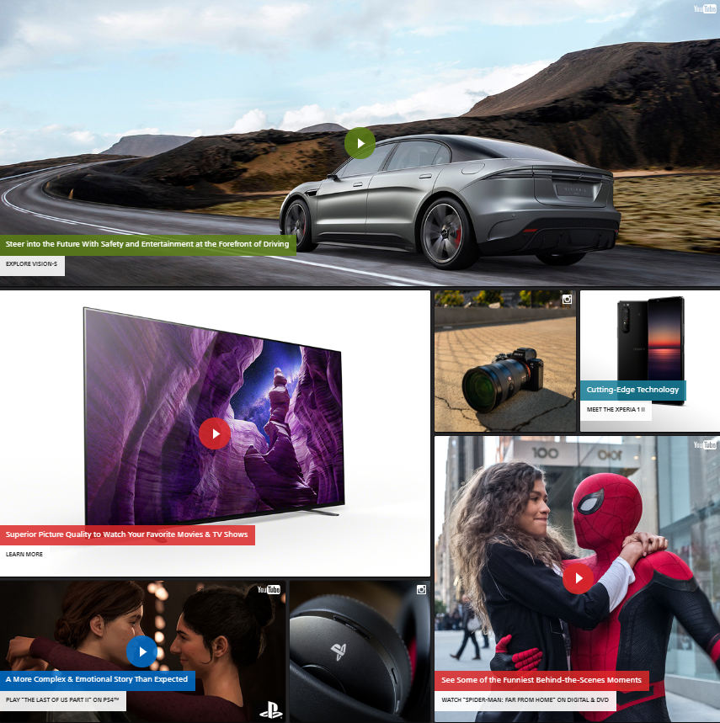
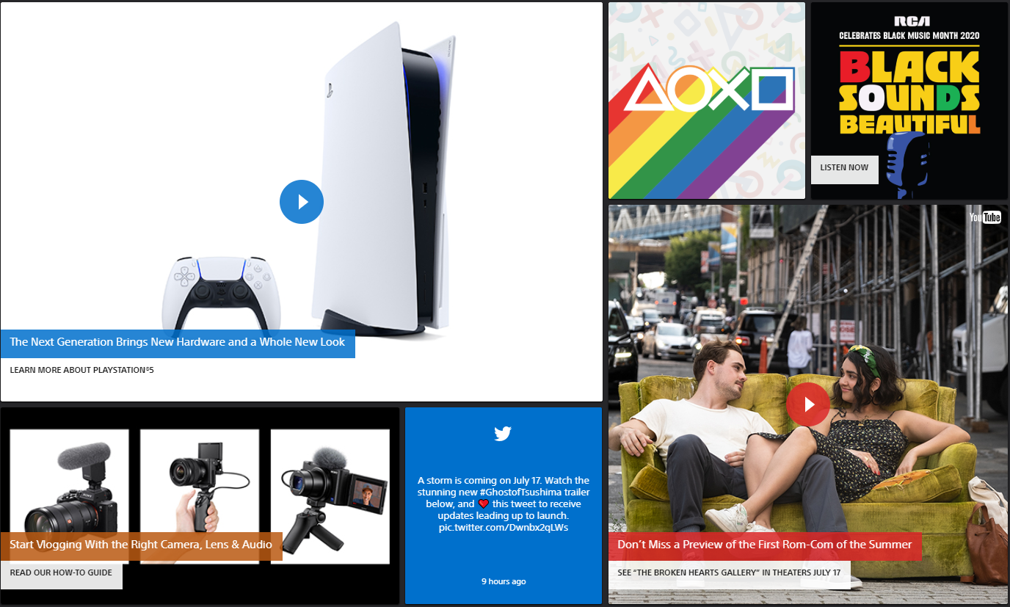
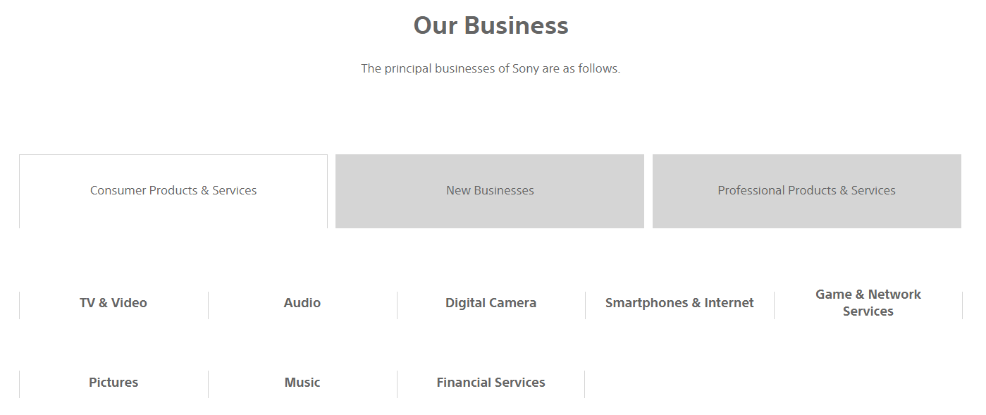
Welcome UIDP Members! An Intro to Sony
What is Sony?
“a creative entertainment company with a solid foundation of technology” Kenichiro Yoshida
Notes:
Welcome everyone and thank you for attending today’s UIDP webinar to learn more about the Sony Research Award Program! I would also like to thank the UIDP leadership and staff for their phenomenal support and assistance in organizing and announcing this webinar. Let’s get started!
Who is Sony? There is a high likelihood that all of you have been touched by a Sony Company in one way or another, whether it be a Sony movie that you’ve seen, a song by a Sony artist you’ve heard, a PlayStation game that you can’t stop playing or by your favorite camera or television.
The images that you see here are from the Sony website and clearly reveal that Sony is a highly diversified company. The principal businesses of Sony may be broken out into the following three categories %, starting with “Consumer Products & Services”. In this category we have TV & Video, Audio, Digital Camera, Smartphones & Internet, Game & Network Services, Pictures, Music, and Financial Services. The second category is %“New Businesses” which comprises Entertainment Robot, Life Space UX, Seed Acceleration Program, Education, and Sports Entertainment. And the third category is %“Professional Products & Services” which includes Professional Products & Solutions, Semiconductors, Medical, and Contactless IC Card Technology. So you can see from this description just how diversified Sony is. %

Slide 8
II. What is the Sony Research Award Program & how does it differ from other Award Programs?
July 15, 2019
Notes:
What is the Sony Research Award Program and how is it different? %

Slide 9
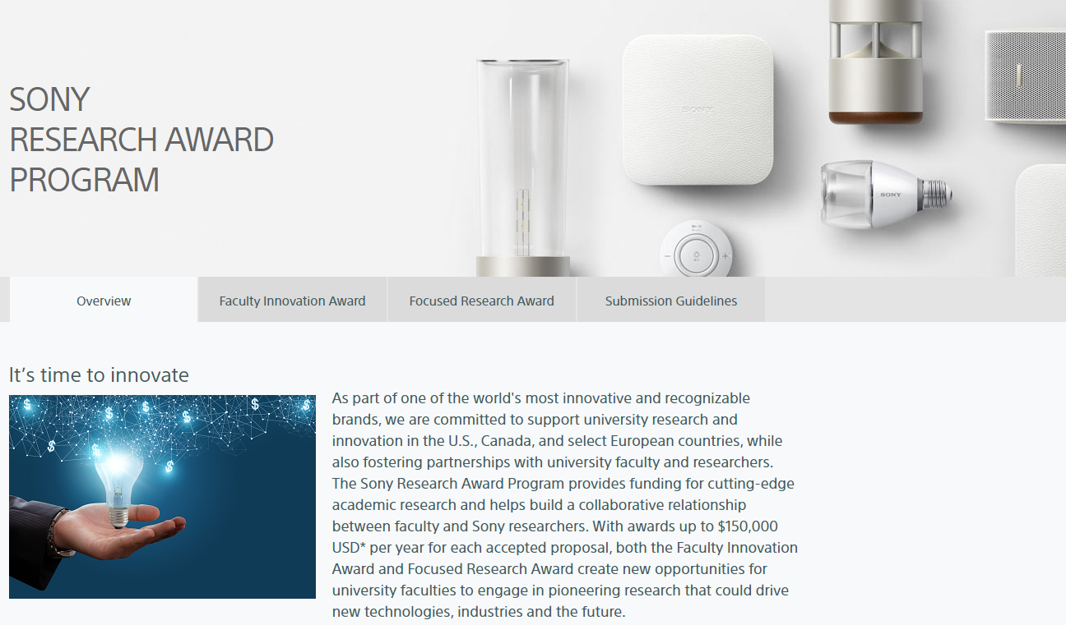
What is the Sony Research Award Program? https://www.sony.com/research-award-program
In Fifth Year of
the Sony RAP!
Includes Select
EU Countries this year
Notes:
Let’s start with “What is the Sony Research Award Program?”. It is a research award program that is part of Sony’s commitment to support university research and innovation throughout the United States and Canada while fostering strong and enduring relationships with leading investigators. The Sony Research Award Program is in its third consecutive year with the 2018 Program.
All additional details required to submit a research proposal may be found at the Sony Research Award Program website at www.sony.com/research-award-program. Please visit us at this website and encourage all of your faculty members involved in research to do the same. %

Slide 10
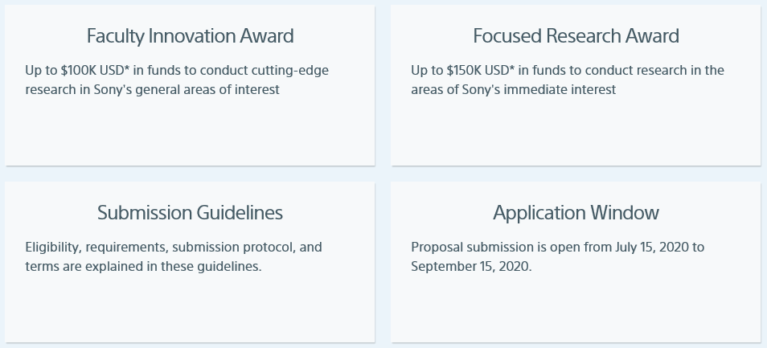
What is the Sony Research Award Program? https://www.sony.com/research-award-program
Notes:
The Sony Research Award Program has two distinct awards, the Faculty Innovation Award and the Focused Research Award. The Faculty Innovation Award provides research funding for each accepted proposal to conduct cutting-edge research in Sony’s general areas of interest. Researchers interested in this award may select from one of many keywords in three broad technology categories. The Focused Research Award provides research funding for each accepted proposal to conduct research in the areas of Sony’s immediate interest. Researchers interested in this award may select from one of various detailed research topics provided.
The Submission Guidelines provide comprehensive instructions to submit a research proposal. The Application Window for this call-for-proposals is from July 15 to September 15 of this year, so it is open now! %

Slide 11
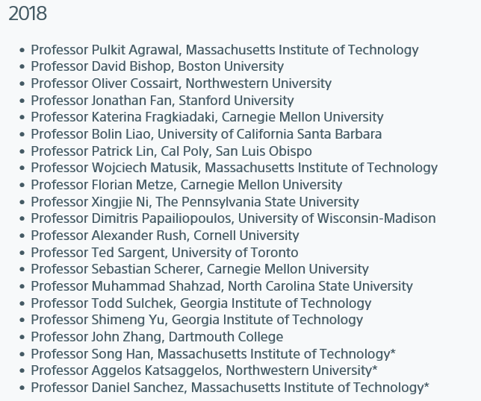
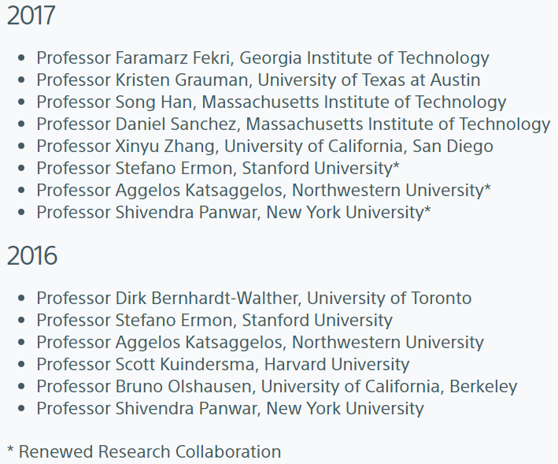
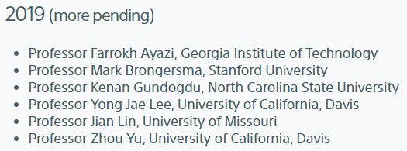
Who are past winners in the Sony Research Award Program?
https://www.sony.com/research-award-program
Notes:
We have been very fortunate to attract some phenomenal talent to apply to past Sony Research Award Programs and we are confident that this year will be no different. There is a list of prior award recipients at the bottom of the front page of our Sony Research Award Program website. You will also note that some of the awards are renewals from the prior year as strong collaborations are formed between a Sony research group and a university professor. %

Slide 12
How is the Sony Research Award Program Different?
Sony research groups seek multi-year professional collaborations that will foster strong relationships
The Sony RAP is not a Gift program but a Sponsored Research program instead, in which PIs and Sony are deeply engaged
All research collaborations have at least quarterly reports but most PIs also provide monthly (and some, even weekly) interactions as well
Notes:
How is the Sony Research Award Program different? The first point that I would like to make about Sony’s Research Award Program is that Sony’s research teams are seeking multi-year research collaborations that will foster strong and lasting relationships. % The second point is that Sony’s Research Award Program is not an “unrestricted gift” program as many others are but, instead, is a sponsored research program in which principal investigators, or PIs, and Sony researchers are deeply engaged in a research topic together. % Lastly, all collaborations have quarterly interactions at a minimum, but most have monthly or even weekly interactions. Some of our PIs have commented on how they enjoy the fact that there is a high level of engagement with Sony researchers. Others have specifically stated that they want to work with Sony because of the prospect of bringing their technology to millions of people through Sony. %

Slide 13
III. Description of Each Award
Notes:
I would now like to provide a more detailed description for each of the two awards. %

Slide 14
Faculty Innovation Award
Provides up to $100k
Principal Investigators select one “keyword” most relevant to their submission
2020 Program to continue the great expansion from the 2018 & 2019 Programs beyond just “IT” to include “Devices & Materials” and “Biomedical & Life Science”
Notes:
The Faculty Innovation Award provides up to one hundred thousand dollars for each accepted proposal. Principal Investigators must select the one keyword from three broad categories that is most relevant to their submission.
!We are particularly excited about this year’s Sony Research Award Program because Sony has added two entirely new major categories, namely Devices & Materials and Biomedical & Life Science. These are two areas in which Sony has already been very active for many years and now seeks to further expand its outside collaborations. %

Slide 15
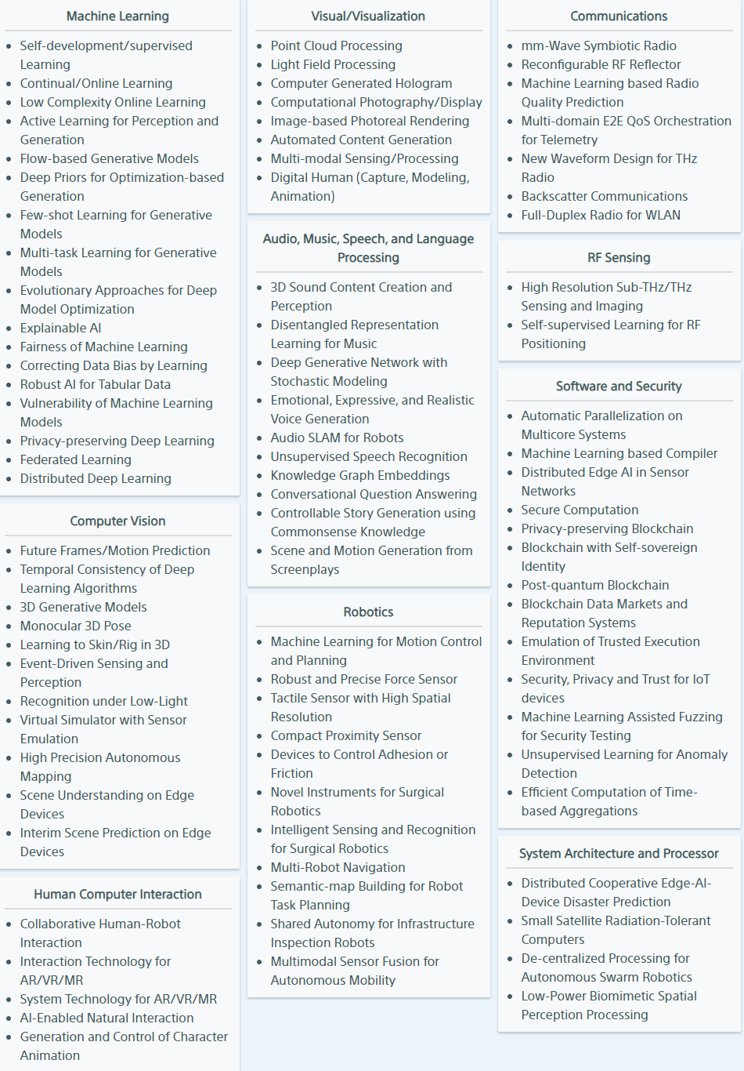
Faculty Innovation Award - Information Technology
Information Technology has 88
keywords in 10
sub-categories
Notes:
The first major category of keywords for the Faculty Innovation Award is Information Technology which encompasses the sub categories of Visual slash Visualization, Computer Vision, Augmented Reality Virtual Reality and Mixed Reality also known as AR VR MR, Audio, Speech, Machine Learning, Mobility Sensing, Robotics, Human Computer Interaction, Communication and Network, System Software, LSI and Hardware, and Other, which is where we have put the keyword “blockchain” slash “distributed ledger.” These thirteen sub-categories have 52 keywords between them for the IT category. This category was the original and only category for the 2016 and 2017 Sony Research Award Programs. %

Slide 16
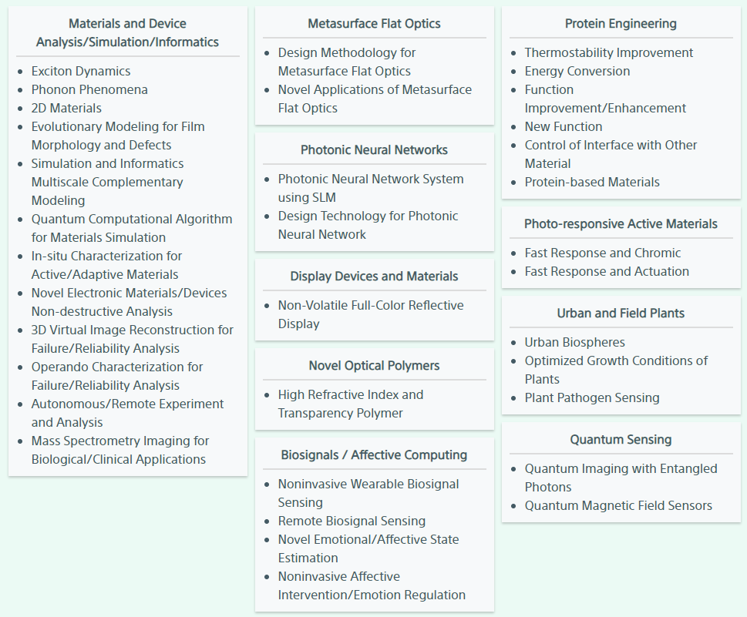
Faculty Innovation Award – Devices and Materials
Devices & Materials has 35
keywords in 10
sub-categories
Notes:
Devices and Materials is one of the new major technology categories for the Faculty Innovation Award for this year’s Program. Under this heading are 12 keywords in the five sub-categories of Display Devices and Materials, Biosignals, Neuromorphic Computing, Materials, and Robotics. We are very excited to be expanding the Sony Research Award Program to this new technology category particularly because of the substantial expertise of U.S. and Canadian universities and researchers in these areas. %

Slide 17
Faculty Innovation Award – Biomedical and Life Science
Biomedical & Life Science has 12 keywords in 3
sub-categories
Notes:
Biomedical and Life Science is the other new major technology category for the Faculty Innovation Award for this year’s Program. Under this heading are 12 keywords or key phrases on topics ranging from Precision Medicine to Surgical Imaging to Medical Robotics. Again, we are very excited to be expanding the Sony Research Award Program to this new major category because of the substantial expertise of U.S. and Canadian universities and researchers in the biomedical engineering and life science areas. %

Slide 18
Focused Research Award
Provides up to $150k
Principal Investigators select one specific topic on which to base their submission.
Sony Research Award Program topics change annually.
https://www.sony.com/research-award-program
Notes:
The Focused Research Award provides up to one hundred and fifty thousand dollars for each accepted proposal. Principal Investigators must select one research topic from the list of thirteen topics upon which to base their submission.
For those of you who were following our Research Award Program last year, you may have noticed that we also had thirteen research topics for the Program last year but I would like to assure you that it was a different list of research topics since Sony’s research interests are constantly evolving. %

Slide 19
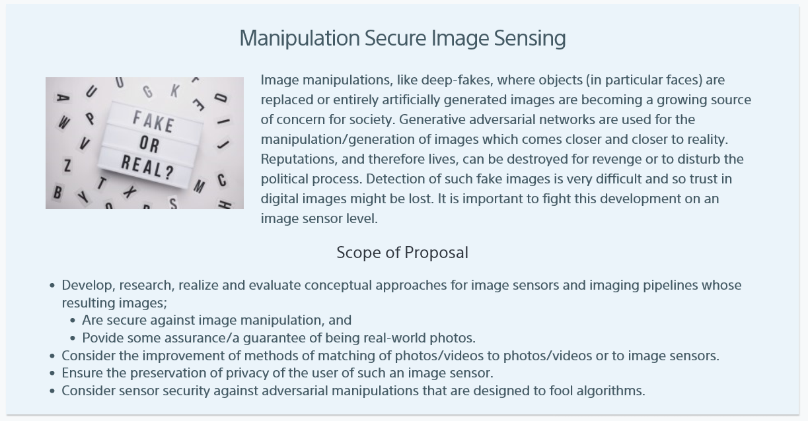
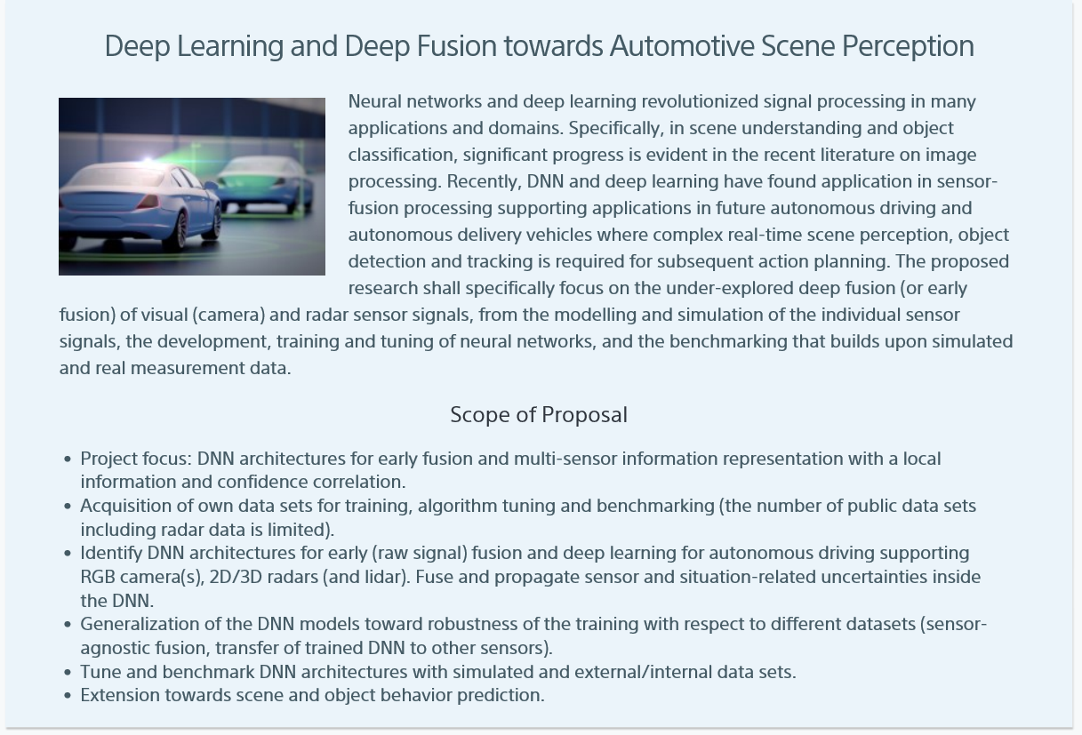
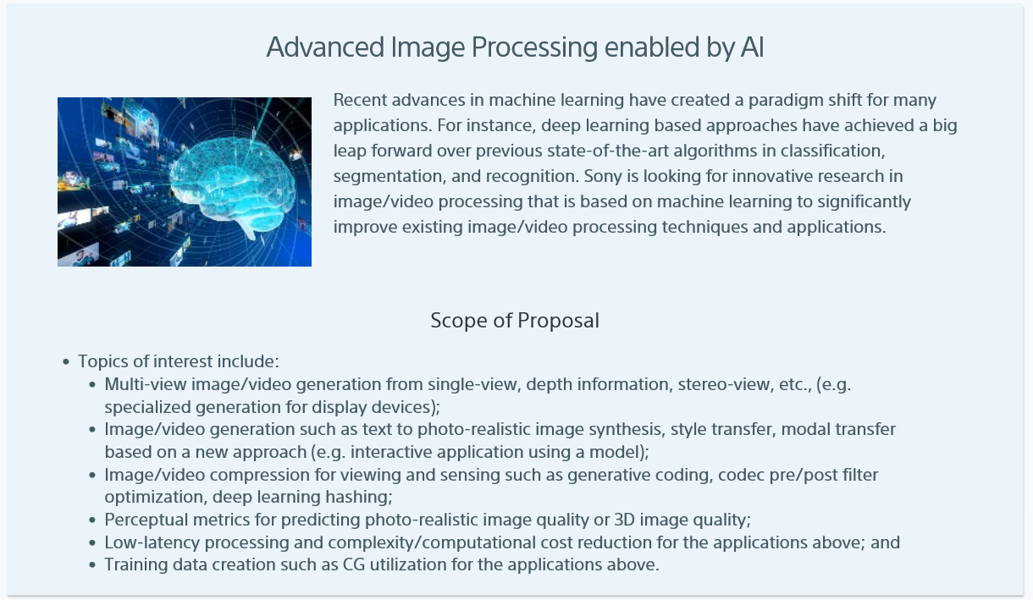
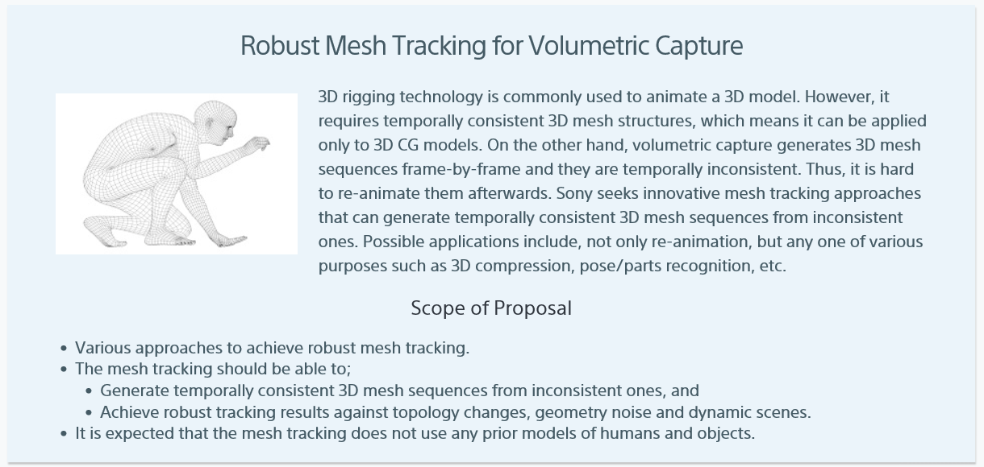
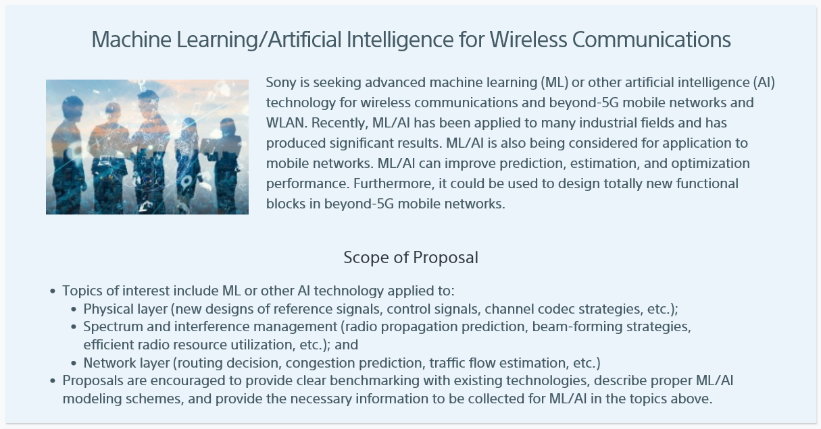
Focused Research Award Topics
Notes:
I can give you a quick sense of this year’s research topics for the Focused Research Award by flipping through them. I would like to point out that under each topic heading, you will find a section entitled “Scope of Proposal” that includes additional important information for making a submission for that particular topic. Some topic descriptions may even include additional important notes in this section, such as in this first one. % % % % % % % % % % % %
You can see that, as I flip through the list of the thirteen Focused Research Award topics for this year, that they are all very diverse and somewhat detailed descriptions of technologies that are of current interest to Sony. %

Slide 20
IV. Submission Guidelines
Notes:
I would now like to briefly review some key points from the “Submission Guidelines” section of the Sony Research Award Program website. %

Slide 21
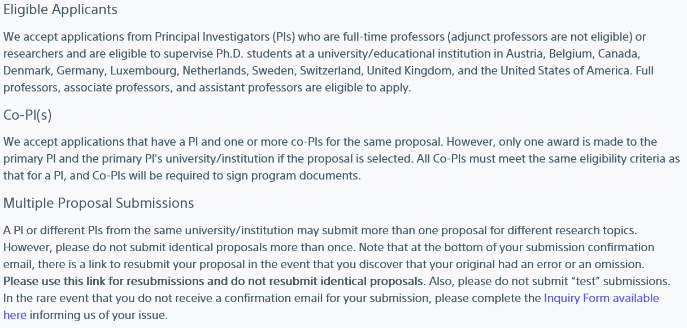
Submission Guidelines - Eligibility
Notes:
The first item in the Submission Guidelines that I would like to mention is under the “Eligible Applicants” section. We state there that full-time professors or researchers are eligible to submit proposals if they are eligible to supervise Ph.D. students at a university in the U.S. or Canada. We receive many inquiries each year about the eligibility of a potential PI to apply if their university has no Ph.D. program? Much university research, as you all well know, is carried out by Ph.D. students or post-doctoral researchers working under the PI. If a professor decides to conduct the research her or himself or has another suitable solution, this is completely acceptable to Sony. We do not intend to exclude great ideas for innovation just because a professor happens to be at an institution with no Ph.D. program.
The next item is regarding multiple proposal submissions of the same proposal. When we get what looks like multiple submissions of the same proposal, we start culling the duplicates and we would hate to throw out a submission that is not a duplicated submission. Therefore, we request that submitters who later discover that their submission had an error or an omission, use the link at the bottom of their submission confirmation form to recall and resubmit their original submission. This will insure that there is only one submission in our system with a given PI’s name, proposal title, and keyword or topic. %

Slide 22
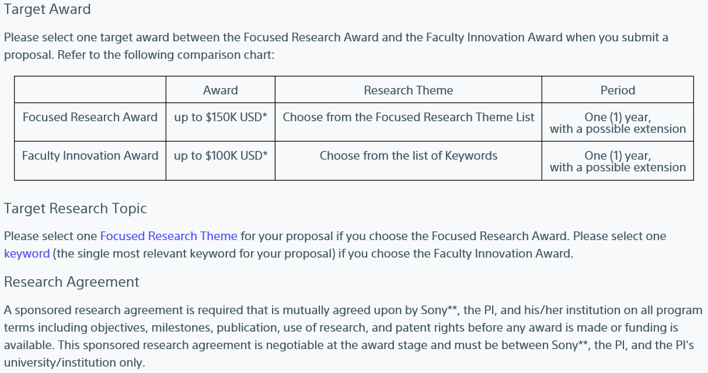
Submission Guidelines - Requirements
Notes:
Each submitter for the Faculty Innovation Award must select the single most relevant keyword for her or his submission.
The PI, the PI’s university, and Sony will have to mutually agree to a sponsored research agreement covering all program terms before any award is made or any funding is available. Sony has negotiated these agreements with public and private and large and small universities and has never been unable to find mutually agreeable terms to successfully execute a sponsored research agreement. %

Slide 23
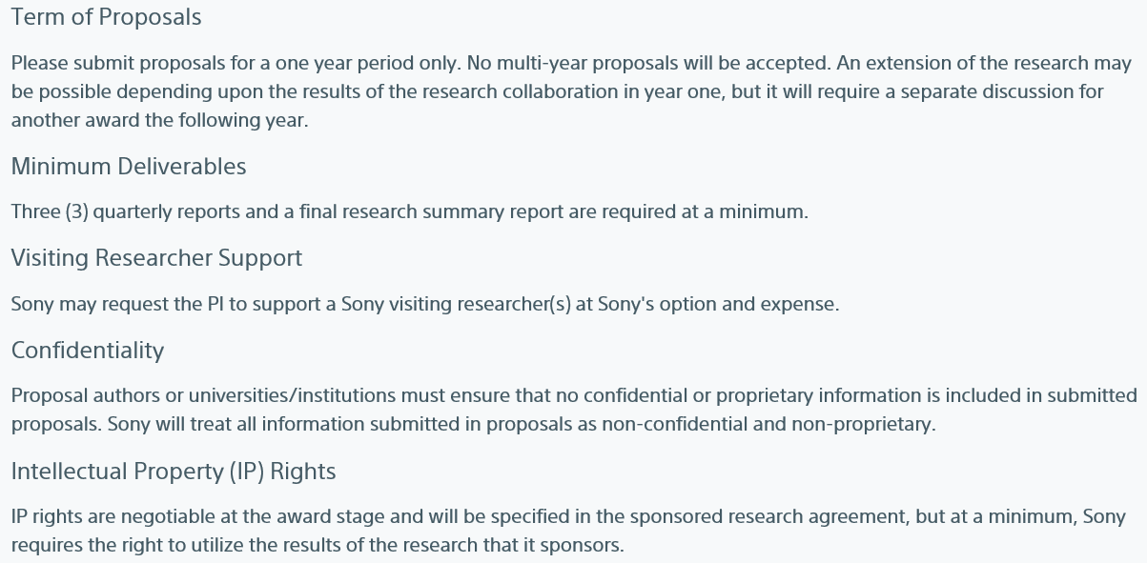
Submission Guidelines - Requirements
Notes:
The next item that I would like to mention is regarding confidentiality. PIs submitting proposals must not include any confidential or proprietary information in their proposals.
Intellectual property or IP rights is the next item that I would like to mention. We have already received quite a few questions this year regarding IP rights. IP rights are negotiable at the award stage, but at a minimum, Sony requires the right to utilize the results of the research that it sponsors. %

Slide 24
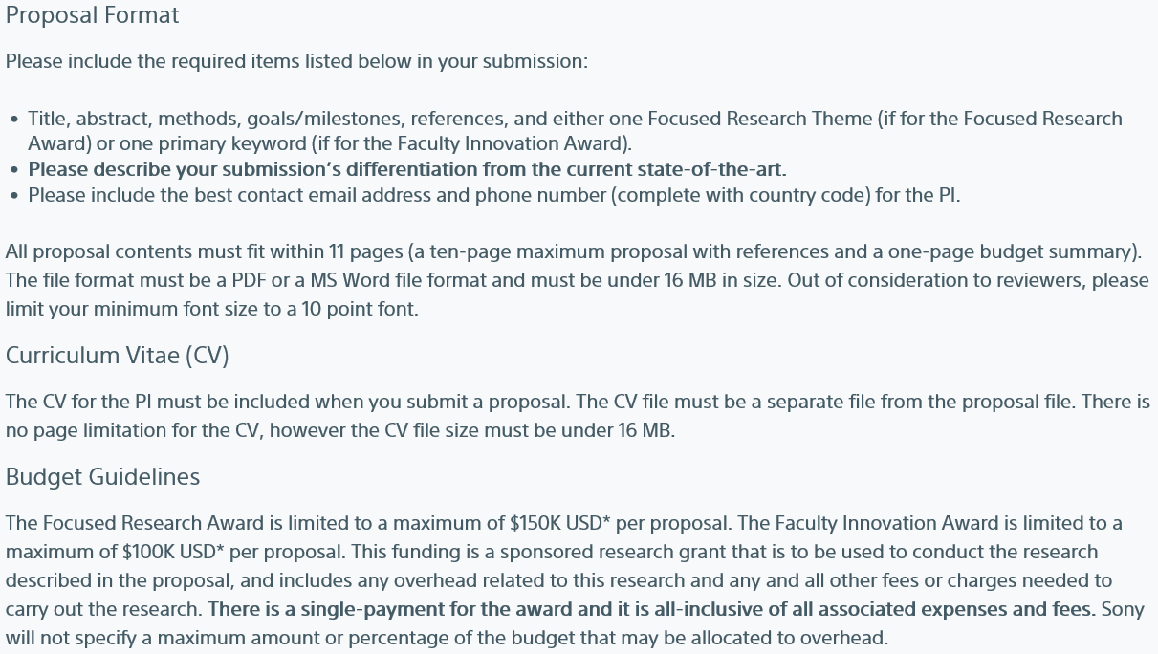
Submission Guidelines - Requirements
Notes:
Under the heading “Proposal Format”, we list a few items that are required to be included with each submission. The one requirement that is most frequently omitted from submissions is the second item listed which is a description of how the proposed research is differentiated from the current state-of-the-art.
Also under “Proposal Format”, is the requirement that proposals be limited to 11 pages which allows for a ten-page maximum proposal length with references and a one-page budget summary. The file format must be an Adobe Acrobat or PDF file format or a Microsoft Word file format and must be under 16 MB in size. Another question that I commonly receive is if it is okay for a proposal to be shorter than ten pages. Yes, absolutely; it is perfectly fine for a proposal to be shorter.
Under “Budget Guidelines”, is the statement that the funding is a sponsored research grant which includes any overhead related to this research or any other fees or charges needed to carry out the research. Sony does not specify a maximum amount or percentage of the budget that may be allocated to overhead. This is where I ask you to please work closely with your new or young faculty members to assist them to understand the nuances of your institution’s research financing, including your institution’s overhead rates. We have had more than one new faculty member be surprised when confronted with the realities of how his institution’s research financing really worked. %

Slide 25
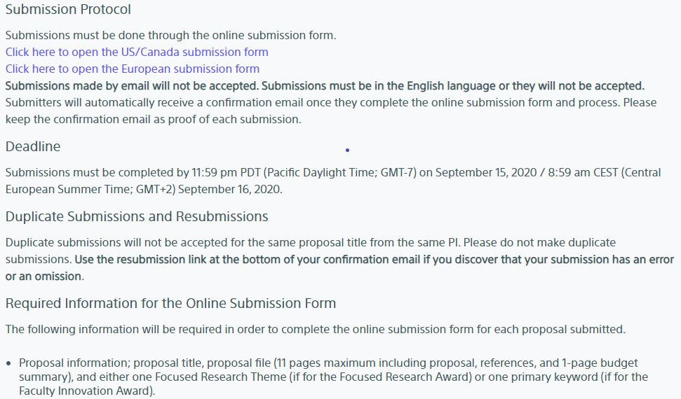
Submission Guidelines - Submission
Notes:
Regarding the topic “Submission Protocol”, I would like to make the point that all submissions must be done through the online submission form and that submissions made by emailing them to us will not be accepted.
Again, regarding resubmissions, we kindly request that the resubmission link at the bottom of the submitter’s confirmation email be used for any resubmissions including errors or omissions. Duplicate submissions run the risk of all versions, copies and originals alike, being culled. We would really hate for this to happen because we are very mindful of the large amount of effort expended for each and every submission.
The online submission form will prompt the submitter for all of the required proposal information which will include the proposal title, the 11 page-maximum proposal file, and either one Focused Research Award topic or the one Faculty Innovation Award keyword. %

Slide 26
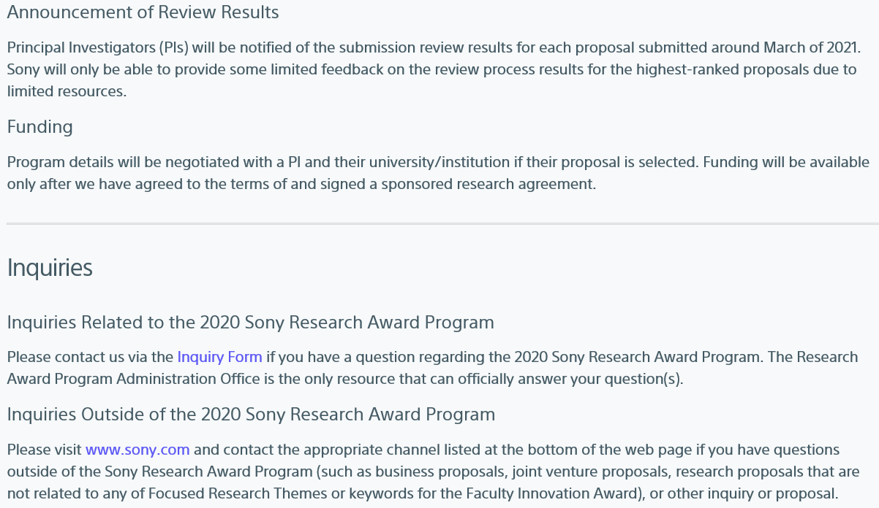
Submission Guidelines – Results, Funding, & Inquiries
Notes:
One of the most frequently asked questions that we get is naturally regarding the notification date for proposal review results. All submitters will be notified of the review results around March of 2019.
Lastly, I would like to mention the resource for getting any questions answered that you, your colleagues, or your faculty members may have regarding the Sony Research Award Program; please send all inquiries by email to ResearchAwardProgram2018@am.sony.com . We often get general questions about Sony but not related to the Sony Research Award Program at this email address. For these, one would have to go to the Sony.com website and use one of the resources listed at the foot of the page under “Contact Us.” %

Slide 27
Questions?
Notes:
Thank you all so much for your time and attention!
I would now like to turn the webinar over to Tony for the Question and Answer session.

Slide 28
Notes:
Thank you very much for attending Sony’s UIDP webinar for its 2018 Sony Research Award Program!

Slide 29
Q&A
Please ask questions in the questions tab on the webinar screen.
Thank you

Slide 30
SEP. 2
12-1 p.m. EDT
A New/Old Approach to Fill a Talent Gap: The Role of Apprenticeship in Cybersecurity Workforce Development
Geanie Umberger
Executive Director, Purdue Cyber Apprenticeship Program (P-CAP)
Purdue University

Slide 31
September 21-25, 2020 REGISTRATION OPENS SOON!

Slide 32
THANK YOU!
Please check your email and complete the survey so UIDP can better meet your needs.

