Slide 1
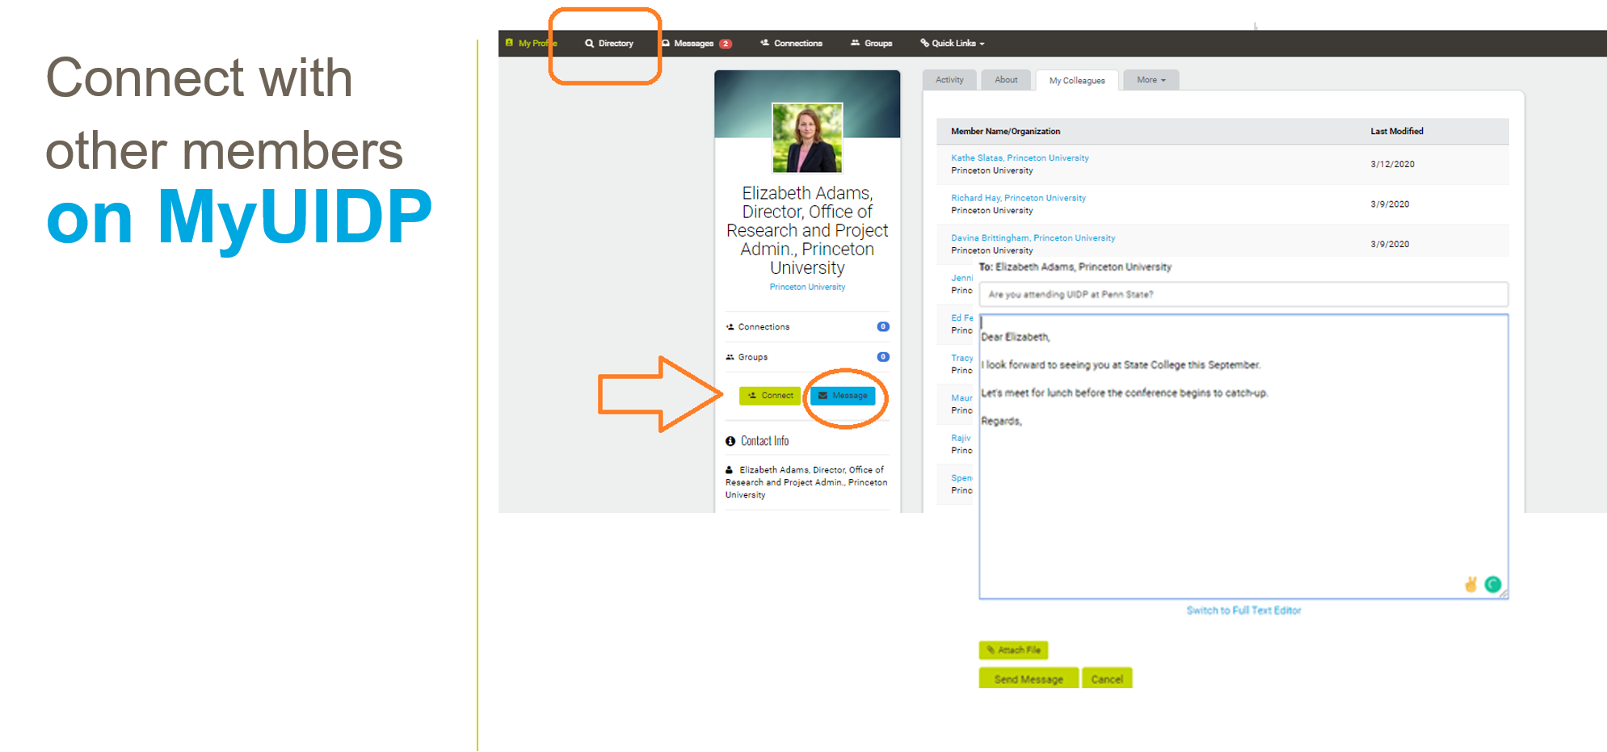
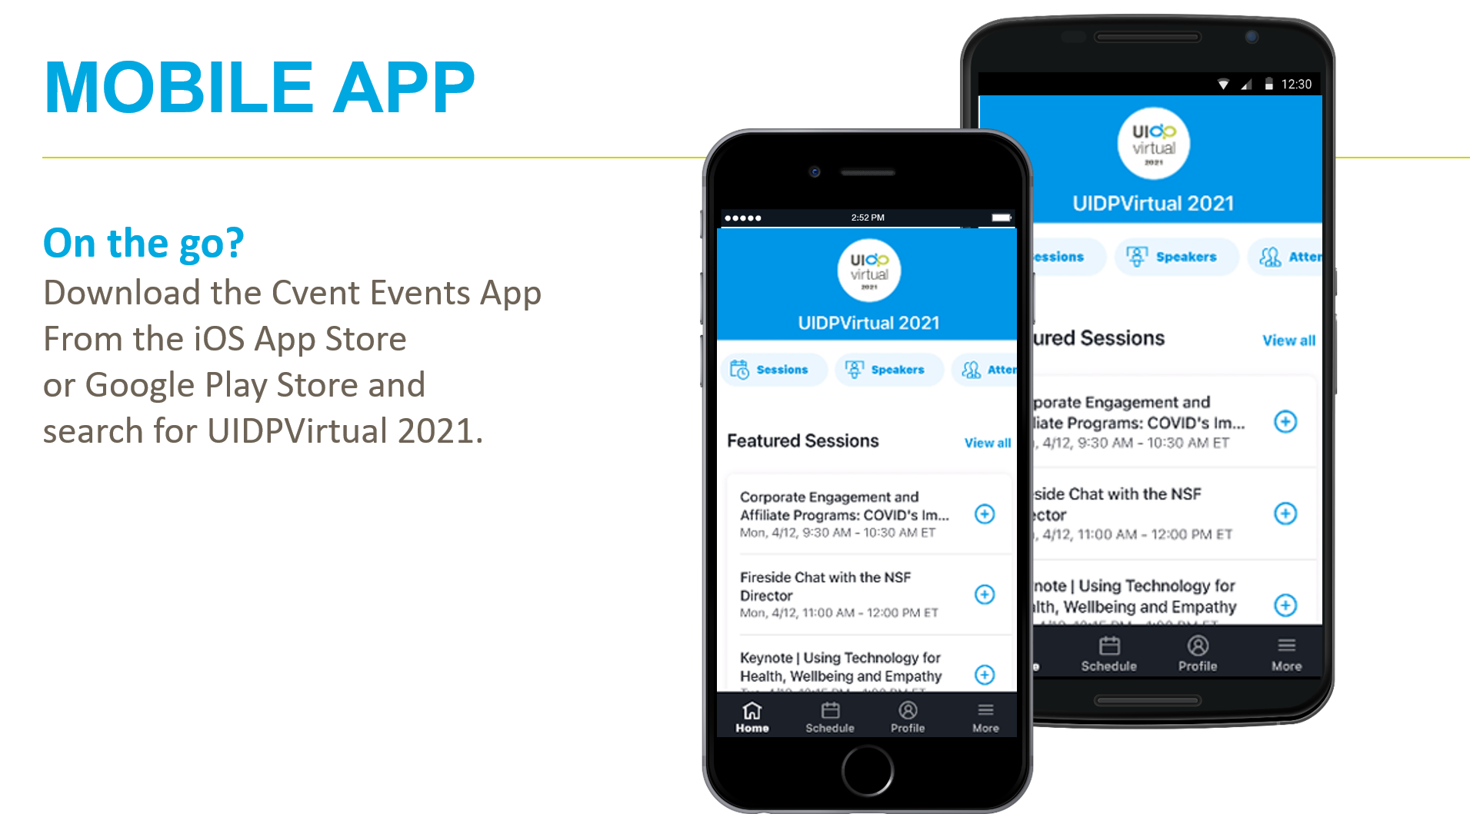
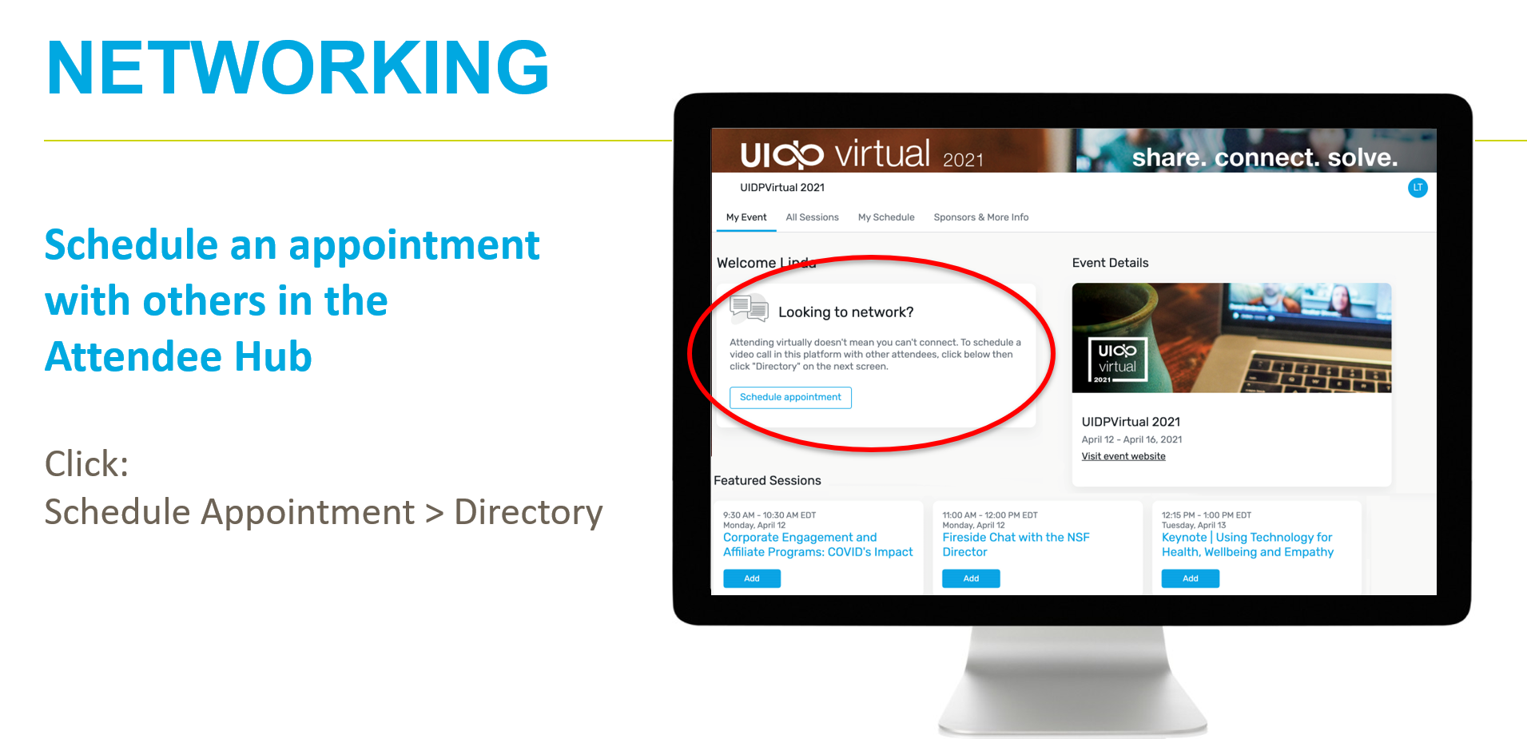
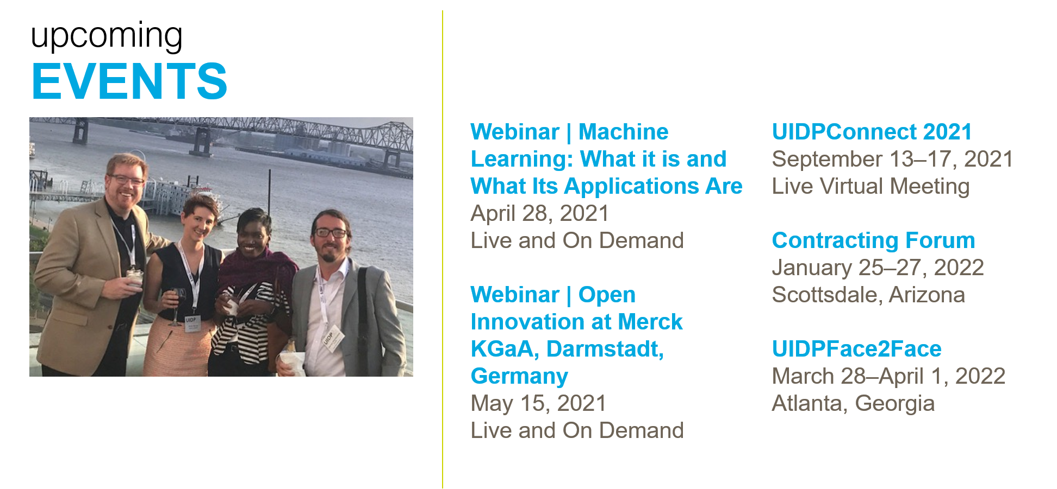
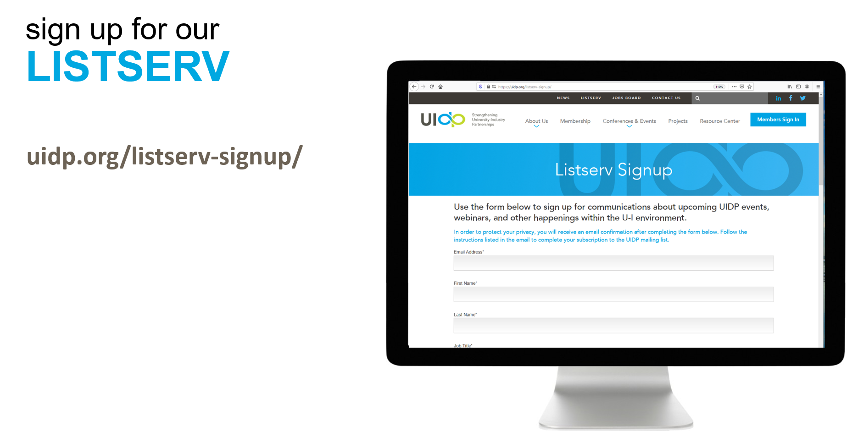

Slide 2
The session will begin shortly.

Slide 5
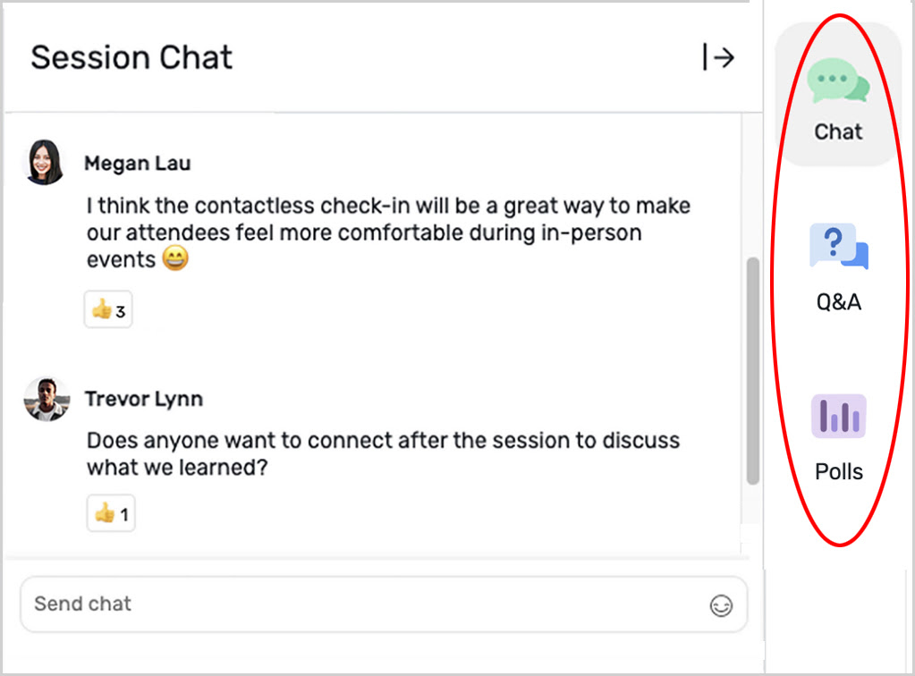
TECH SUPPORT
Having technical problems?
Look for the Tech Q&A doc in chat on the right side of your screen. Or email info@uidp.net.
If the session shuts down due to connection issues, do NOT close the Attendee Hub window. The room will reopen just a couple of minutes.

Slide 6
how to PARTICIPATE
Live Chat and Q&A
At the right of your screen
Chat with one another
Submit questions using the Q&A

Slide 7
how to PARTICIPATE
Handouts and Recordings
Download available handouts from the Session Content tab on the bottom of your screen.
Session recordings will be posted in the Attendee Hub. You will be notified via email when they are available at uidp.org.

Slide 8
Affective Computing for Health and Wellbeing
Presence & Motion Face Detection Face Tracking Face Location
Head Pose
Physiology Heart Rate Respiration Ox Sat.
Audio
Language Sentiment Voice Prosody Speech-to-Text
Expressions Facial Actions Facial Expressions Head Gestures
Peripherals Keyboard Mouse Touch
We created a multimodal sensing platform to build an intelligent systems/agents.

Slide 9
Making Meetings More Inclusive and Effective
Iterative design study of 8 teams for 4 weeks.
Interviews and surveys. Interactive dashboard developed.
22
Samrose, S., McDuff, D., Suh, J., Hernandez J., Rowan K., Sim, R., Moynihan K., Czerwinski M.., "MeetingCoach: An Intelligent Dashboard for Supporting Effective and Inclusive Meetings,“ Under review at CHI

Slide 10
Digital Psychosocial Interventions
RESEARCH GOAL
Digitize skill-based dialectical behavioral therapy into a conversational mobile app to improve access and increase self-efficacy
Quantify the effectiveness of individual skills for better design and support
CLINICAL PARTNERSHIP
Professional psychologist (Chelsey Wilkes)
Creator of DBT (Marsha Linehan)
FIELD STUDY
73 participants with mental health disorders, including suicidal behaviors
Schroeder et al. CHI 2018. PocketSkills: A Conversational Mobile Web App to Support Dialectical Behavioral Therapy
Schroeder et al. PervasiveHealth 2020. Data-Driven Implications for Translating Evidence-Based Psychotherapies into Technology-Delivered Interventions
9

Slide 11
Calibrating Expectations
Gartner Hype Cycle Emerging Technologies 2015
Algorithmic biases
Abuse of terminology Field confusion
Lack of proper calibration High risk of harm
Reducing bias in ML
Facial expressions, Physiological sensing,…
Repositioning Microsoft Products
Face API: https://docs.microsoft.com/en-us/xamarin/xamarin-forms/data-cloud/azure-cognitive-services/emotion-recognition
Emotion AI Ethics
Guidelines for responsible innovation: https://aka.ms/ethics-emotion-expression
Partnership on AI: Greene G., The Ethics of AI and Emotional Intelligence: Data sources, applications, and questions for evaluating ethics risk, Partnership on AI, 2020
27

Slide 12
Breathe break
Angie Taylor
UIDP Membership Services Manager

Slide 13
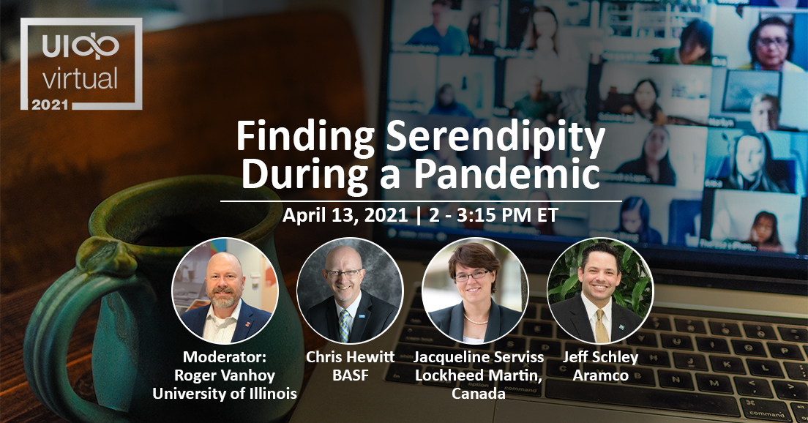
Breakout Sessions

Slide 14
THANK YOU!
Did you enjoy the session? Rate it in the Attendee Hub!
You’ll receive a survey via email about UIDPVirtual at the end of the week. Please give us your feedback.
Session recordings will be posted in the attendee hub shortly after the session ends. In about a week they will be posted to uidp.org.

