Slide 1
Competing for the Future:
Pittsburgh Metropolitan Region-- Innovation Roundtable
Daniel Calto
Director of Solution Services
Research Intelligence
Elsevier Inc.
Pittsburgh
November 4th
UIDP Innovation Roundtable
Ann Gabriel
SVP Global Strategic Networks

Slide 2
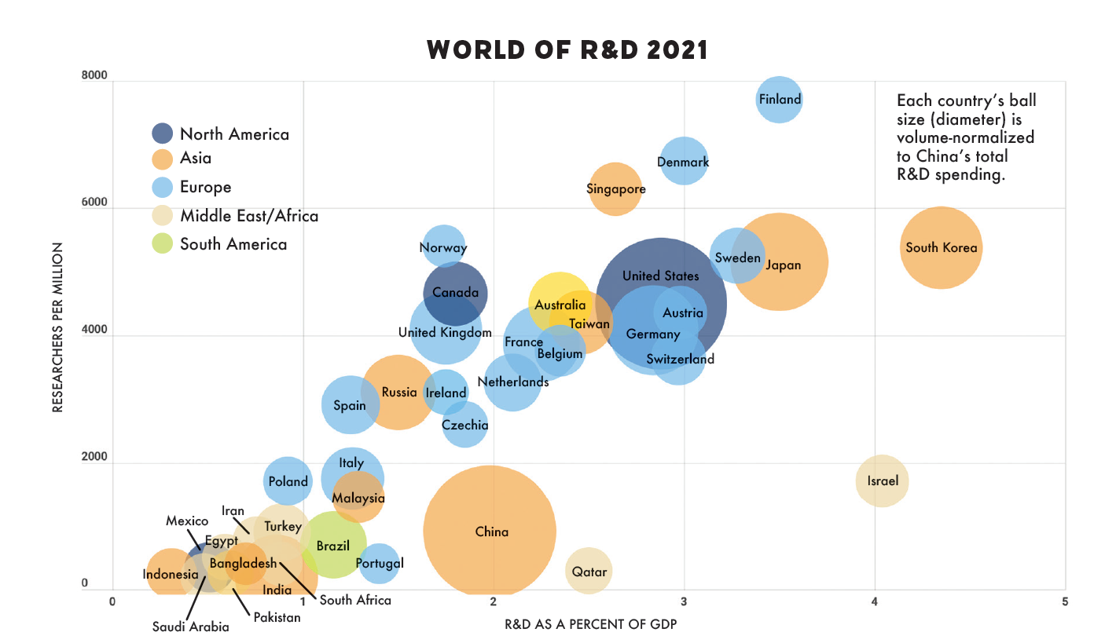
Notes:
The world spends a lot on R&D, an estimated $2.43T USD in PPP terms in 2020. This data is from R&D Magazine 2021 R&D Funding Forecast. In 2021, it’s estimated that Chinese spending will exceed US spending for the first time ever. Japan and Germany are #3 and #4, and India now spends more than South Korea and is #5 globally, spending nearly two times as much as the UK. About 70% of this spending is by corporations, primarily “D” spending, with the remaining 30% spending by governments, mostly funding universities and government laboratories—that is heavily focused on basic and applied research.
The question is why, and the answer is these countries are chasing innovation and economic impact.

Slide 3
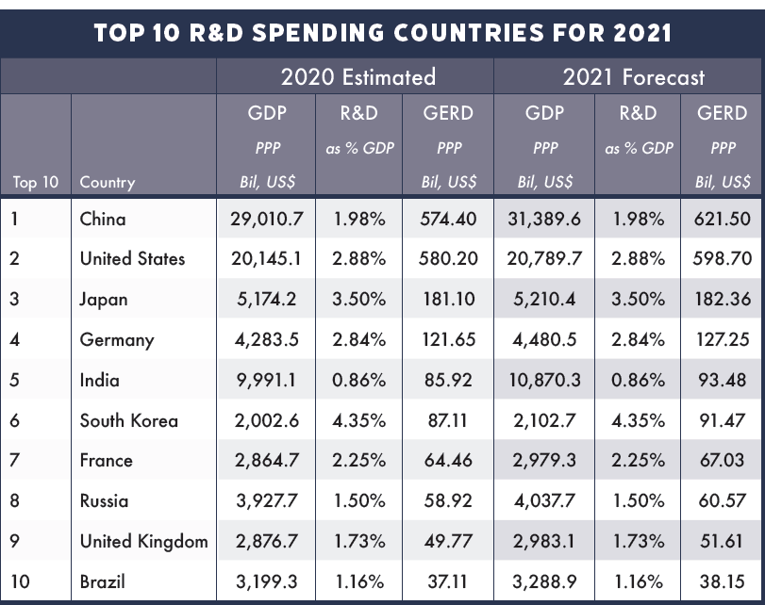
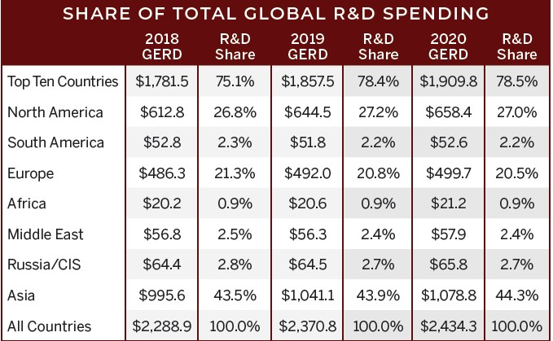
Share of Total R&D Spend by Continent/Country
Notes:
The world spends a lot on R&D, an estimated $2.43T USD in PPP terms in 2020. This data is from R&D Magazine 2021 R&D Funding Forecast. In 2021, it’s estimated that Chinese spending will exceed US spending for the first time ever. Japan and Germany are #3 and #4, and India now spends more than South Korea and is #5 globally, spending nearly two times as much as the UK. About 70% of this spending is by corporations, primarily “D” spending, with the remaining 30% spending by governments, mostly funding universities and government laboratories—that is heavily focused on basic and applied research.
The question is why, and the answer is these countries are chasing innovation and economic impact.

Slide 4
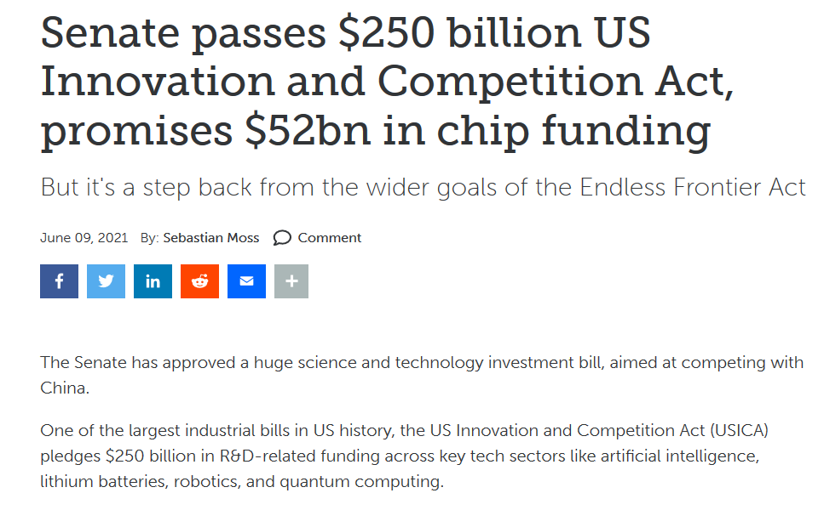
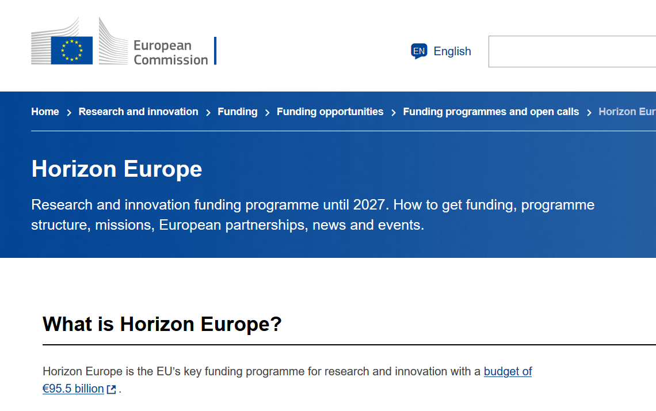
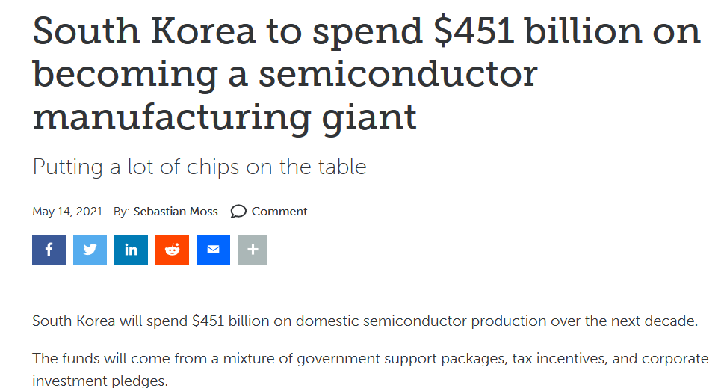
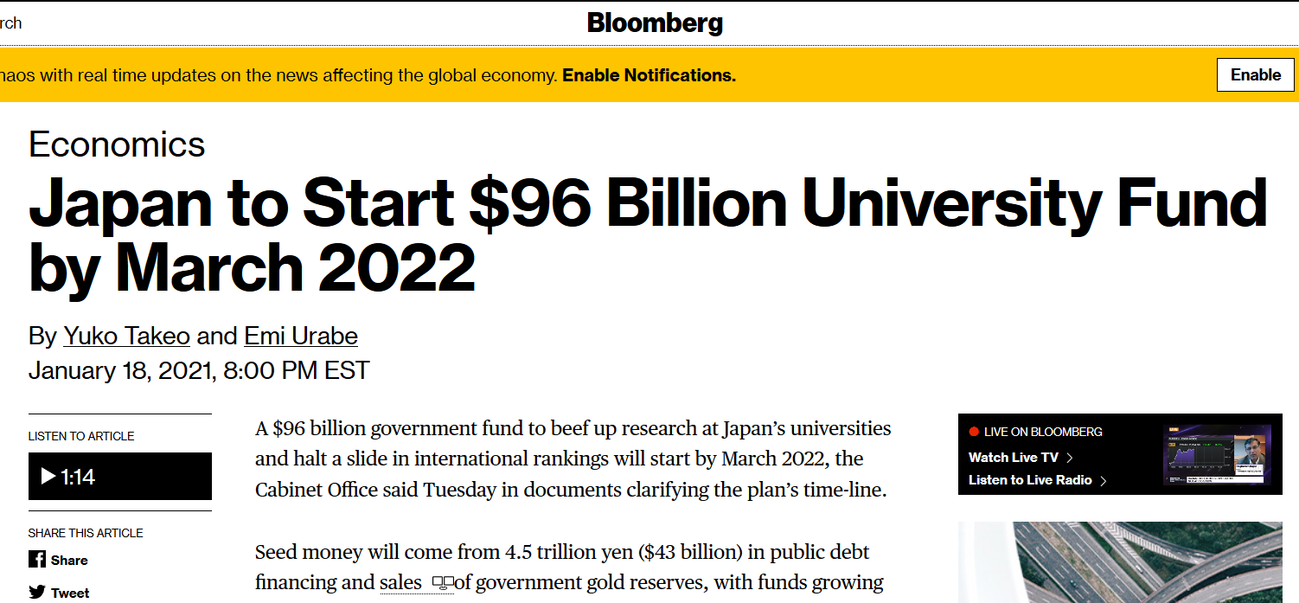
Global Resurgence in R&D Investments
4
Notes:
There has been a global resurgence in R&D investments, not only proposed for the us but proposed or approved in many developed countries around the world. Part of this is in response to COVID-related shortages and supply chain disruptions, but much of it is in response to the Chinese technological challenge. Today we will talk about the United States specifically, but it is important here to understand the global context.

Slide 5
Est. 2020 Spending on Academic R&D by Country (Billion $USD, unadjusted—nominal rates as of 4-29-21)
2020 Japan academic sector (all sources) ($23B/yr.)
2020 China academic sector (all sources) ($43B/yr.)
2020 EU academic sector (all sources) ($67B/yr.)
2020 US academic sector (all sources) ($87B/yr.)
2020 FAAMG (Facebook Amazon Apple Microsoft Google) ($130B/yr.)
Note: Includes product development (“D” in “R&D”) expenditures. Other figures are all primarily “R” expenditures
5
Notes:
Looking at current spending on academic R&D by country (this is in nominal unadjusted USD) the EU and US as a whole continue to outspend Japan and China.
It’s notable that the five big tech FAAMG companies spend over $130B per year on R&D, mostly on the “D” side. Still a huge number.

