Slide 2
How to Participate
Webinar Logistics
Tech Support
If you experience audio/video issues, you can try refreshing your window or use the “Support” tab at the top of your Chat window and someone will assist you.
You may also use the “Support” tab for any other webinar-related questions.
Chat and Resources
Please submit your questions using the Chat box on the right side of your screen. You may submit questions at any time during the webinar.
To access the slide deck, please use the “Resources” tab on the bottom left of your screen, under the chat window.
A recording will be emailed to all registrants 1-2 days after the webinar is over.

Slide 3
Disclaimer
UIDP materials, which include publications, webinars, videos, and presentations, reflect an amalgamation of the experiences and knowledge of those who participate in UIDP activities. The views and opinions expressed in UIDP materials do not necessarily reflect the official policy or position of any individual organization or the UIDP. At no time should any UIDP materials be used as a replacement for an individual organization’s policy, procedures, or legal counsel. UIDP is not a lobbying organization and UIDP materials are not intended to be used to influence government decisions.

Slide 4
The 4 Practices of High-Growth Innovators Findings from the 2021 R&D and Innovation Agenda research study
Robert A. Lowe
Chief Executive Officer
December 2021

Slide 5
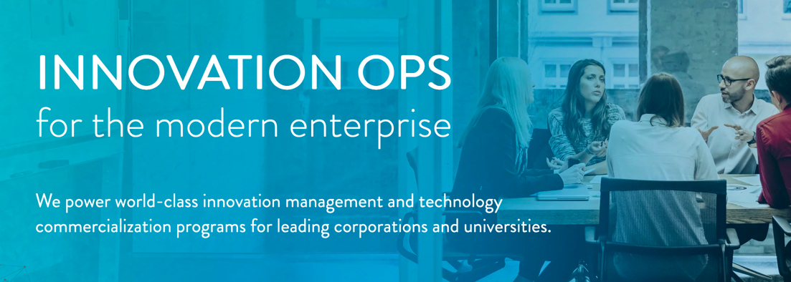
About Wellspring
Notes:
Innovation Ops describes the practices, processes, governance, and KPI’s to enable organizations to most effectively achieve their innovation goals

Slide 6
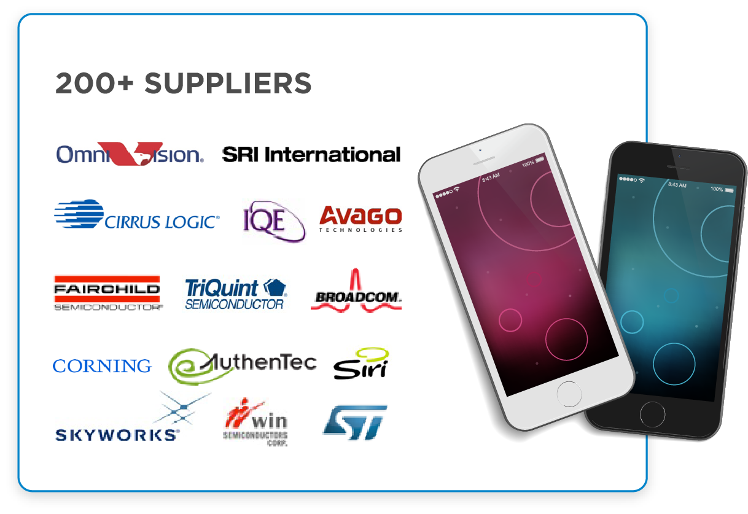
Innovation has evolved
The new innovation game is global, distributed, and accelerating. Every half hour, 720 patents are filed, 150 research articles are filed, and 70 new startups are founded.

Slide 7
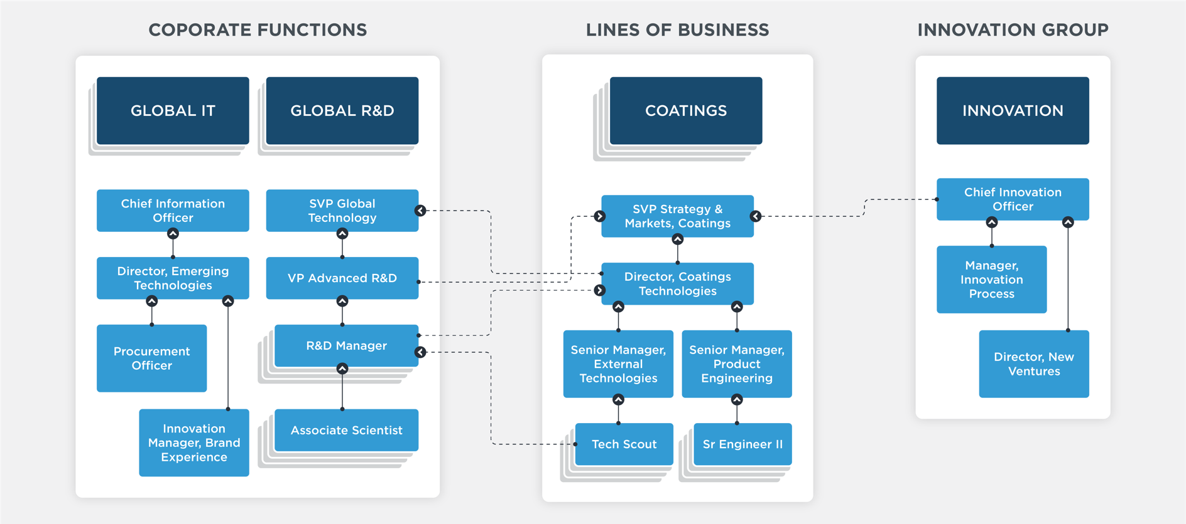
Corporate innovation management: it’s complicated

Slide 8
Hundreds of organizations use our solutions
We Help the World Innovate

Slide 9
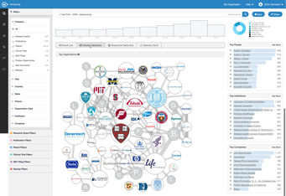
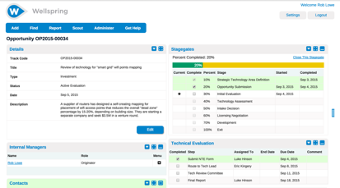
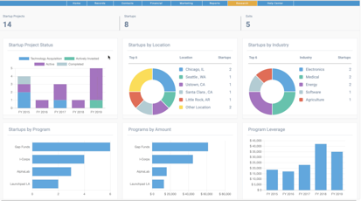
Manage global Innovation Ops – all in one place
Search & Scouting
Projects & Workflows
KPIs & Reporting
Comprehensive technology search (AI-driven)
Innovation landscapes and maturity assessments
World’s largest online technology marketplace
…and much more
Enterprise-wide innovation portfolio management
Open ideation and innovation opportunity submissions
Technology asset management
…and much more
Personalized, configurable charts and dashboards
Status alerts and automated notifications
Portfolio-wide analytics tools
…and much more

Slide 10
Research Study: The 2021 R&D and Innovation Agenda

Slide 11
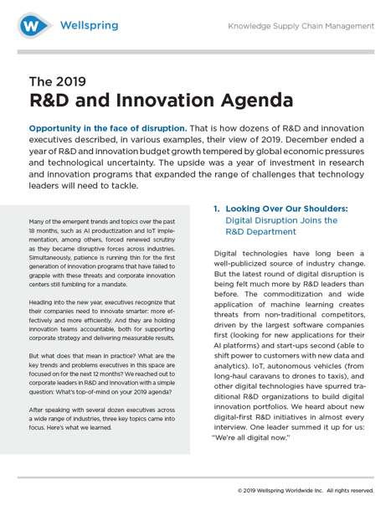
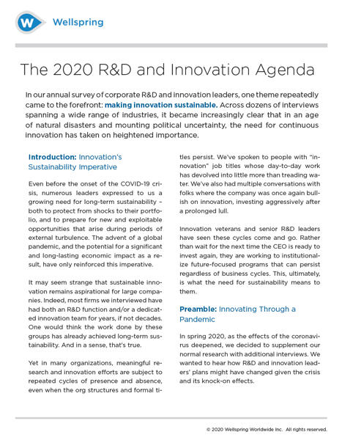
Wellspring’s annual study: three years and counting
2019
2020
2021

Slide 12
What did we want to understand? Research Questions
1. Can large companies innovate effectively and drive growth?
If so…
2. What separates high-growth and slow-growth organizations?
Do high-growth companies innovate differently?
3. What barriers to innovation exist at lagging organizations?

Slide 13
Research methods for the 2021 study
Data Sample
300 respondents (50% US, 50% UK)
$1B+ companies in a broad range of industries
Primary job function in R&D, Innovation, Strategy, Product, or General Management
6% C-Suite, 19% VP, 35% Director, 40% Manager
Survey Design
Double-blind phone survey by outside firm
49 survey questions on innovation management practices
Topics: Strategy, Governance, Budgets, KPIs, Processes, Systems, etc.
Supplemental qualitative phone interviews to build context

Slide 14
Analysis
Econometric model
Reveals the innovation practices of high-growth companies
Based on multinomial logistic regression to compare differences across 5 categories of growth
Controlled for a wide variety of variables
Size (Revenue)
R&D Spend
Patent Filings
Industry Class
Geography

Slide 15
Innovation ambitions are on the rise – across sectors
Overall ambition
Innovation spending

Slide 16
Most companies aren’t prepared to innovate strategically

Slide 17
The Innovation Habits of High-Growth Companies

Slide 18
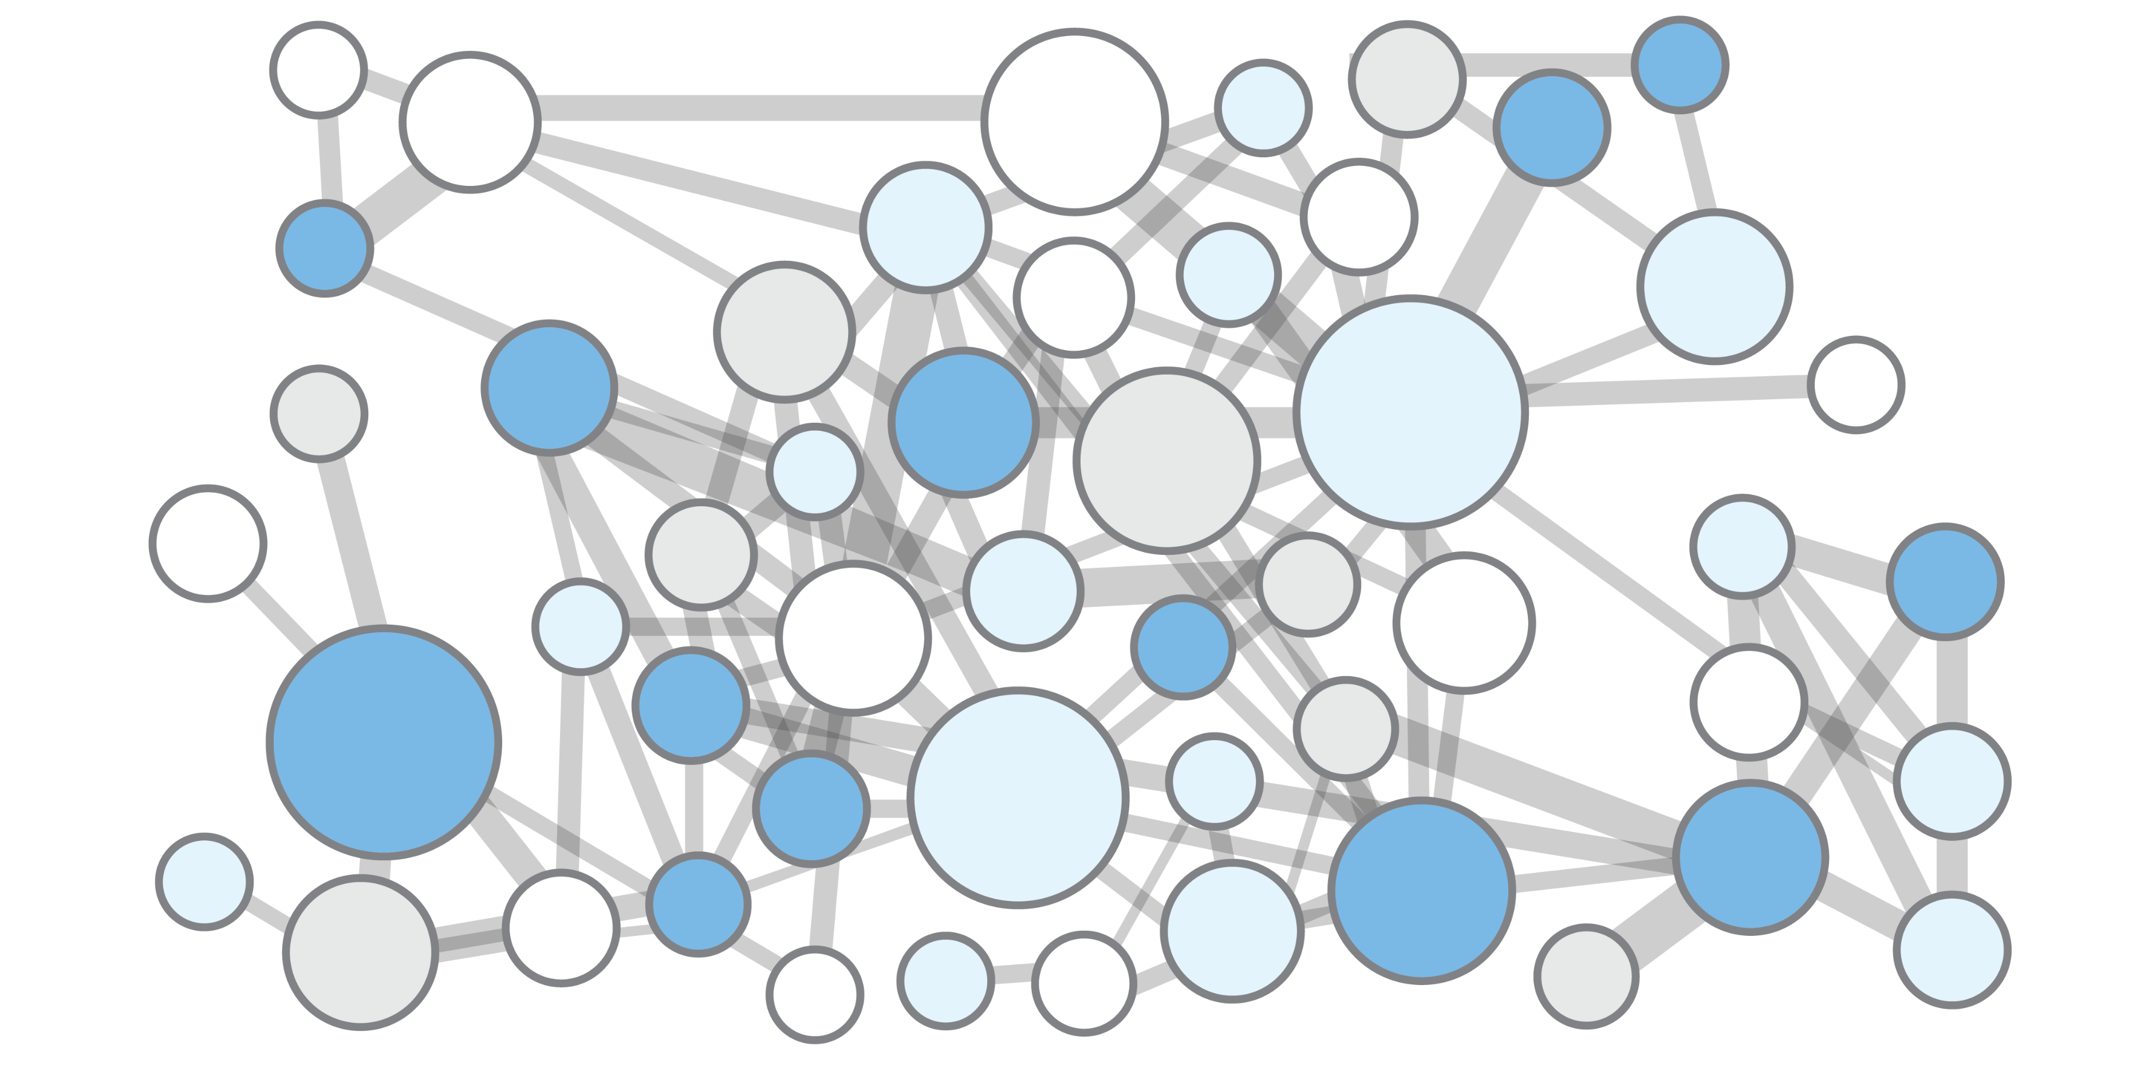
The innovation practices that define high-growth firms
1. Prioritize & Budget for Next Gen Innovation
2. Empower & Coordinate R&D
3. Develop a Unique Network of Partners
4. Create Responsibility for Innovation

Slide 19
1. Prioritize & Budget for Next Gen Innovation
H1. Better mouse trap
H2. The next generation
H3. Strategic leverage
Notes:
Take out better mouse trap maybe and just focus on the phone progression?
Chose phone because it’s a company that wasn’t even in the industry.

Slide 20
High-growth companies prioritize H2/H3 innovation
10%
20%
70%
Sources: McKinsey Quarterly, December 1st 2009
Harvard Business Review, May 2012

Slide 21
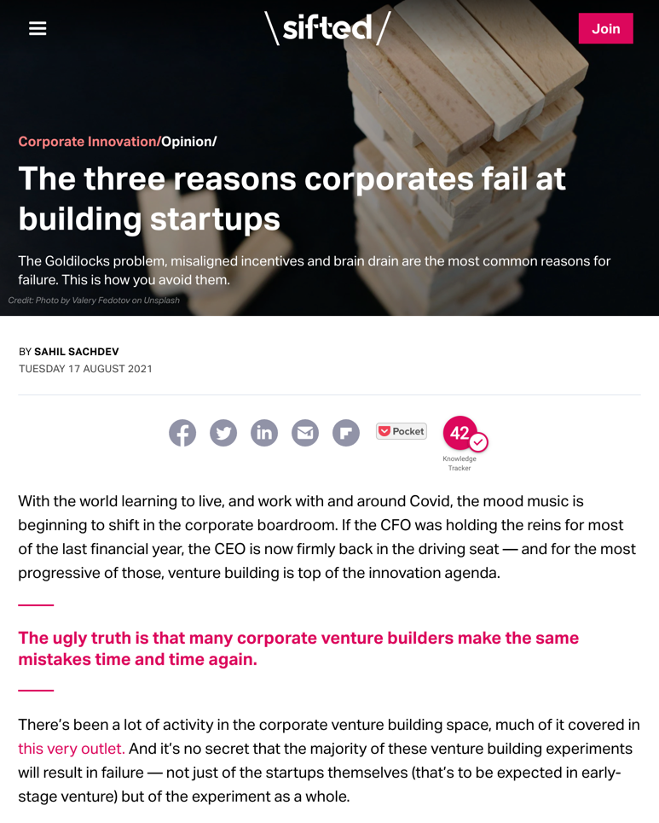
Breakaway-growth companies incubate strategic bets
Source: Sifted, August 17th 2021

Slide 22
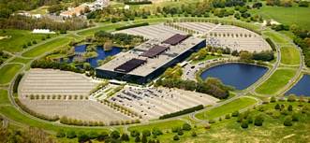
2. Empower & Coordinate R&D
Golden Age of R&D (1950s-1980s)
Global Innovation (2020s-?)
“In R&D, we began reaching out to customers directly and forming our own opinions of their needs. This has helped us broker more of a peer-based relationship with Marketing.”
~ R&D executive, F500 consumer products company
Relationship Marketing (1990s-2010s)
“We first measure ourselves in terms of the metrics most indicative of our market leadership: customer and revenue growth, the degree to which our customers continue to purchase from us on a repeat basis, and the strength of our brand.”
~ Excerpt from Amazon.com’s original letter to shareholders in 1997

Slide 23
High-growth companies have a strong R&D function
Notes:
We’re showing histograms here. But there’s all the analysis we did, like high-growth companies being surprisingly more likely to…whatever. “Above-average companies have had CINOs for more than 2 years.” It’s a statement of the specific result.
So maybe we just add the phrase like “highly correlated” or something in the slide title.
(This comment applies to the last few slides as well.)

Slide 24
High-growth companies let R&D focus on its strengths
Don’t confuse “handoff” with “goodbye”
The highest-performing companies ensure there is continuous knowledge transfer and collaboration throughout the innovation pipeline. For any significant innovation project, R&D teams stay involved as advisors and technology experts.

Slide 25
3. Develop a Unique Network of Partners

Slide 26
High-growth companies partner with government
This Finding was Consistent Across Industries
Agriculture/Agribusiness
Biotech
Chemicals
Food and Beverage
Insurance
Healthcare/Hospitals
Pharmaceuticals
Software

Slide 27
Dedicated tech scouting: Constantly seeking new partners

Slide 28
4. Create Responsibility for Innovation

Slide 29
Global innovation governance is a critical enabler

Slide 30
Enterprise software drives innovation success
Building the “business system” for innovation
Unlike other firms, breakaway-growth companies view innovation as a strategic function – with an inherent operating logic that is distinct from business-as-usual.

Slide 31
The innovation practices that define high-growth firms
1. Prioritize & Budget for Next Gen Innovation
2. Empower & Coordinate R&D
3. Develop a Unique Network of Partners
4. Create Responsibility for Innovation

Slide 32
From theory to practice: Innovation Ops

Slide 33
Innovation Ops is a corporate discipline for managing innovation as a mission-critical function that orchestrates a global portfolio of strategic growth options.

Slide 34
Coming soon: Innovation Ops webinars & content
Deep-dive topics (2021+)
Executive support: how to speak softly and drive big results.
Why Corporate Venturing fails without strong incubation practices.
How to build and scale a world-class Tech Scouting team.
What’s the right mix of innovation partnerships?
Fit for purpose: designing KPIs and budgets for H2 & H3 innovation.
Right-sizing the Chief Innovation Officer’s core mission.
…and much more

Slide 35
Manage global Innovation Ops – all in one place
Search & Scouting
Projects & Workflows
KPIs & Reporting
Comprehensive technology search (AI-driven)
Innovation landscapes and maturity assessments
World’s largest online technology marketplace
…and much more
Enterprise-wide innovation portfolio management
Open ideation and innovation opportunity submissions
Technology asset management
…and much more
Personalized, configurable charts and dashboards
Status alerts and automated notifications
Portfolio-wide analytics tools
…and much more

Slide 36
Thank you
Rob.lowe@wellspring.com

Slide 37
Q&A Perigon
Please submit your questions using the questions tab on your screen.

Slide 38
Mark your calendar and join us!
UIDP Face2Face
Don’t miss UIDP’s first in-person conference since 2019!
REGISTER at bit.ly/UIDPFace2Face
Have a speaker or topic suggestion? Let us know at info@uidp.net
March 29-31, 2022
Atlanta, Georgia

Slide 39
Help shape the future of engineering R&D
UIDP is administrative partner, with core partners Big Ten Academic Alliance and EPSCoR IDeA Foundation
Inclusive, multi-stakeholder organization
NSF-funded, five-year initiative
Get involved!
Become an ERVA Champion at www.ervacommunity.org
Follow #ERVACommunity on LinkedIn, Facebook, Twitter
Notes:
UIDP is the fiscal and administrative agent

Slide 40
THANK YOU!
Please check your email and complete the survey so UIDP can better meet your needs.

