Slide 2
How to Participate
Webinar Logistics
Tech Support
If you experience audio/video issues, you can try refreshing your window or use the “Support” tab at the top of your Chat window and someone will assist you.
You may also use the “Support” tab for any other webinar-related questions.
Chat and Resources
Please submit your questions using the Chat box on the right side of your screen. You may submit questions at any time during the webinar.
To access the slide deck, please use the “Resources” tab on the bottom left of your screen, under the chat window.
A recording will be emailed to all registrants 1-2 days after the webinar is over.

Slide 3
Disclaimer
UIDP materials, which include publications, webinars, videos, and presentations, reflect an amalgamation of the experiences and knowledge of those who participate in UIDP activities. The views and opinions expressed in UIDP materials do not necessarily reflect the official policy or position of any individual organization or the UIDP. At no time should any UIDP materials be used as a replacement for an individual organization’s policy, procedures, or legal counsel. UIDP is not a lobbying organization and UIDP materials are not intended to be used to influence government decisions.

Slide 4
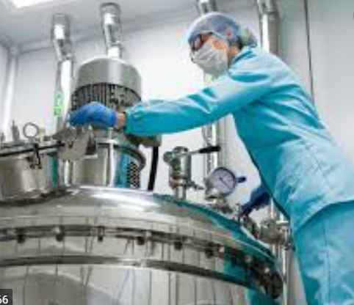
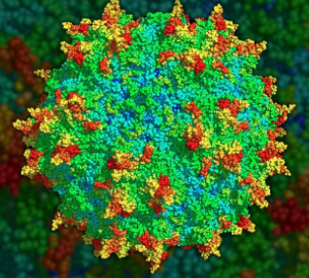
Accelerating Medicines Partnership® Bespoke Gene Therapy Consortium (BGTC)
Courtney Silverthorn, Ph.D.
Foundation for the National Institutes of Health
University Industry Demonstration Partnership
January 19, 2022
4

Slide 5
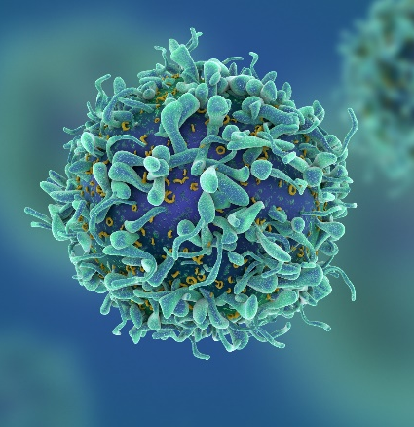
By the Numbers
About the FNIH
The Foundation for the National Institutes of Health (FNIH) was created by Congress in 1990 as a not-for-profit charitable organization. The Foundation began its work in 1996 to facilitate groundbreaking research at the U.S. National Institutes of Health (NIH) and worldwide.
$1.2B
raised to date
Created by Congress
$0.90
of every dollar spent directly supports programs
The mission of the Foundation for the National Institutes of Health is to support the mission of the NIH. The FNIH creates and leads alliances and public-private partnerships that advance breakthrough biomedical discoveries and improve the quality of people’s lives.
600+
active research partnerships, scientific education/training, conferences/events, capital programs
117
Mission
17
years of outstanding Charity Navigator ratings
5

Slide 6
Select FNIH Partnerships
Accelerating COVID 19 Therapeutic Interventions and Vaccines (ACTIV) $1+ billion
NIH OD, BARDA, CDC, DOD, VA, EMA, OWS, FDA, 20 companies, 4 not-for-profit organizations
Accelerating Medicines Partnership® $733 million
NIH OD, 13 NIH ICs, 25 companies, 23 not-for-profit organizations
Partnership for Accelerating Cancer Therapies $220 million
NCI, PhRMA, 12 pharmaceutical companies
Alzheimer’s Disease Neuroimaging Initiative (ADNI) $206 million
NIA, NIBIB, 25+ companies, 3 not-for-profit organizations
Grand Challenges in Global Health (GCGH) $201 million
Bill & Melinda Gates Foundation
The Biomarkers Consortium $107 million
FDA, NIH, CMS, PhRMA, BIO, pharmaceutical and nutrition companies, not-for-profit organizations
LungMAP: Master Lung Protocol Trial $42+ million
NCI (SWOG), FDA, Friends of Cancer Research, 10 companies to date
6

Slide 7
BGTC is part of a broader AMP® ecosystem
AMP Alzheimer’s Disease ‘1.0’ Project A: Biomarkers
AMP AD ‘1.0’ Project B: Target Discovery and Preclinical Validation
AMP AD ‘2.0’
AMP Type 2 Diabetes
AMP Common Metabolic Diseases
AMP Rheumatoid Arthritis/Lupus
AMP Autoimmune and Immune-Mediated Diseases
AMP Parkinson’s Disease
AMP Schizophrenia
AMP Gene Therapy
AMP 7, 8, 9…
2014 | 2015 | 2016 | 2017 | 2018 | 2019 | 2020 | 2021 | 2022 | 2023 | 2024 | 2025 | 2026 | 2027

Slide 8
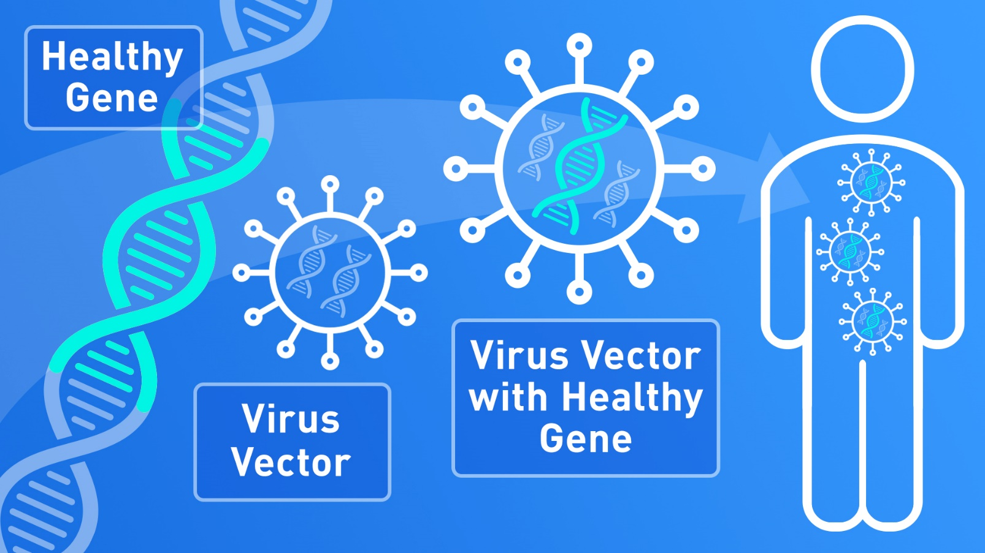
Gene Therapy – what is the opportunity?
Over 7000 rare diseases…
Over 5000 rare genetic diseases…
Over 4000 rare single-gene diseases
High level of precision
Enables tailor-made or “bespoke” treatments
e.g.,
Adeno-associated
viruses (AAVs)
https://www.fda.gov/consumers/consumer-updates/what-gene-therapy-how-does-it-work

Slide 9
Gene Therapy – What is the challenge?
Investment
Most pharmaceutical investment is directed at common diseases and disorders
Efficiencies of scale
Established regulatory path
Large customer market
ROI
Over 40% of rare diseases and disorders have fewer than 50 patients – no effective business models for ROI
Lack of efficiencies of scale
Lack of common regulatory path
Small to no customer market
Siloed work does not advance the field
Investment

Slide 10
What is the BGTC trying to solve?
AAV Biology
Manufacturing and Clinical Trials
Regulatory Frameworks

Slide 11
AMP® Bespoke Gene Therapy Consortium Components
1
AAV Basic Biology Translational Implications
Goal: Increase efficiency by orders of magnitude.
Enhancing Vector Generation
Enhancing therapeutic gene expression
Therapies for patients
Goal: Standardized, faster, reduced $
2
Advancing Access to AAV Technologies and Vectors for Bespoke Clinical Applications
Create & Build > Capacity
Harmonize best practices
Streamline Regulatory Paths
Vector
generation
Manufacture
of therapeutic
Clinical ability to treat patients
Standard vector menus
Standard process menus
Standard delivery menus
Gene therapy target for rare disease
11

Slide 12
Integration of BGTC research and clinical workstreams
AAV Basic Biology
Translational Implications
Enhancing Vector
Generation
Enhancing therapeutic
gene expression
in patients
Advancing Access to AAV Technologies and Vectors for Bespoke Clinical Applications
AAV vector
manufacturing
and analytics
Clinical
Development
Bespoke Gene Therapy Consortium
12

Slide 13
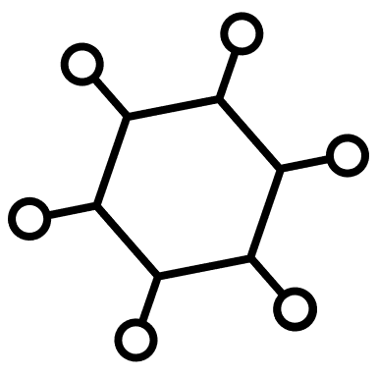
Understanding AAV biology to increase therapeutic efficiency
Improving vector generation
Increasing therapeutic gene expression
X
AAV Biology
Manufacturing and Clinical Trials
Regulatory Frameworks

Slide 14
Developing repeatable, optimized processes that can be used broadly
Submission of potential diseases to BGTC
Standardize manufacturing, pre-clinical characterization and clinical trials conducted using the same processes
Single gene
Conduct trials of 5-6 diseases with high likelihood of clinical success selected by Steering Committee
No business case
Short follow-up
Assembled patient group
AAV Biology
Manufacturing and Clinical Trials
Regulatory Frameworks
14

Slide 15
BGTC research awards and clinical trials inform standardization
Develop and promote “blueprint” of AAV research, clinical, and manufacturing protocols
Work with FDA to create a standard regulatory submission and reference materials for gene therapies
Revolutionize the field of gene therapy to enable faster and cheaper treatments for all patients
AAV Biology
Manufacturing and Clinical Trials
Regulatory Frameworks

Slide 16
How can my organization be involved?
Consortium Membership
16

Slide 17
Current BGTC partners
$76.6M
Public + Private Contributions

Slide 18
Subteams and Working Groups will carry out BGTC workstreams
AMP BGTC Steering Committee
AAV Biology Subteam
Manufacturing Subteam
Clinical Subteam
Communications Subteam
Regulatory Subteam
Proposal Review Working Group
Disease Selection Working Group
Disease-Specific Roundtables
AAV Clinical Manual WG
NIH Roundtable
18

Slide 19
How can my organization be involved?
Consortium Membership
Research Funding
19

Slide 20
FNIH released two AMP BGTC RFP opportunities for AAV biology
A. Enhancing Vector Generation
B. Enhancing therapeutic gene expression
Viral genome replication and processing for virion packaging
Capsid production and assembly
Packaging of viral genome to generate productive viruses
Transport and release of virus
Host factors that influence the process of viral generation
The endosomal state of the AAV virion
Trafficking to the nucleus
Uncoating in the nucleus
Second strand synthesis
Concatemerization of the viral genome
Post expression events
Results to be broadly applicable to all AAV vectors
Results to be targeted to cell types relevant to clinical program
AAV Biology
Manufacturing and Clinical Trials
Regulatory Frameworks
Vector Generation RFP
Gene Expression RFP
Submissions due February 18th
20

Slide 21
How can my organization be involved?
Consortium Membership
Research Funding
Clinical Trial Proposals
21

Slide 22
Comprehensive process for soliciting and reviewing information about rare diseases for BGTC clinical program
Open submission process for clinical, research, patient communities to nominate potential diseases
Down-selection based on required and preferred criteria, invited to submit full clinical trial proposal
5-6 diseases selected in priority order
Paired with vector manufacturing for first-in-human clinical trial
Submissions due February 18th
Disease/disorder info
Patient demographics
Clinical presentation
Pre-clinical and clinical research history
Monogenetic disorder
No existing commercial programs
Sufficient information to run a successful clinical trial
Currently assembled patient group
Cost
Ability to secure AAV manufacturing
Modest requirements for testing and follow up
Patient/program diversity
AAV Biology
Manufacturing and Clinical Trials
Regulatory Frameworks
Disease Nomination Form
22

Slide 23
Diversity in BGTC clinical trials
The BGTC has taken a very broad view of diversity, including age, gender, geography, race, and ethnicity
Balancing program diversity with the reality that monogenetic diseases frequently have homogeneous patient populations
Program goal is primarily to establish diversity across the total patient population of the 5-6 diseases selected for the clinical program
Where possible and relevant, will also strive for diversity within an individual clinical trial population
23

Slide 24
How can my organization be involved?
Consortium Membership
Research Funding
Clinical Trial Proposals
Public Events and Information
24

Slide 25
AMP BGTC short- and long-term deliverables
RFPs and Disease Nomination Open
Dec 2021
Disease Selection White Paper
Fall 2022
AAV Clinical Manual
2026
Trials 1-3
Trials 4-6
Q4 2021
2022
Q3 2021
2023-2026
AMP BGTC Launch
October 27, 2021
AAV Research Awards, Diseases Selected
Spring/Summer 2022
Go/No-Go
Decision
2024
Gene Therapy Regulatory Framework
2025
25

Slide 26
BGTC research and clinical program upcoming actions
December
January
February
March
April
May
…
Clinical Program
Info Webinars
Establish review
working group
Review nominations, down-select for RFP invitations
Clinical Trial RFP open to invited applicants
AAV
Research
Info Webinars
Establish review working group
Review applications, select awardees, issue awards
RFPs and disease
nomination form
published December 2nd
Proposals and disease nominations due
February 18th
to BGTC@fnih.org

Slide 27
Projected AMP BGTC project timeline
2021
2022
2023
2024
2025
2026
AAV Bio RFPs
Vector Generation / Expression Development
HTS Assay Testing & Analytics
HTS Assay Testing & Analytics
Disease Form
Clin Trial RFP
Vector Manufacturing
Pilots 1 - 3
Vector Manufacturing
Pilots 4 - 6
Pilot Clinical Trials (1 - 3)
Pilot Clinical Trials (4 - 6)
Develop consensus proposal for CMC testing
Streamline regulatory process
Communications and Patient Education, continuous updates to website & portal
1
2
3
4
5
Launch
Final
Disease
Selection
Draft Reg
Framework
Draft
Manual
Go /No Go
Milestone
Final Framework
& Manual
Key Milestones
27

Slide 28
Thank you and contact information
Courtney Silverthorn, Ph.D.
Associate Vice President, Research Partnerships
Foundation for the National Institutes of Health
csilverthorn@fnih.org | 301-827-8365
Program Website
https://fnih.org/BGTC
Program Email
BGTC@fnih.org
28

Slide 29
Q&A Perigon
Please submit your questions using the questions tab on your screen.

Slide 30
Mark your calendar and join us!
UIDP Face2Face
Don’t miss UIDP’s first in-person conference since 2019!
REGISTER at bit.ly/UIDPFace2Face
Have a speaker or topic suggestion? Let us know at info@uidp.net
March 29-31, 2022
Atlanta, Georgia

Slide 31
Help shape the future of engineering R&D
UIDP is administrative partner, with core partners Big Ten Academic Alliance and EPSCoR IDeA Foundation
Inclusive, multi-stakeholder organization
NSF-funded, five-year initiative
Get involved!
Become an ERVA Champion at www.ervacommunity.org
Follow #ERVACommunity on LinkedIn, Facebook, Twitter
Notes:
UIDP is the fiscal and administrative agent

Slide 32
THANK YOU!
Please check your email and complete the survey so UIDP can better meet your needs.

