Slide 1
Center for Data-Driven Drug Development and Treatment Assessment (DATA)
BIOMEDICAL AND Clinical INFORMATICS LAB
UNIVERSITY OF MICHIGAN
Kayvan Najarian
Biomedical and Clinical Informatics Lab
Department of Computational Medicine and Bioinformatics
Michigan Institute for Data Science
University of Michigan, Ann Arbor

Slide 2
Main Objectives of DATA
Addressing Data Challenge
Provide an industry-wide, secure centralized data hub for integration, curation, and sharing of pharmaceutical and patient data
Addressing AI/ML Algorithm Challenge
Develop, test, and validate advanced artificial intelligence and machine learning methods for drug discovery and treatment assessment

Slide 3
Current Partners

Slide 4
Current International Sites (Academic Partners)

Slide 5
Where will our solutions reside?
We intend to cover the entire spectrum of drug design
A highly simplified diagram to emphasize our capabilities
Reduced list of potential candidates
Further reduced list of potential candidates
Identifying phenotypes , treatment assessment and creating feedback
List of potential candidates
Testing in-vitro/in-vivo diseases models
Assessment of Clinical trials + treatment
Algebraic screening methods
Mechanistic + ML methods
Potential drugs

Slide 6
Data Challenges
Size and diversity: Computational methods and models require large datasets containing all potential phenotypes for training and testing
Data standards: Data (and metadata) has to stored in standard format(s)
Privacy and security: Protecting privacy while enabling potential data sharing to create larger and more diverse databases
Curation and integration: Noisy/redundant data is a major issue when using computational models

Slide 7
Algorithmic Challenges
Sample complexity: Some methodologies are too complex and may require very large databases
Privacy and security: To properly train models, large and comprehensive databases are needed but privacy issues restrict creation of such databases
Model transparency: Many AI/ML methods are not transparent - they provide a prediction but do not explain how the prediction was produced and what major factors were involved in decision making
Learning from incomplete databases: Many AI/ML methods are unable to learn if some attributes/features are not always available

Slide 8
Computational Approaches to Drug Design and Treatment Assessment
Target identification
and validation
Compound screening
and lead discovery
Preclinical development
Clinical development
Successful applications in drug discovery
Target identification and prioritization based on gene-disease associations
Target druggability predictions
Identification of alternative
targets (splice variants)
Compound design with desirable properties
Compound synthesis reaction plans
Ligand-based compound screening
Tissue-specific biomarker identification
Classification of cancer drug–response signatures
Prediction of biomarkers of clinical end points
Determination of drug response by cellular phenotyping in oncology
Precise measurements of the tumor microenvironment in immuno-oncology
Required data characteristics and algorithmic approaches
Current data are highly heterogeneous: need standardized high-dimensional target-disease-drug association data sets
Comprehensive omics data from disease and normal states
High-confidence associations from the literature
Metadata from successful and failed clinical trials
Large amounts of training data needed
Models for compound reaction space and rules
Gold standard absorption, distribution, metabolism and excretion (ADME) data
Numerous protein structures
Biomarkers: reproducibility of models based on gene expression data
Dimension reduction of single-cell data for cell type and biomarker identification
Proteomic and transcriptomic data of high quality and quantity
Pathology: well-curated expert annotations for broad-use cases (cancer versus normal cells)
Gold standard data sets to improve interpretability and transparency of models
Sample size: high number of images per clinical trial

Slide 9
Datasets in DATA
Access to larger and/or more comprehensive shared databases
Curated integrated datasets
Partner dataset 2
Publicly available datasets
Partner dataset 1
U-M Databases

Slide 10
An Algebraic Approach to Drug Repositioning and Repurposing
Systematic Integration of Auxiliary Information

Slide 11
Computational Approach to Drug Discovery
Rationale
“Wet lab” experiments are costly and time-consuming
For docking simulations, the structures of the drugs and targets must be known.
Solution: ML methods to find candidate therapeutic drug-target, target-target, or any other pairwise interactions.
Various ML methods used for drug discovery
Similarity/distance-based methods
Deep learning
Matrix factorization
Feature-based

Slide 12
Our Approach - Coupled Tensor Methods
Coupled Matrix-Matrix Completion (CTMC)
Coupled Tensor-Matrix Completion (CTMC)

Slide 13
Our Approach - Coupled Tensor Methods
Advantages
Incorporates multiple modalities and multiple instances of auxiliary information (target-target interaction, drug-drug interactions)
Systematic curation of correlated, noisy information through algebraic methods
State-of-the art performance
Works with sparse data
Computationally efficient (i.e., low runtime)

Slide 14
Testing and Validation of CMMC/CTMC
Created a drug-interaction matrix from DrugBank and BioGrid comprised of 6,784 drugs and 4,765 targets, with a sparsity of 99.94%.
In order to evaluate CMMC/CTMC performance, the performance on 100 different subsets is averaged.
Each subset is created by randomly selecting 10% of the rows and 10% of the columns.
Performances of CMMC and CTMC are compared with those of other methods

Slide 15
Results - DrugBank
Coupled with | Algorithm | Runtime (s) |  | AUC |  | Suggested Threshold |  | F1 |  | Sensitivity |  | Specificity |  | Accuracy
 |  | Mean | SD | Mean | SD | Mean | SD | Mean | SD | Mean | SD | Mean | SD | Mean | SD
Tensors | CTMC | 0.513 | 0.045 | 0.778 | 0.078 | 0.541 | 0.188 | 0.180 | 0.107 | 0.164 | 0.071 | 0.998 | 0.005 | 0.998 | 0.005
Sparse Interaction Matrices | CMMC | 0.337 | 0.026 | 0.664 | 0.072 | 0.441 | 0.243 | 0.184 | 0.110 | 0.164 | 0.085 | 0.997 | 0.011 | 0.997 | 0.011
 | GRMF | 1302.294 | 251.657 | 0.629 | 0.078 | 0.768 | 0.110 | 0.061 | 0.068 | 0.120 | 0.085 | 0.986 | 0.025 | 0.986 | 0.025
 | WKNKN + GRMF | 1299.383 | 252.889 | 0.645 | 0.083 | 0.782 | 0.104 | 0.072 | 0.078 | 0.114 | 0.076 | 0.988 | 0.031 | 0.988 | 0.031
 | L21GRMF | 1288.877 | 261.152 | 0.636 | 0.078 | 0.765 | 0.103 | 0.062 | 0.071 | 0.117 | 0.076 | 0.986 | 0.026 | 0.986 | 0.025
 | WKNKN + L21GRMF | 1279.952 | 254.770 | 0.648 | 0.076 | 0.793 | 0.104 | 0.074 | 0.078 | 0.104 | 0.063 | 0.990 | 0.027 | 0.990 | 0.026
 | NRLMFβ | 37.938 | 0.570 | 0.596 | 0.077 | 0.622 | 0.192 | 0.050 | 0.062 | 0.116 | 0.079 | 0.976 | 0.047 | 0.976 | 0.047
 | WKNKN + NRLMFβ | 37.883 | 0.665 | 0.602 | 0.081 | 0.638 | 0.175 | 0.051 | 0.063 | 0.116 | 0.090 | 0.980 | 0.063 | 0.979 | 0.063
 | NRLMF | 1.551 | 0.086 | 0.597 | 0.077 | 0.623 | 0.192 | 0.050 | 0.062 | 0.116 | 0.079 | 0.976 | 0.047 | 0.976 | 0.047
 | WKNKN + NRLMF | 1.546 | 0.076 | 0.602 | 0.080 | 0.639 | 0.174 | 0.051 | 0.063 | 0.115 | 0.090 | 0.980 | 0.062 | 0.980 | 0.062

Slide 16
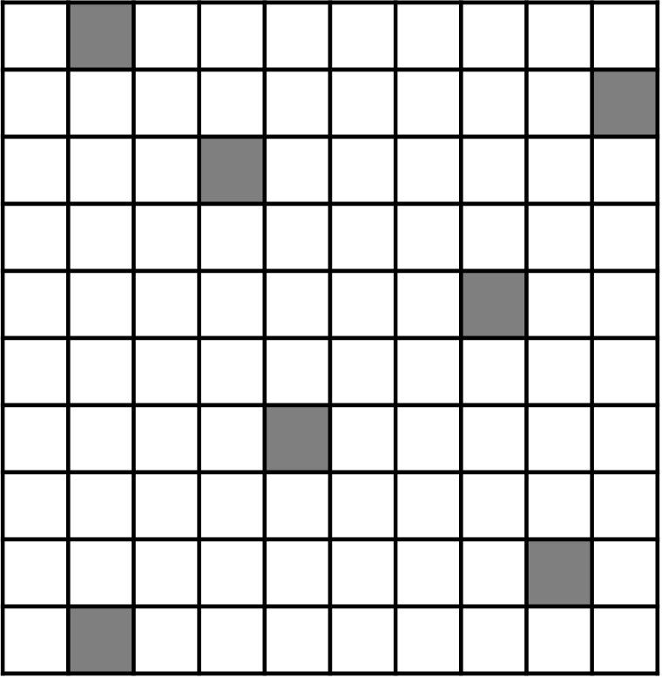
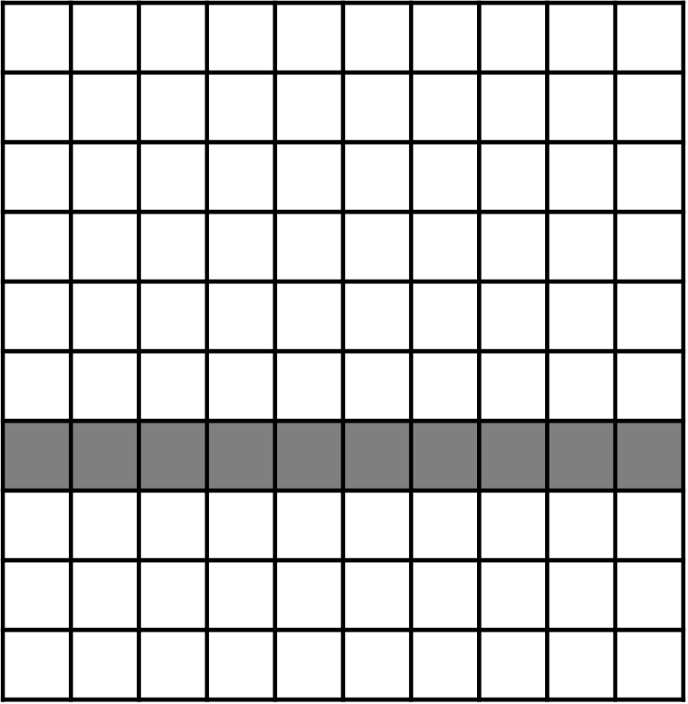
Additional CTMC Results
Simulate and assess predictions for a completely new drug and/or target using $500×500$ submatrices of the previous DTI matrix
(a) Random removal of DTI
(b) All DTIs removed for a drug
(c) All DTIs removed for a target

Slide 17
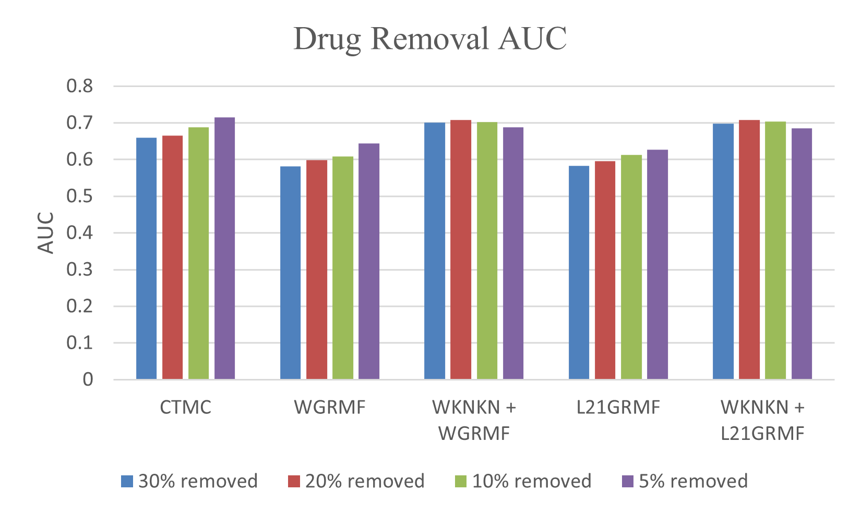
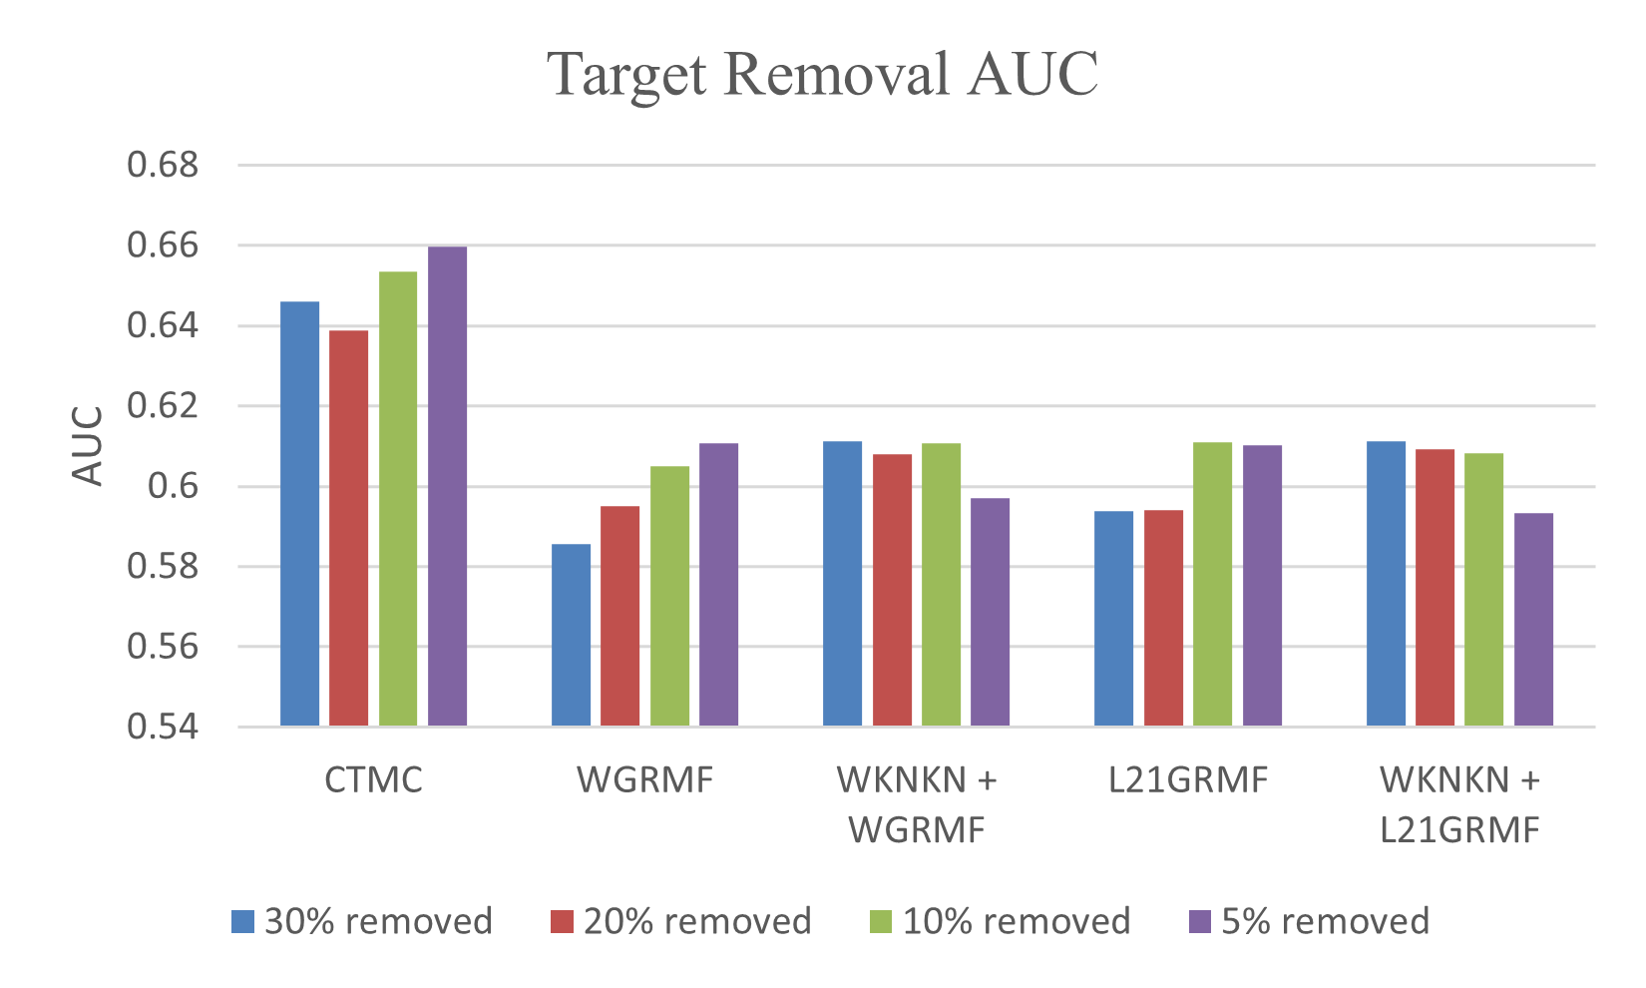
Drug/Target Removal - AUC
All DTIs removed for drugs
All DTIs removed for targets

Slide 18
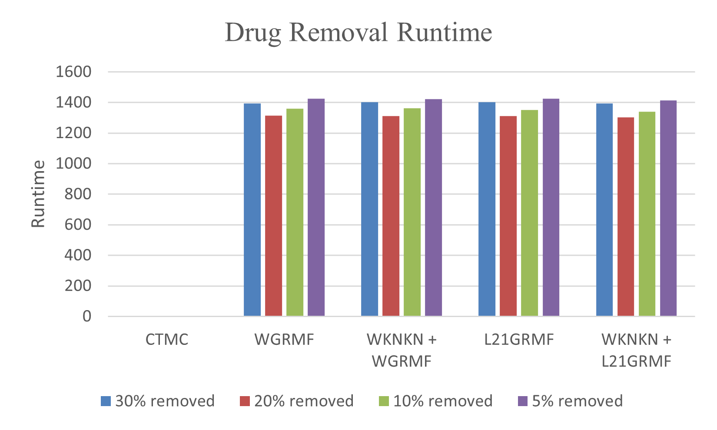
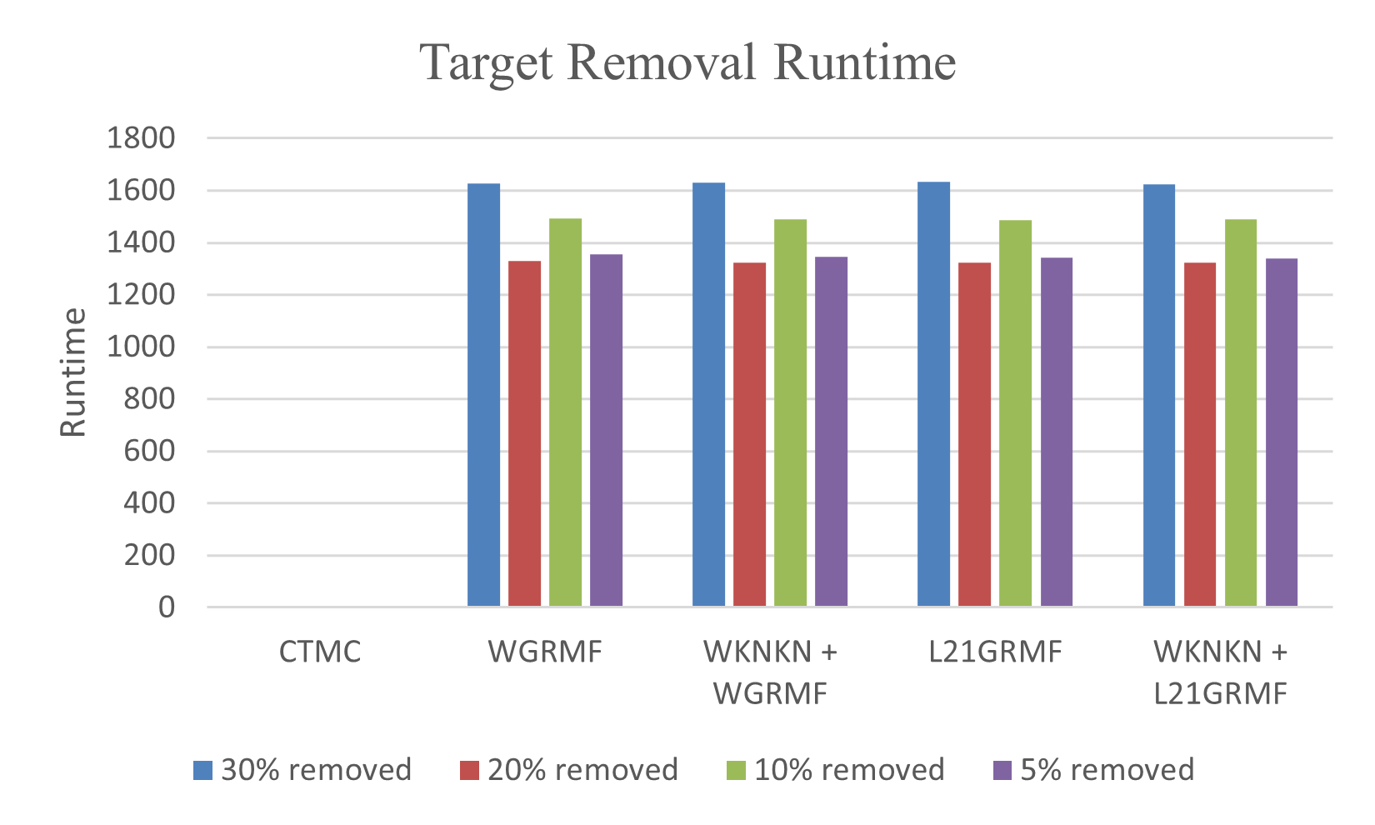
Drug/Target Removal - Runtime
All DTIs removed for drugs
All DTIs removed for targets

Slide 19
Machine Learning and Third-Party Private Search using Fully Homomorphic Encryption (FHE)
Data Security, Privacy, and Sharing

Slide 20
The Spectrum of Data Sensitivity
Low Sensitivity
High Sensitivity
Data Sensitivity
Small Datasets
In vivo
Toxicology
Rare Diseases
Knowledge Extracted from Public Dataset
Restricted Datasets
Compound Library
Informed Consent
Public Domain
Secure
Data Hub
External Federated FHE Learning System
Third Party Private Search
Internal Federated FHE Learning System

Slide 21
Three Major Challenges:
There is a need to analyze large amounts of proprietary pharmaceutical/biomedical data without divulging identities (e.g., Sequence ID or patient PHI)
There is a need to integrate small datasets from diverse sources (e.g., for rare diseases)
There is a need to train (and retrain) ML models across internal or external databases containing sensitive information.
Solution: Fully Homomorphic Encryption (FHE)
Fully homomorphic encryption allows calculations to be performed directly on encrypted data without decrypting the data

Slide 22
Applications
Third-party Private Search
Third-party private search (TPPS) provides a mechanism for securely and anonymously searching a database in which neither the content of the search query nor the underlying database records are revealed to any party.
Our TPPS scheme combines the GKS FHE scheme with the Paillier cryptosystem for secure modular reduction (SMR).
Machine Learning over FHE Data
Using the GKS scheme, we have implemented decision tree and Naive Bayes models that can operate over FHE data.
Other models under development include kernel-based SVM
Federated Machine Learning over FHE Data
We are working on extending our FHE models to the federated learning setting.

Slide 23
Application 1: Third-Party Private Search
Pharma DB₁
BioGrid
Private Query
CRO DB
Secure
Data Hub
DrugBank
Client
Pharma DB₂
Private Response
Michigan Drug Discovery
Michigan Medicine
Future Partner
Third-Party Private Search

Slide 24
Application 2: ML over FHE Data
Train
FHE Adapted Model
Trained Model for Deployment
Client
Secure Data Hub

Slide 25
Application 3: Federated ML over FHE Data
Train
FHE Adapted Model
Trained Model for Deployment
Train
FHE Adapted Model
Trained Model for Deployment
Client
Client
External Federated FHE Learning System
Internal Federated FHE Learning System
Secure Data Hub
Partner X
Dataset
Partner Y
Dataset
Affiliate Z Dataset
Partner X
Dataset 1
Partner X
Dataset 2
Partner X Dataset 3
X
Y
Z
X
X

Slide 26
Improving Care for Heart Failure Patients Using Tropical Geometry and Soft Computing
Incorporating Domain Knowledge into Machine Learning

Slide 27
Challenge: “Black-Box” Machine Learning Models
Model Interpretability
Many conventional machine learning (ML) algorithms are opaque, which prevents the widespread use of these methods in sensitive clinical applications.
Justifications for the resulting recommendations and predictions are important.
Model Complexity
Many popular ML methods, such as deep learning, utilize a large number of parameters and require tremendously large training datasets.
In many applications, generating large training datasets may be costly or even impossible.
The model is less interpretable and too complex to inject existing human knowledge.
Notes:
Hard to interpret
Lack of large dataset
Take use of knowledge from clinicians
4 mins

Slide 28
Heart Failure
Background
Heart failure (HF) is predicted to affect more than 8 million adults by 2030.
Morbidity and mortality remain high.
Therapeutic options are limited: Heart Transplantation (HT) and durable Mechanical Circulatory Support (MCS) device implant.
Objective
Develop an automatic decision support system that can identify patients eligible for a Mechanical Circulatory Support (MCS) or Heart Transplant (HT) based on clinical observations
Notes:
Hard to interpret
Lack of large dataset
Take use of knowledge from clinicians
4 mins

Slide 29
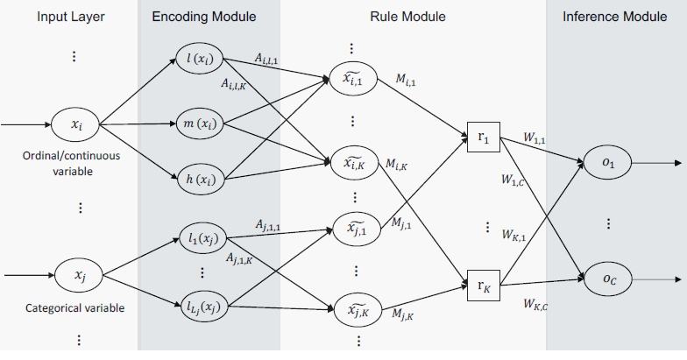
Tropical Geometry Fuzzy Neural Networks
Tropical geometry allows gradual and improved training of models using gradient-based methods
Interpretable machine learning method
Rule based model
Transparency with respect to knowledge extraction and interpretation.
Fusing domain knowledge (e.g., clinical criteria/standards for therapy selection) into the network

Slide 30
Datasets
Class 1 (positive): Eligible for MCS/HT; Class 0 (negative): Not Eligible for MCS/HT.
23 routinely collected clinical variables: age, lab test, physical examinations, echocardiography, etc.
REVIVAL Dataset:
All enrolled patients were assessed for outcomes and underwent follow-up assessments and tests for 2-years at 1-6 time points: 0, 2, 6, 12, 18, 24-months.
96 positive samples from 64 patients; 1335 negative samples from 339 patients
INTERMACS Dataset
2999 positives samples from 2999 patients

Slide 31
Performance Comparison
Proposed Network
 | Random Initialization | Initialized Using Clinical Rules
AUC | 82.32 (2.43) | 85.32 (2.09)
AUCPR | 56.83 (3.45) | 63.82 (2.40)
F1 | 48.88 (5.56) | 52.76 (5.17)
Optimal Epsilon | 0.4 | 0.6
Popular Machine Learning Algorithms
 | Logistic Regression | Random Forest | XGBoost | EBM | SVM
AUC | 65.82 (5.33) | 85.88 (2.38) | 83.04 (3.75) | 74.51 (13.72 | 0.37 (2.72)
AUCPR | 39.07 (4.92) | 63.82 (3.58) | 59.40 (5.64) | 49.42 (14.53) | 53.00 (5.57)
F1 | 0.00 (0.00) | 19.80 (4.45) | 28.61 (5.45) | 22.28 (13.53) | 15.20 (4.70)

Slide 32
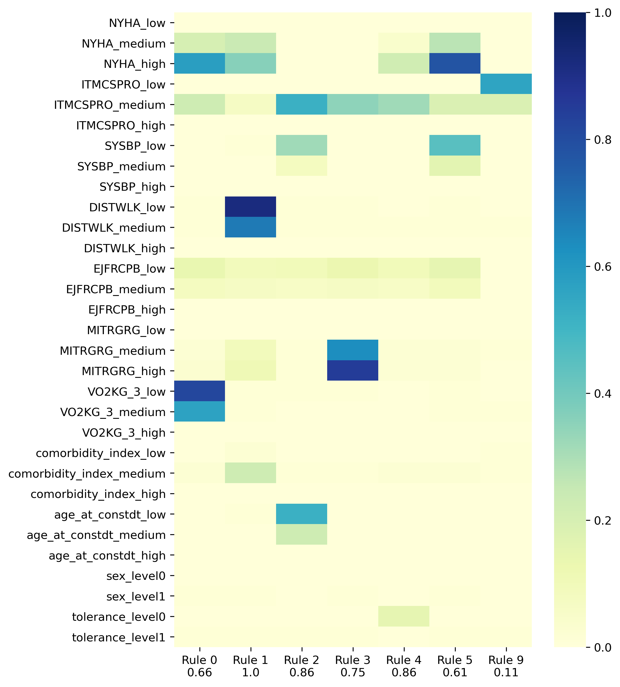
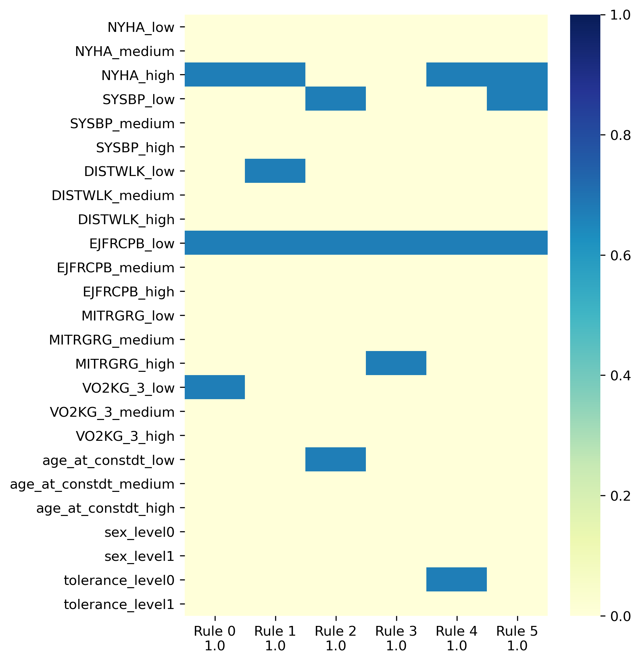
Rule Visualization

Slide 33
Treatment Monitoring of Hemodynamic Instability by Systematic Integration of Multimodal Clinical Data
Leveraging Higher Order Structured Data

Slide 34
Structure Matters!
Why Tensors?

Slide 35
Tensor-based Prediction of Hemodynamic Instability Events
Monitoring patients for signs of hemodynamic instability and decompensation is an essential component of postoperative care.
Goal: Create a clinical decision support system that incorporates all salient physiological signal and EHR data to predict the onset of hemodynamic decompensation.
Challenge: How to capture trends in the data across different temporal and spatial cases, while reducing the number of features in the machine learning model.

Slide 36
Data Representation When Assessing Treatments
Physiological Signals Features
Medication
Lab Results
Medical History
Surgical Treatments
Injury Scores
Imaging
Time
Clinical Decision
Clinical Decision
Clinical Decision

Slide 37
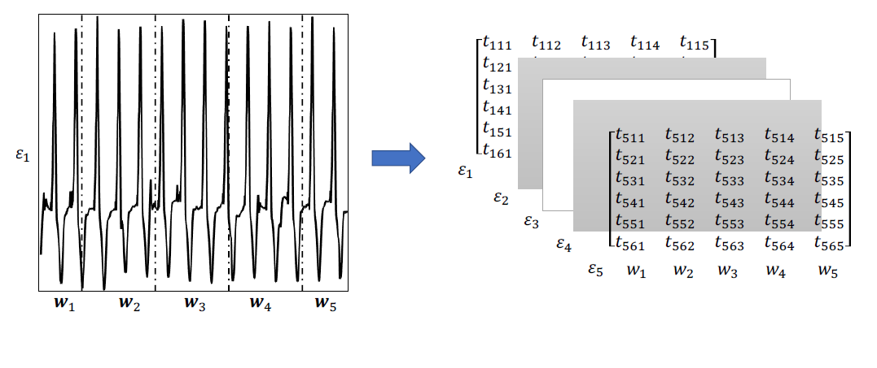
Data Processing – Taut String for Tensorization
A 5 × 6 × 5 tensor extracted from an ECG signal.

Slide 38
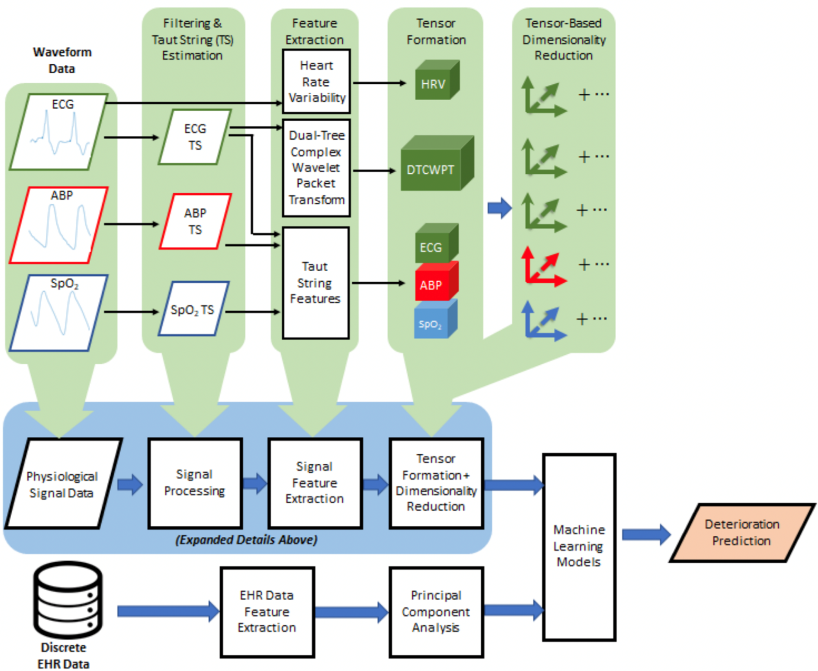
Overall Decision Support Pipeline

Slide 39
Cohort Descriptions
Cohort 1
Elective cardiac surgery cohort
Cohort 2
Major vascular surgery
Cohort 3
Abdominal surgery (e.g., exploratory laparotomy)
Orthopedic surgeries (e.g., total hip replacement)
Neurosurgery (e.g., craniotomy, spinal fusion)

Slide 40
Cohort 1 Results
Prediction Window (hrs.) | LUCCK AUC mean (SD) | RF AUC mean (SD) | NB AUC mean (SD) | SVM AUC mean (SD)
0.5 (n = 423) | 0.90 (0.01) | 0.94 (0.01) | 0.83 (0.02) | 0.91 (0.01)
1 (n = 466) | 0.89 (0.01) | 0.93 (0.01) | 0.84 (0.02) | 0.91 (0.01)
2 (n = 426) | 0.89 (0.01) | 0.93 (0.01) | 0.83 (0.02) | 0.90 (0.01)
4 (n = 414) | 0.91 (0.01) | 0.93 (0.01) | 0.85 (0.02) | 0.91 (0.01)

Slide 41
Cohort 2 Results
Prediction Window (hrs.) | LUCCK AUC mean (SD) | RF AUC mean (SD) | NB AUC mean (SD) | SVM AUC mean (SD)
0.5 (n = 66) | 0.94 (0.02) | 0.94 (0.01) | 0.82 (0.06) | 0.91 (0.08)
1 (n = 60) | 0.94 (0.02) | 0.94 (0.01) | 0.83 (0.07) | 0.91 (0.06)
2 (n = 64) | 0.92 (0.01) | 0.94 (0.02) | 0.88 (0.04) | 0.92 (0.04)
4 (n = 63) | 0.90 (0.02) | 0.92 (0.02) | 0.87 (0.03) | 0.90 (0.06)

Slide 42
Cohort 3 Results
Prediction Window (hrs.) | LUCCK AUC mean (SD) | RF AUC mean (SD) | NB AUC mean (SD) | SVM AUC mean (SD)
0.5 (n = 21) | 0.75 (0.13) | 0.82 (0.15) | 0.42 (0.03) | 0.80 (0.15)
1 (n = 20) | 0.75 (0.12) | 0.82 (0.10) | 0.51 (0.09) | 0.67 (0.16)
2 (n = 16) | 0.74 (0.08) | 0.72 (0.16) | 0.79 (0.07) | 0.81 (0.16)
4 (n = 12) | 0.77 (0.09) | 0.77 (0.15) | 0.63 (0.10) | 0.74 (0.14)

Slide 43
Prediction and Assessment of Treatments for Acute Diseases
Challenge: Incorporating Label Uncertainty and Asynchronous Data Availability to Create More Robust Models

Slide 44
Using Privileged Information
When analyzing EHR and physiological data to predict complex diseases, clinicians may not have even ordered medications/treatments/labs
Regular machine learning:
Clinical Outcome
“ Y ”
Physiological and Clinical Data
“ X ”
Regular Machine Learning
“ f ”
Treatments, drugs and some lab results
“ X* ”
Nowhere in the picture!
f: X →Y
Even though there is no privileged information available, can one infer the underlying phenotype had it been ordered and used for diagnosis?

Slide 45
Bringing Chest X-Rays into the Picture
Key observation: Retrospective training datasets contain privileged information, which are not used in regular machine learning
Solution: Learning with Privileged Information
Training Phase:
Using training data, find f_{p}: X →Y, using the knowledge of X*
Operational / Real-time Use:
f_{p}: X →Y
After training, we will only need X to predict Y, i.e., we won’t need privileged information to predict the outcome
Privileged information in training data have already influenced the choice of f_{p}

Slide 46
Results - Comparison with Privileged Learning
 | Train |  |  |  | Test
 | Accuracy | Sensitivity | Specificity | AUC | Accuracy | Sensitivity | Specificity | AUC
SVM | 88.61 | 80.43 | 91.76 | 86.10 | 89.27 | 76.58 | 90.33 | 83.46
SVM with LU | 87.56 | 78.74 | 90.96 | 84.85 | 89.52 | 80.03 | 90.32 | 85.17
LUPAPI | 88.09 | 81.28 | 90.72 | 86.00 | 88.78 | 82.23 | 89.34 | 85.78
LULUPAPI | 87.96 | 83.59 | 89.65 | 86.62 | 88.38 | 85.40 | 88.63 | 87.01
Shallow NN (2 layers, 10 nodes) | 87.52 (± 1.32) | 86.65 (± 6.01) | 87.77 (± 4.26) | 87.31 (± 0.94) | 79.98 | 84.99 | 79.56 | 82.23
Shallow NN (2 layers, 50 nodes) | 87.89 (± 1.26) | 84.81 (± 4.44) | 89.08 (± 3.13) | 86.94 (± 1.05) | 83.41 | 82.97 | 89.05 | 85.39
Shallow NN (2 layers, 100 nodes) | 87.41 (± 1.14) | 82.43 (± 11.35) | 89.33 (± 5.45) | 85.88 (± 3.09) | 87.97 | 66.67 | 89.76 | 78.22
LSTM (25 layers, 10 nodes) | 90.94 (± 0.45) | 83.10 (± 2.25) | 93.97 (± 0.53) | 88.53 (± 0.96) | 88.39 | 64.33 | 90.41 | 77.34
LSTM (25 layers, 50 nodes) | 91.99 (± 0.68) | 84.67 (± 2.51) | 94.82 (± 0.46) | 89.74 (± 1.21) | 88.91 | 70.39 | 90.47 | 80.43
LSTM (25 layers, 100 nodes) | 92.62 (± 0.42) | 85.79 (± 1.87) | 95.25 (± 0.86) | 90.52 (± 0.69) | 87.40 | 71.76 | 88.71 | 80.24

Slide 47
Contact Information
Web: http://najarianlab.ccmb.med.umich.edu
Kayvan Najarian
Professor of Computational Medicine and Bioinformatics
Professor of Emergency Medicine
Professor of Electrical Engineering and Computer Science
Director of the Biomedical and Clinical Informatics Lab
Associate Director, Michigan Institute for Data Sciences
Associate Director, The Max Hari Weil Institute for Critical Care Research and Innovation
Email: kavyan@med.umich.edu

