Slide 1
National Science Board
Informational Slides
Source: National Science Board | Science & Engineering Indicators | NSB-2022-1
SCIENCE & ENGINEERING INDICATORS

Slide 2
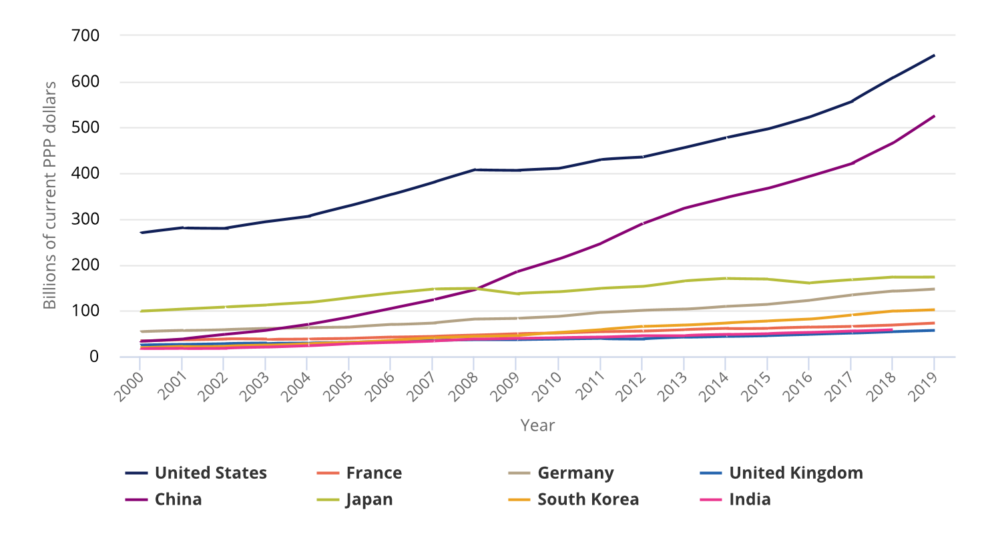
Gross domestic expenditures
Gross domestic expenditures on R&D, 2000-19
ON R&D
Source: National Science Board | Science & Engineering Indicators | NSB-2022-1

Slide 3
Contributions to growth
Contributions to growth of worldwide R&D expenditures, 2000-17
R&D
SPENDING
Source: National Science Board | Science & Engineering Indicators | NSB-2022-1

Slide 4
R&D
expenditures
R&D intensity, by selected country: 2000 and 2019
BY GROSS
DOMESTIC PRODUCT
Source: National Science Board | Science & Engineering Indicators | NSB-2022-1

Slide 5
Shares of worldwide
Shares of worldwide R&D expenditures, 2000, 2010, and 2019
R&D SPENDING
Source: National Science Board | Science & Engineering Indicators | NSB-2022-1

Slide 6
U.S. R&D
U.S. R&D expenditures, by performing sector: 2000-19
SPENDING
Source: National Science Board | Science & Engineering Indicators | NSB-2022-1

Slide 7
U.S.
U.S. R&D expenditures, by source of funds: 2000-19
R&D SPENDING
Source: National Science Board | Science & Engineering Indicators | NSB-2022-1

Slide 8
U.S.
U.S. R&D performance and funding, by type of R&D and Sector: 2019
R&D FUNDING
Source: National Science Board | Science & Engineering Indicators | NSB-2022-1

Slide 9
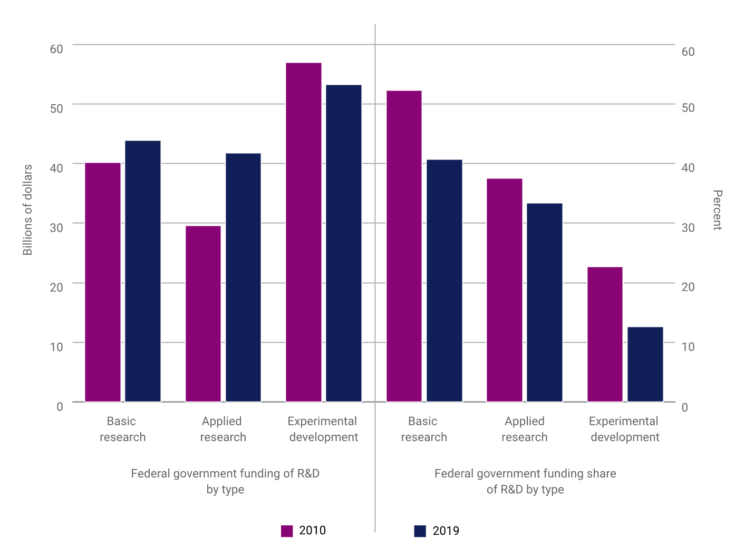
R&D performance
R&D performance funded by the federal government,
by type of R&D, 2010 and 2019
FEDERALLY FUNDED
Source: National Science Board | Science & Engineering Indicators | NSB-2022-1

Slide 10
S&E
International collaboration on S&E articles, by country: 2020
ARTICLES
Source: National Science Board | Science & Engineering Indicators | NSB-2022-1

Slide 11
Highly
cited
Highly cited article index, by selected country or economy: 2000, 2010, and 2018
ARTICLES
Source: National Science Board | Science & Engineering Indicators | NSB-2022-1

Slide 12
Doctoral degrees
S&E doctoral degrees, by selected countries: 2000-2018
IN S&E
Source: National Science Board | Science & Engineering Indicators | NSB-2022-1

Slide 13
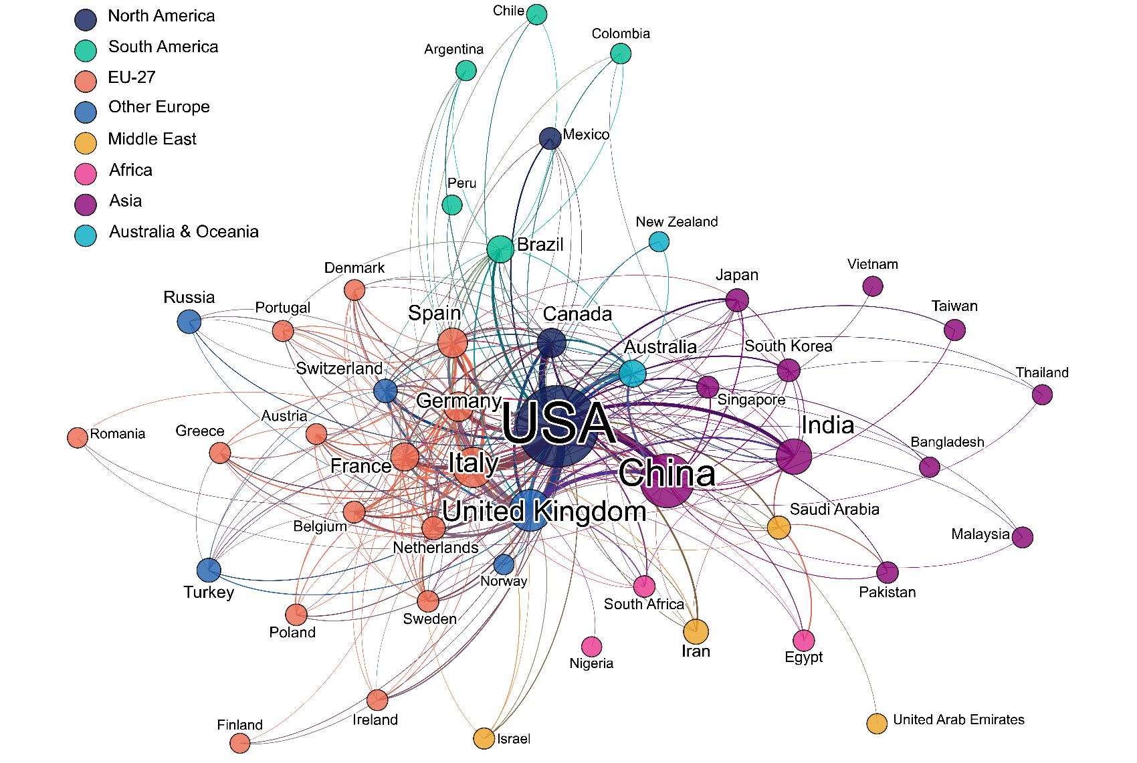
Covid-19
Collaboration network on coronavirus-related articles,
by country: 2020
Collaboration
Source: National Science Board | Science & Engineering Indicators | NSB-2022-1

Slide 14
Keep in touch
uidp.org
info@uidp.net
TeamUIDP #collaboration #UIDP

