Slide 1
Chemistry-driven innovation for sustainable mobility
June 14, 2017
Dr. Michael Pcolinski
Notes:
Hello, everyone. My name is Mike Pcolinski and I’m with BASF Corporation. And as Vice President for our Advanced Materials & Systems Research at BASF, I have the best job in the company. You see jointly with my team and our global colleagues in Research and Development, we explore, design and develop materials to meet the ever changing demands of our customers.
It’s my privilege to be with you all today and share some examples of where chemistry plays a vital role for sustainable mobility.

Slide 2
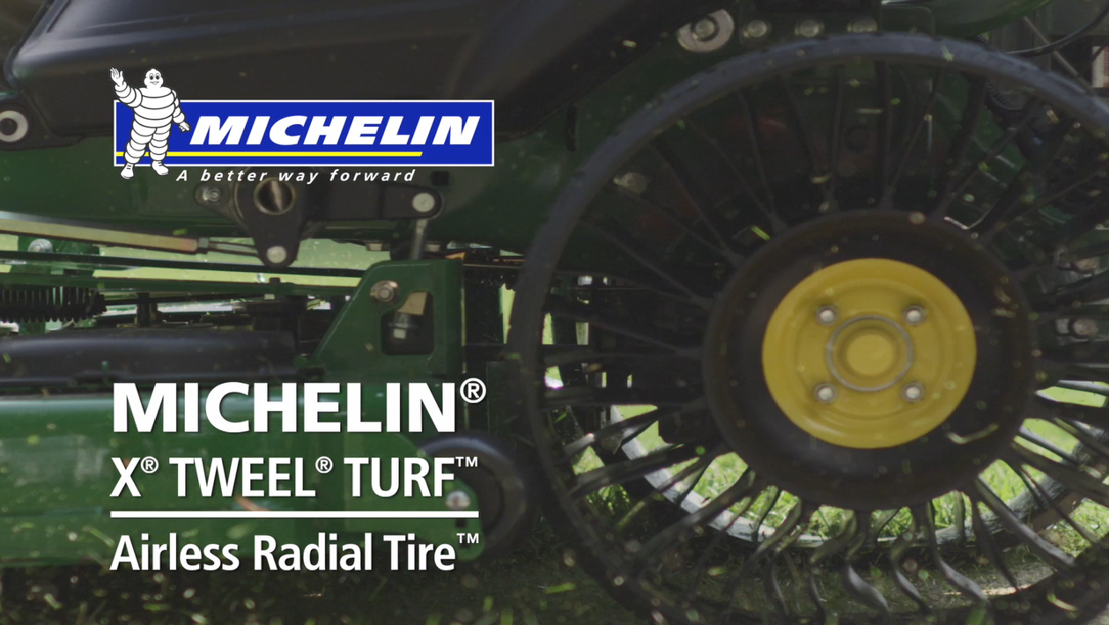
Notes:
“MICHELIN® X® TWEEL® Turf Airless Radial Tire” video
Here‘s a short video about the Michelin X Tweel Turf airless radial tire. The example shown here is for turf, but these tires can also be seen on skid steer loaders. Through our partnership BASF and Michelin technologists and commercial colleagues worked collaboratively on creating Michelin Tweel airless radial tires. It is an alternative to the pneumatic wheel – pneumatic meaning that it uses air. This tire is non pneumatic… airless. It uses BASF high performance compounds to create a light but strong wheel rim. It replaces the metal components in the wheel and helps reduce air-loss-related maintenance and downtime. Let’s take a look…
(After video)
So what if the technology used in this example is something that could be used in the future for on road vehicles?

Slide 3
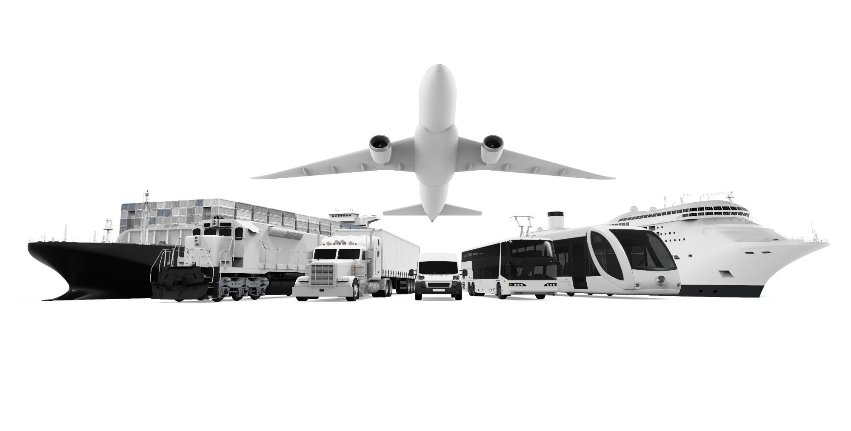
Notes:
How many of you took a flight to get to the MOVIN’ ON conference? Who drove? Who flew and then drove to get here? What about a train or a bus? What were your mobility experiences?
We all traveled from somewhere to get to this event. Planes, trains and automobiles. We‘re all consumers when it comes to the topic of mobility and there are certain trends that we are noticing. We‘re concerned about the comfort of the ride, our personal safety in the event of an accident. We want better fuel efficiency and reduced emissions. I want my ride to be in my favorite color. Our focus at BASF is figuring out how chemistry can address those needs. We supply and develop functional materials and solutions that enable vehicles to be built and to operate more efficiently and for roads, bridges and tunnels to be more durable.
At BASF, we’ve been a player in this industry for many years and we always look to innovate.
New ways of thinking about mobility are easier today than ever before.
Tools for enabling collaboration broaden the pool of possible collaborators; feedback loops are fast paced & urgent
The capability to explore new modes of assembly are better than ever
So what’s lagging?
According to Materials Genome Initiative, there is an estimated 15-20 year gap in moving significant advances in materials for transportation out of universities & institutes and into production
And the question is why?

Slide 4

Notes:
Approaches to innovation haven’t changed so much from the early decades of industrialization; concepts & language around innovation for example have changed over the last century.
When asked about innovation the great inventor Thomas Edison said that he & his teams were continuously building on previous innovations, and more importantly, anticipating what consumers wanted in their new products. Edison, like many other inventors, worked to meet the expectations of customers.

Slide 5
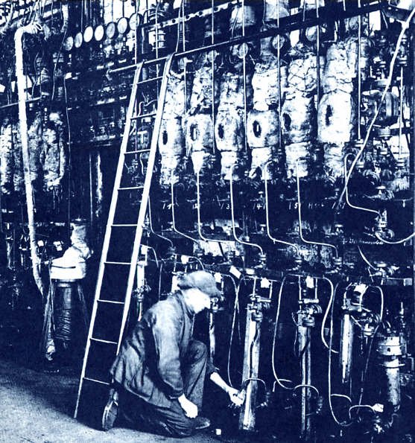
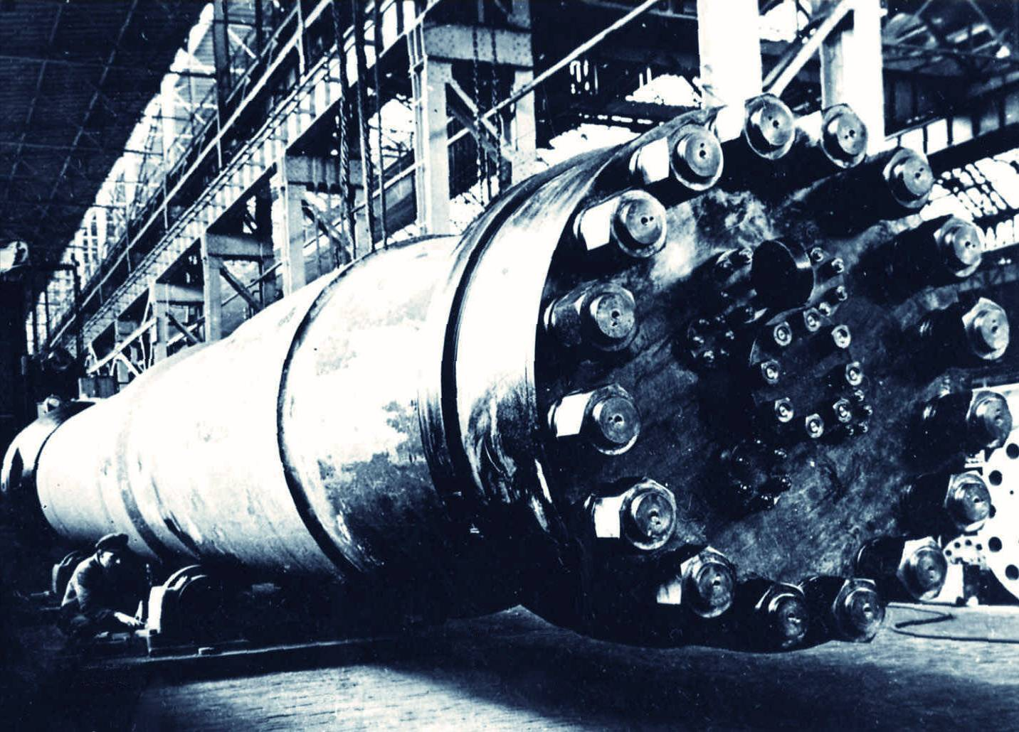
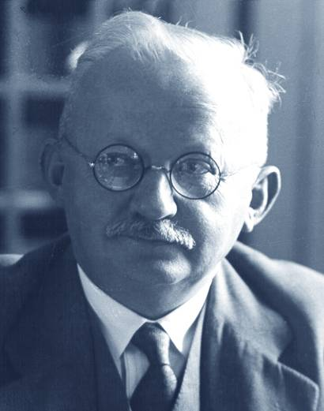
Alwin Mittasch
Notes:
At BASF, Sustainability informs all that we do. Our 150+ year history is built on a tradition of developing & driving technology commercialization through open collaboration and innovation. For example, the industrial production of ammonia, one of the world’s most important chemicals for the production of fertilizers was the culmination of very close collaboration between Fritz Haber working at the University of Karlsruhe and Carl Bosch of BASF.
In the lab Prof Haber proved the concept of Nitrogen capture from air to make ammonia. Carl Bosch and a team of world class engineers, scientists, metallurgists & financial colleagues made it commercially possible on an industrial scale. The food production for half the world's current population depends on this method for producing nitrogen fertilizers
Let me couple innovation approaches from the past to our approaches today: Words like ‘high throughput screening”, or data discipline are not new; Alwin Mittash and a troupe of expert lab technicians tested >20,000 compounds for catalytic activity in less than 2 years! The picture above shows what a “high throughput catalyst screening” lab looked like in 1910. Today the concept is the same, however we approach the hardware/software in a much more effective manner.

Slide 6
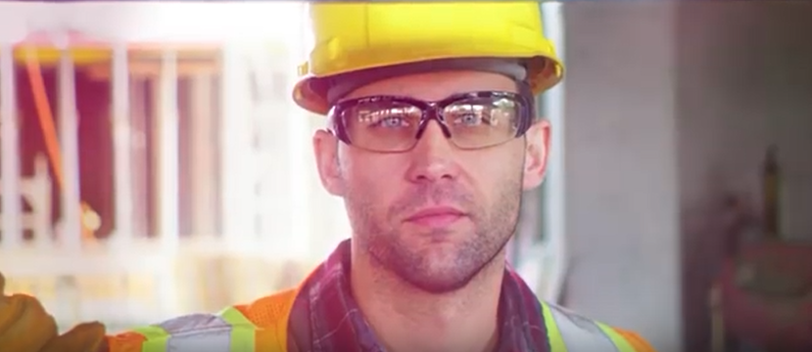
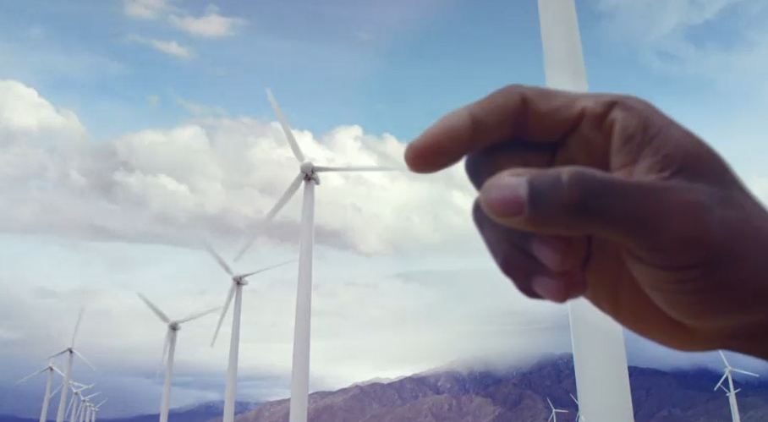
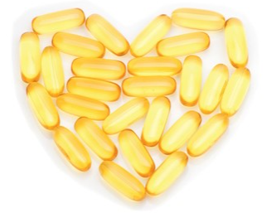


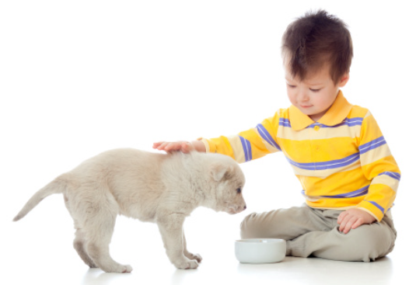
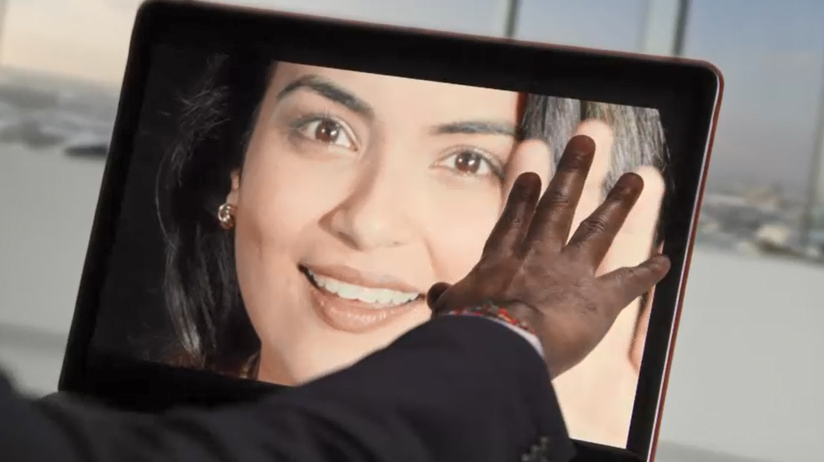


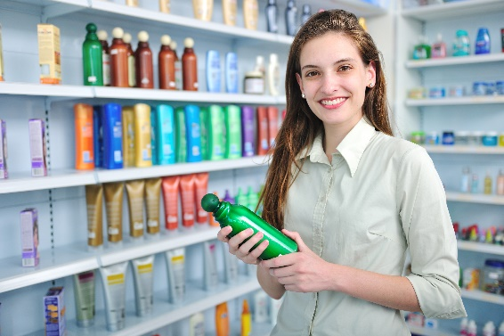


Notes:
Intro to BASF
So let me provide you a framework of who we are. Our portfolio breadth: we’re in everything. You think of it, we probably do something within it!
Chemistry is an enabler. Our products and solutions contribute to conserving resources, ensuring nutrition and improving quality of life. We have building and construction materials, foams and plastics that go into sporting equipment, spandex that goes into clothing, UV filters for sun care creams, hygiene materials… we sell materials that go into detergents, soaps and shampoos, including the containers that the products are packaged in.
It’s not just about creating chemistry, but it’s about doing so sustainably - how we produce materials and where they end up in products and consumables.
These are just a handful of techologies and solutions that BASF offers to help customers be more successful and consumers more satisfied.
..............................................................................
More info...
(We have seven distinct segment strategies for BASF’s We create chemistry. We have products and solutions for:
Agriculture
Construction
Consumer Goods
Electronics
Energy & Resources
Health & Nutrition
and
Transportation)

Slide 7
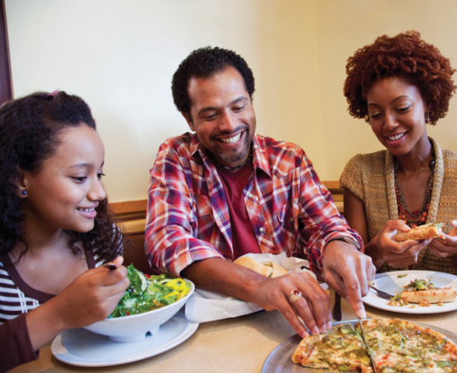
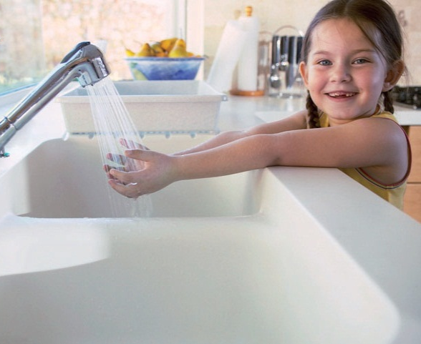

Notes:
In 2050, nine billion people will live on this planet. If we don’t change anything in the way we live and manufacture goods then we will need the resources of almost three of our planets to meet the demands of the population. We are therefore facing huge global challenges. At the same time, these challenges open up many opportunities for using chemistry as an enabler to help, solve, improve and innovate.
Resources, environment and climate: Dramatically rising energy demand is one of the world’s most pressing challenges. In addition, access to clean water and efficient use of resources are becoming increasingly important.
Food and nutrition: A growing world population obviously needs correspondingly more food, which has to be produced from less arable land. And it will be necessary to enhance nutrition quality.
Quality of life: Aspirations differ greatly from region to region and among different social groups, but there is a common ambition: People want to improve their individual quality of life. This may take very different forms, depending on a country’s economic and demographic development: In some places, the focus is on affordable housing or mobility, elsewhere the emphasis is on good healthcare or effective pharmaceuticals.
In all these areas, chemistry acts as an enabler for innovation and sustainability.
BASF is uniquely positioned to address society’s needs of resources and environment, food and nutrition and quality of life – with our broad portfolio of technologies, our market access, and our resources and expertise.
For our resources and environment - we have advances in fuel economy, lightweight construction and greenhouse gas reduction
Within the spaces of food and nutrition - chemistry plays in the space for farm equipment & transportation/distribution of food
The quality of life – quieter cars, autonomous vehicles, improved public/mass transportation, construction and infrastructure - chemistry plays enormous roles to help

Slide 8

Notes:
But what if?
What if we could make cars & buses that are more comfortable? (NVH reduction)
What if we could make air in planes cleaner? (Catalyst)
What if greenhouse gas generation could be lowered by generating parts & coatings that contributed to lightweight construction of buses & cars or even trains? (Coatings of plastic composite parts)
What if we could design road infrastructure & airport runways, and tunnels that were more durable (Construction)
Imagine the savings in resources & money if demands for inventory could be significantly reduced through additive manufacturing (3D printing), or if we could reduce the volume of material needed to produce a part by coupling computer design, prototyping, testing and ultimately manufacture of materials efficient, high functional parts or components (3D printing)
What about connected systems, or direction/navigation systems, or safety systems that can measure whether you as a driver are paying attention?

Slide 9

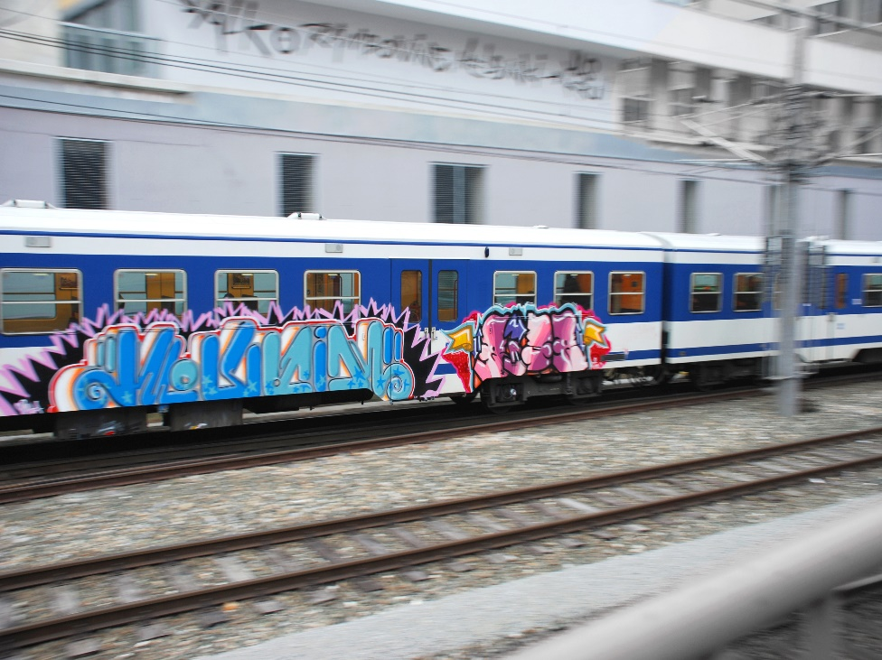
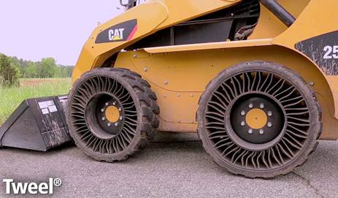
Notes:
Comfortable? Noise Vibration and Harshness reduction materials create safer and smoother rides for passengers and drivers. What if chemistry could improve the durability of tires and increase the life of a skidsteer loader from 900 hours to 1200 or even 1500?
Graffiti and other types of vandalism make people feel more vulnerable. This can impact ridership numbers, contributing to fewer people taking mass transportation and adding more traffic to the roads and increasing our carbon footprint even more. With our thermoset coating solution, transit authorities can easily clean spray paint and other materials from the exterior of trains and buses.
That’s sustainability at its best – making our investments in goods last longer and reducing demands on our valuable energy, materials & resources.

Slide 10
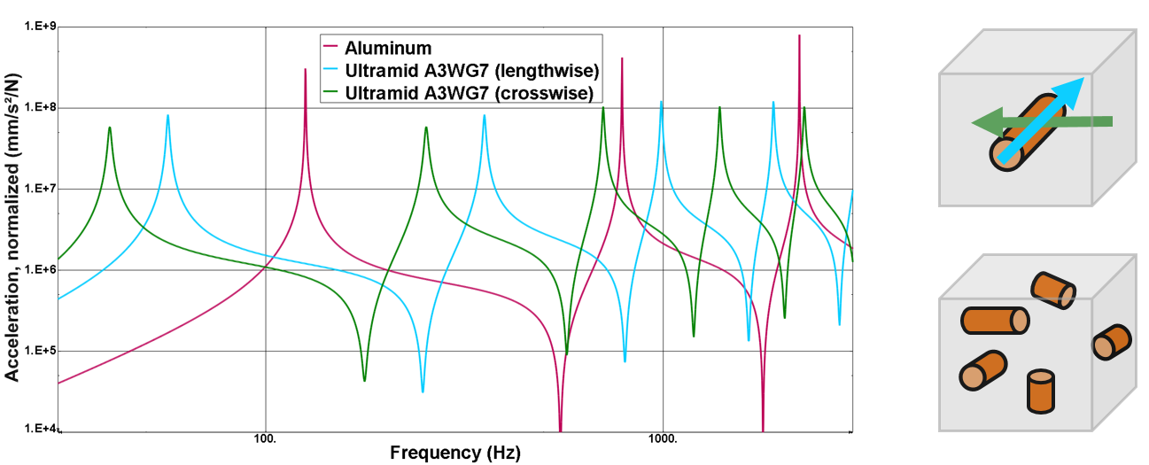
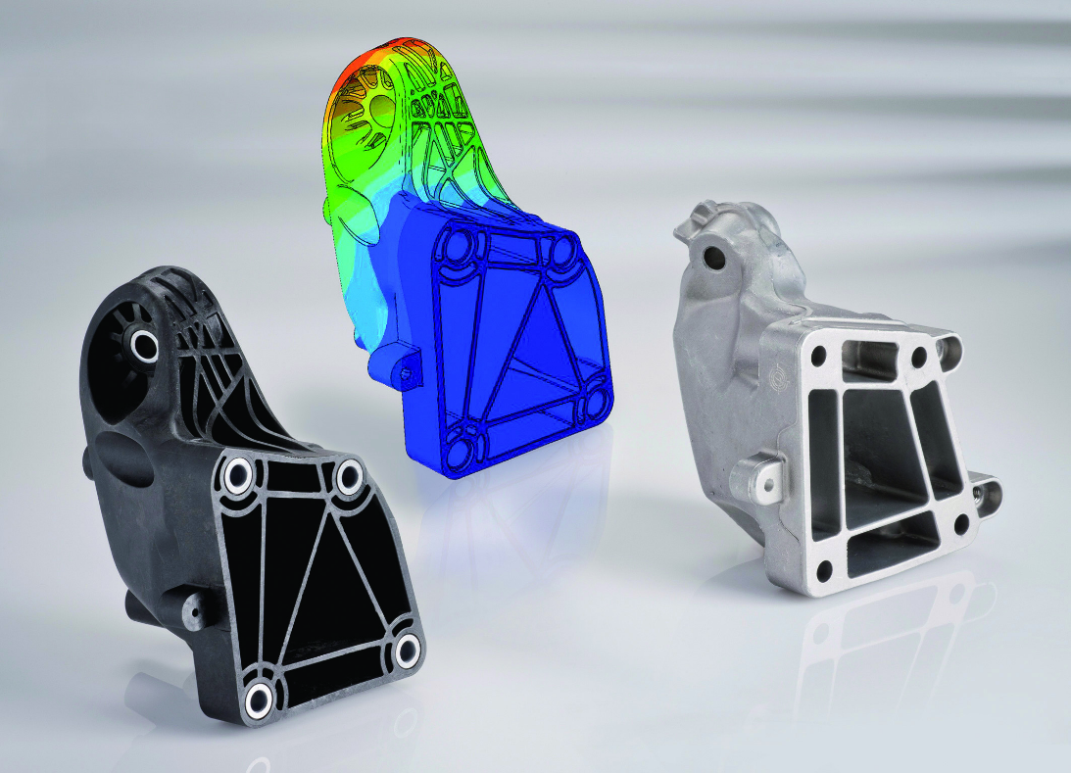
Notes:
Imagine using modeling & simulation coupled with materials properties know-how to develop alternatives to current ways of thinking about automotive components. Our studies on the fundamental elements of materials and dampening of NVH effects have yielded products for our customers that create safer and smoother rides for passengers and drivers.
Collaboration with Mercedes Benz on lightweight construction options leveraged fundamental computer modeling, physics and materials properties to produce the MB GL series’ composite engine mount that not only saved weight and reduces vibration, but also resulted in a reduction in ambient noise levels in the passenger cabin.

Slide 11
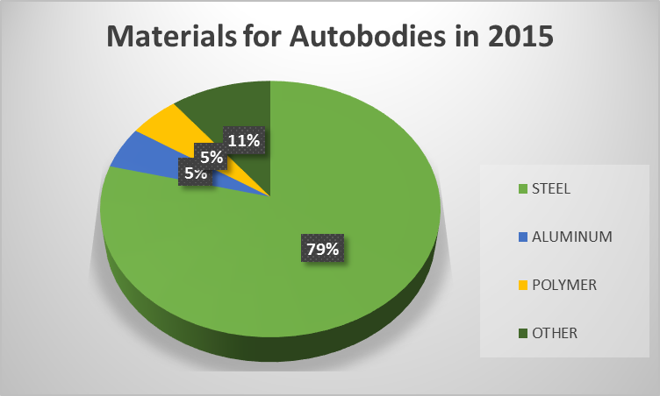
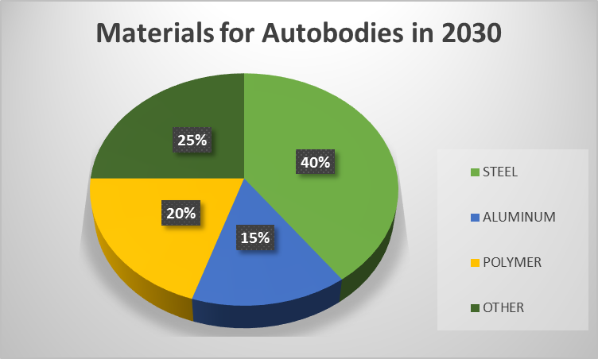
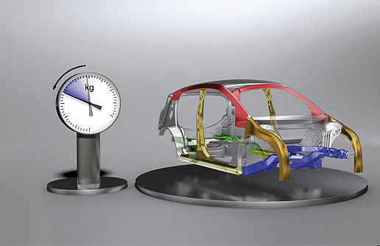
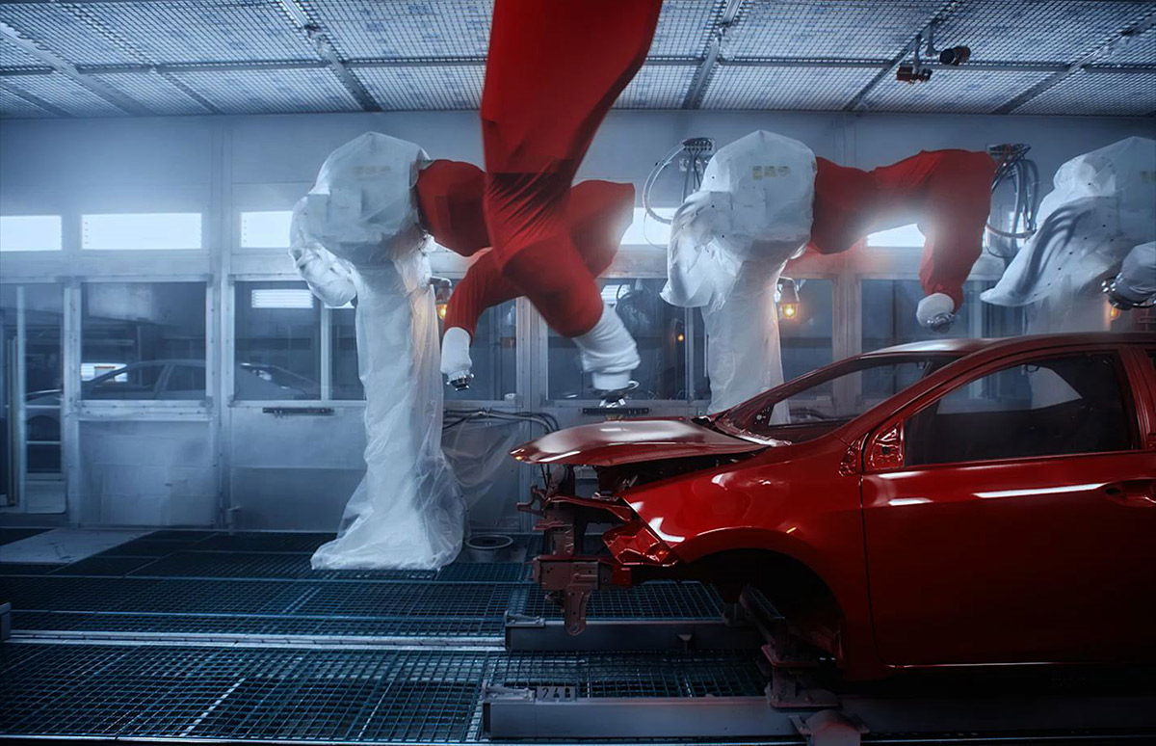
Notes:
Fuel Efficiency Targets are changing…and creating new jobs in discovery and technology….What if we could lower greenhouse gas generation by designing parts and coatings that contributed to lightweight construction of planes, buses, cars and even trains? We have tailor-made solutions for mass transportation and personal vehicles. Our solutions from coatings, lightweight flooring, chassis and battery technologies to lubricants, sealants and adhesives all leverage chemistry as an enabler in design and performance. These sort of design choices that deliver lighter weight, longer-lasting, & lower maintenance vehicles offer sustainability advantages.

Slide 12

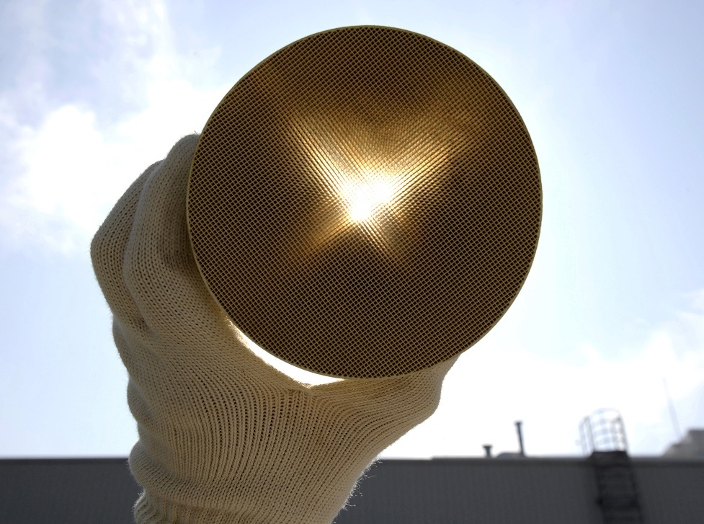
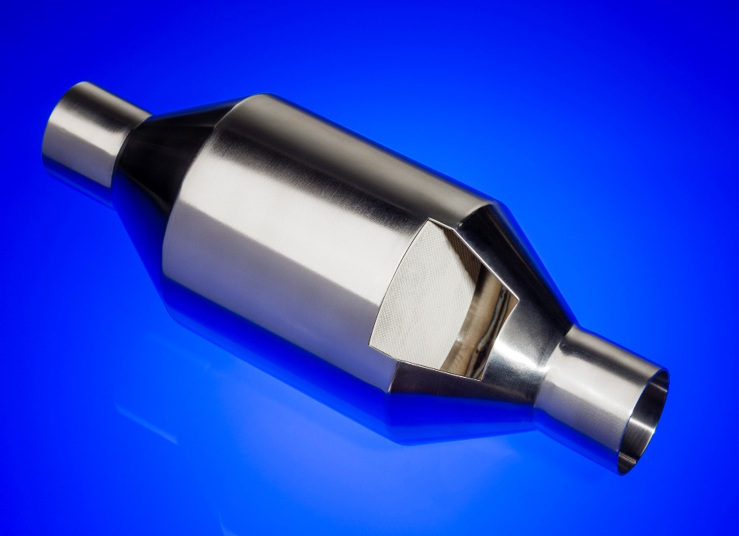
Notes:
What if we could make air in planes cleaner? air quality in airplane cabins and cars is improved with our catalyst solutions.
Removing pollutants and particulates in the air we breathe is important. The catalytic converters in cars with internal combustion engines have long been equipped with catalytic converters to clean the exhaust gas flow.
Scientists at BASF have now further developed the well-established Three-Way Conversion catalyst used in gasoline applications. Our new Four-Way Conversion (FWC™) catalyst combines the catalyst function and a particulate filter in a single component. This compact catalytic converter system from BASF removes gaseous pollutants AND particulates. This new technology helps automakers meet strict new emissions regulations.
Our Seneca, South Carolina site is BASF‘s global production hub for the recylcing of end of life automotive and chemical catalysts. BASF‘s efficient recovery and recycling of platumim group metals creates a sustainable secondary supply source for limited global resources and expands our engagement for promoting a circular economic mindset across our organization.

Slide 13
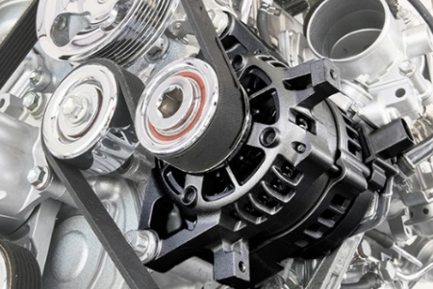
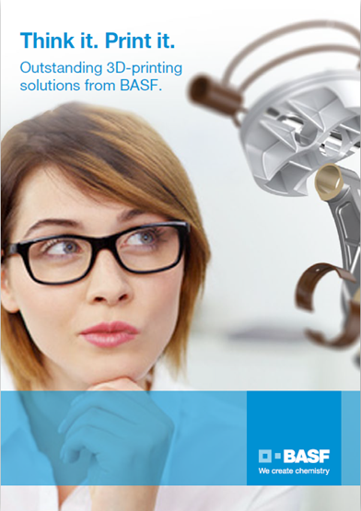
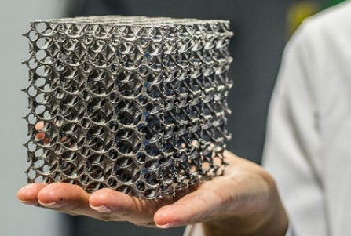
Notes:
We’ve all heard about 3D Printing & it’s pretty exciting… but could you imagine the various ways chemistry plays a key role? Chemistry-enabled additive manufacturing offers solutions for current and future needs in functional integration, lightweight construction, individualization and ultimately faster time to market.

Slide 14
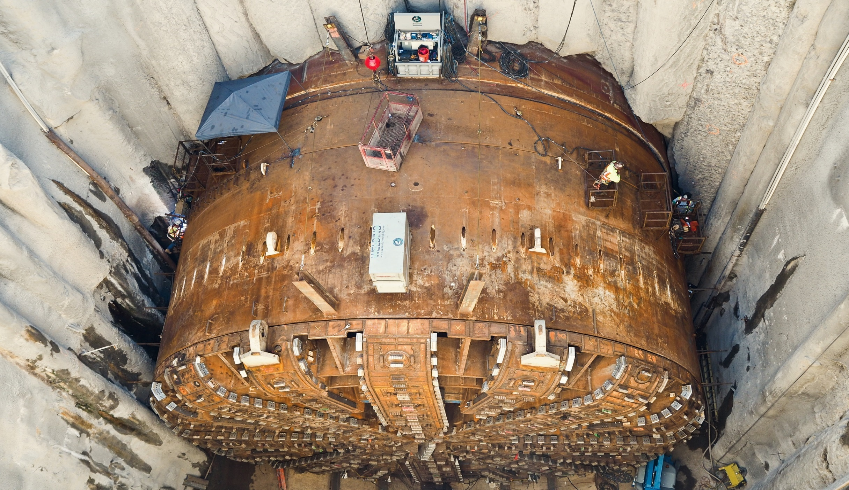
Photo credit: Washington State Dept. of Transportation
Notes:
What a bore! What we’re looking at here is a boring machine.
Bertha, affectionately nicknamed after Seattle's mayor from the 1920’s, Bertha Knight Landes, is the tunneling machine that recently bored the SR 99 tunnel to replace Seattle’s Alaskan Way Viaduct, a tunnel nearly 3,2 Kilometres in length.
Bertha is 5 stories tall and 100m long – about as long as a football field.
Bertha not only drills, digs and carries rock and soil out of its way, the machine also assembles the precast concrete segments that line the tunnel.
Bertha’s power excavated up to 28 truckloads of soil every 25 minutes.
Bertha even has her own Twitter account… with close to 22K followers! So why I am mentioning all of this to you?.... What if we could design road infrastructure & airport runways, and tunnels that were more durable?
Sources: https://www.flickr.com/photos/wsdot/sets/72157675202550505/; https://creativecommons.org/licenses/by-nc-nd/2.0/
http://www.wsdot.wa.gov/Projects/Viaduct/About/FollowBertha?mc_cid=de3aac31e6&mc_eid=%5BUNIQID%5D
https://twitter.com/BerthaDigsSR99?ref_src=twsrc%5Etfw&ref_url=http%3A%2F%2Fwww.wsdot.wa.gov%2FProjects%2FViaduct%2FAbout%2FFollowBertha%3Fmc_cid%3Dde3aac31e6%26mc_eid%3D%255BUNIQID%255D

Slide 15
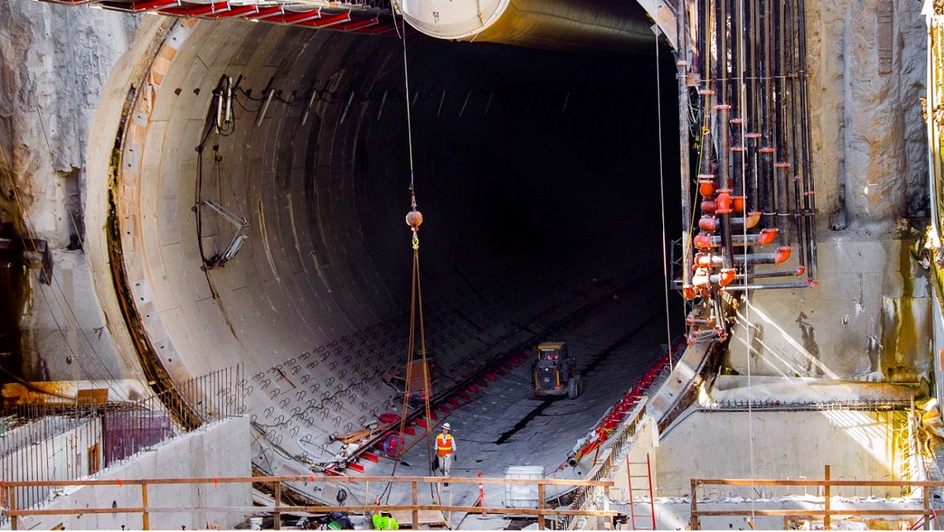
Photo credit: Catherine Bassetti Photography
Notes:
This is an innovative way of creating sustainable mobility in and around the city of Seattle. And BASF experts along with around 25 of our products helped Bertha dig through dense, wet soil and rock and produced the concrete segments that line the 3,2 Kilometer tunnel.
Our products include soil conditioners, sealant greases, grout admixtures, polymer injection systems and admixtures for manufacturing the precast concrete segments. We even formulated some new products, customized just for this project.
Road decking will be installed – both lower and upper decks (northbound and southbound roadways, respectively).
The tunnel is due to open around the spring of 2019.

Slide 16
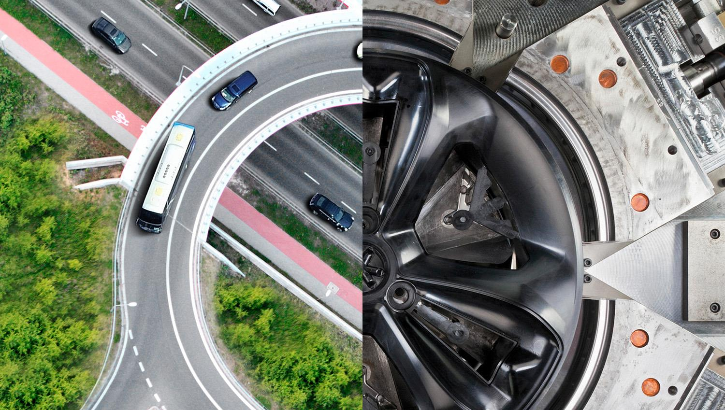

Notes:
What if…it’s an interesting question.
Some year’s back a study of UK children < 5 years old whose language and interactions were being tracked on a daily basis for several months was conducted. And the Researchers compared those interactions & language with Adults. And the most surprising thing they found is that the children asked 300+ questions/day where as the average adult asked 6.
Women & men throughout history have persistently asked “What if.” A smaller number have heard the what if and have contributed to figuring out “How”. And those What if and How success stories have almost always been a result of collaborations.
We are often asked by our customers “What if.” At BASF, we’re most excited to be able to determine “How.”
Chemistry is involved in everything you want to do – so collaborate with BASF, the world’s leading chemical company.
Thank you very much for your attention. It’s been an honor for me to be here and explore mobility of the future.

Slide 17
