Slide 1
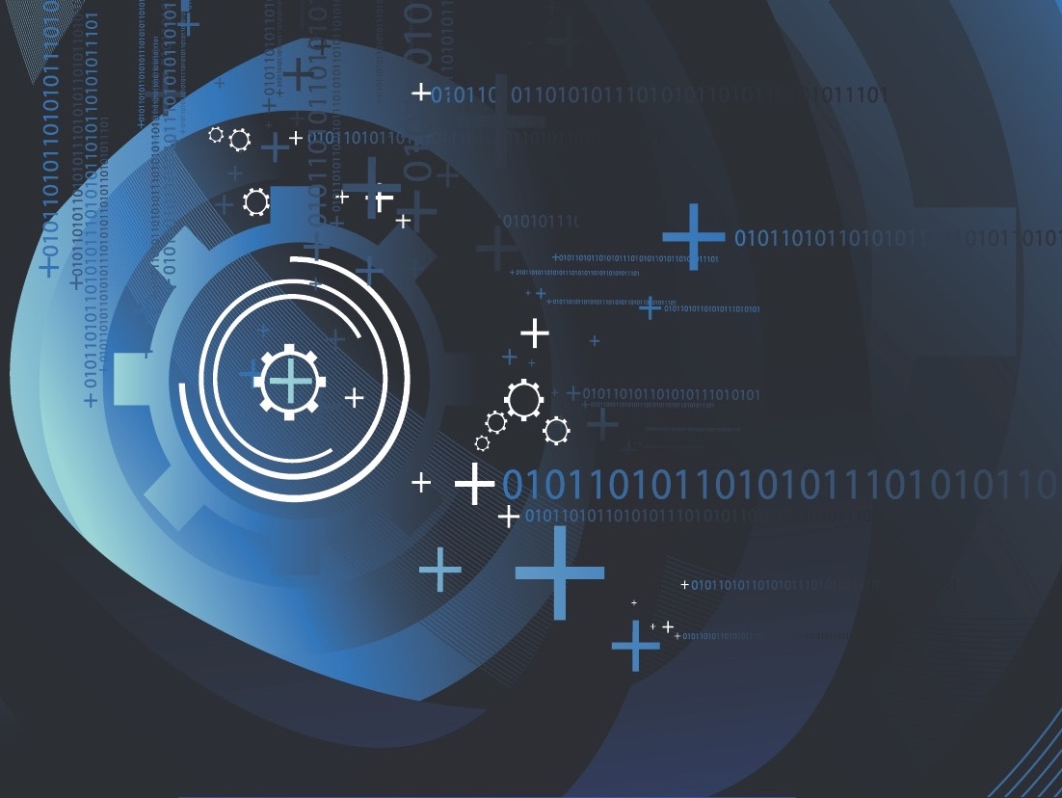
Cybersecurity Panel Discussion
Farnam Jahanian
Carnegie Mellon University
University Industry Demonstration Partnership
September 27, 2017

Slide 2


Reagan, War Games, NSDD145
“Could something like this really happen?
Could someone break into our most
sensitive computers?”
– Ronald Reagan, June 1983
“Mr. President, the problem is much worse than you think.” – Gen. John Vasey, Chairman of Joint Chiefs
September 17, 1984: National Security Decision Directive 145, titled “National Policy on Telecommunication and Automated Information Systems Security”
– United States’ first “cyber warfare” directive

Slide 3
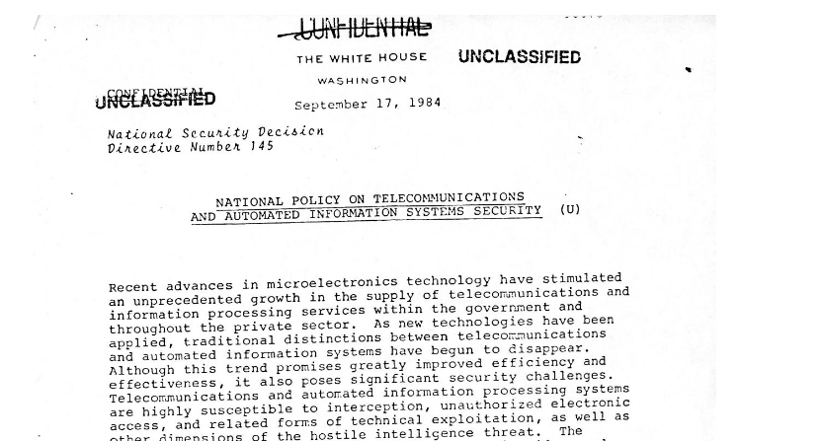
Reagan, War Games, NSDD145
“Could something like this really happen?
Could someone break into our most
sensitive computers?”
- Ronald Reagan , June 1983
The new devices are “highly susceptible to interception, unauthorized electronic access, and related forms of technical exploitation.”
Hostile “foreign intelligence agencies are extensively” hacking into these services already, and “terrorist groups and criminal elements” had the ability to do so as well.
“Mr. President, the problem is much worse than you think.”
- Gen. John Vasey, Chairman of Joint Chiefs
September 17, 1984: National Security Decision Directive 145, titled “National Policy on Telecommunication and Automated Information Systems Security” – Our nation’s first “cyber warfare” directive.

Slide 4
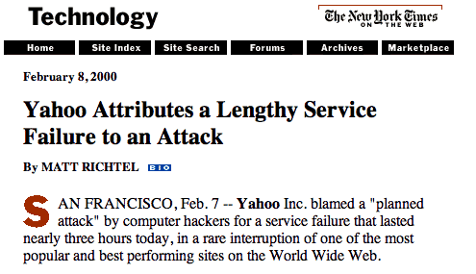
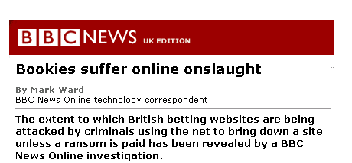
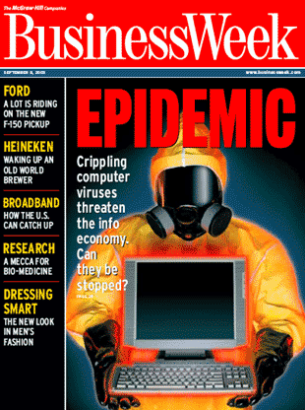
Early Years: Cyber Vandalism
  The primary motivation of hackers was bragging rights.
  Worms and viruses were intended to simply wreak havoc on the infrastructure.
  These were availability attacks that impacted network access and services, and often, reputations.

Slide 5
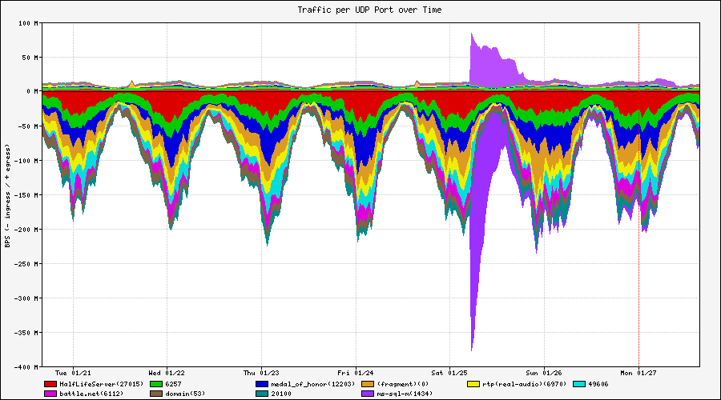
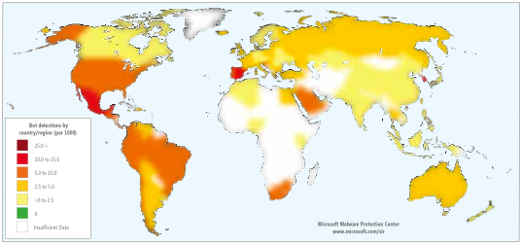
The Rise of Botnets: Cyber Crime
Dramatic Transformation and Escalation
  A compromised system is more useful alive than dead
  A compromised system provides anonymity
  A network of compromised hosts provides a powerful delivery platform
Increased sophistication, the targeting of specific applications, and attempts to foil attribution.

Slide 6
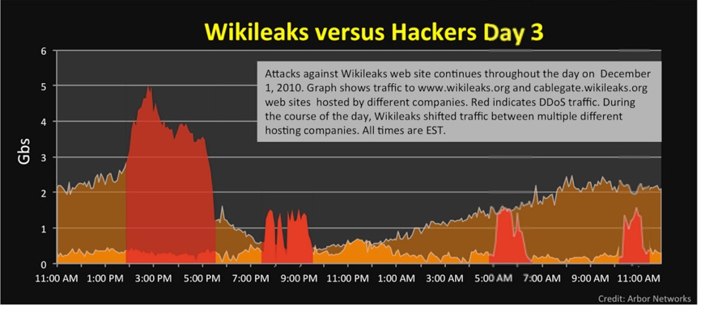
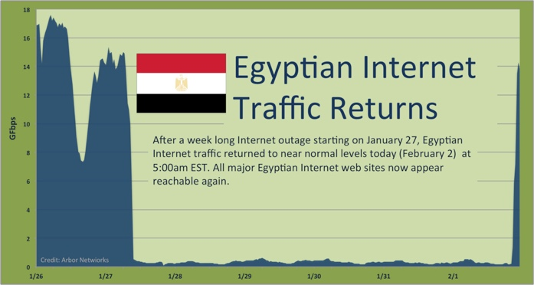
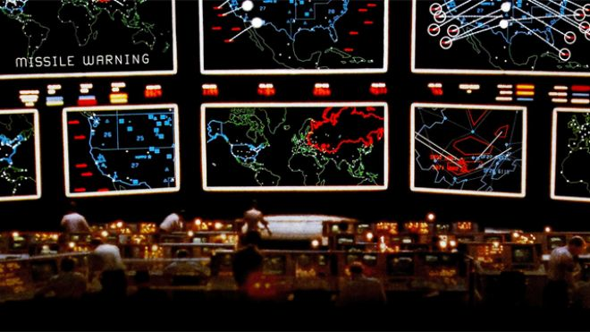
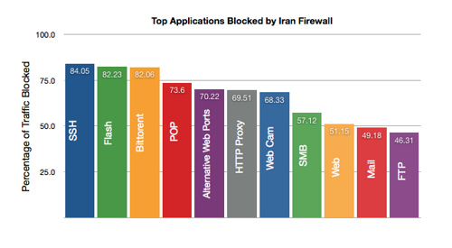
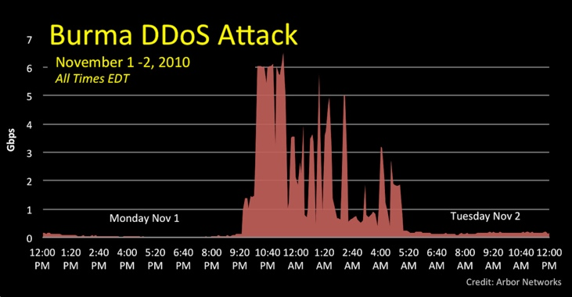
Cyber-War, Censorship, Hack-ivism, and Cyber-Espionage
2016
2015
2013
2012
2011
2010
2009
2008
2007
High-profile attack on DNC led to release of 20K emails by WikiLeaks
Power outages in W. Ukraine on were the result of a coordinated attacks on SCADA servers in several regional distribution power companies
Syria sees wide scale outages
Izz ad-Din al-Qassam Cyber Fighters claim large attacks against US Financial services companies
Russian news and political candidate sites are attacked in run up to March 4th Elections
Egypt's Internet censored by the government
WikiLeaks DDoS’d by pro-US supporters
Burma’s main Internet provider, the Ministry of Post and Telecommunication (MPT), DDoS’d
July 4–10 attack on US and S. Korean commercial and government targets.
Electronic Spy Network infiltrated the computers of embassies, foreign ministries, news media outlets, and the offices of Dalai Lama.
CNN.com attacked by Chinese hackers over coverage of the Olympics
Georgia-Russia cyber attacks in July and August Radio Free Europe Network attacked after its coverage of the Chernobyl anniversary.
National infrastructure of Estonia taken offline by attack, fueled by Russian nationalists.
Russian politician Gary Kasparov and his political party attacked.
Top Applications Blocked by Iran Firewall

Slide 7
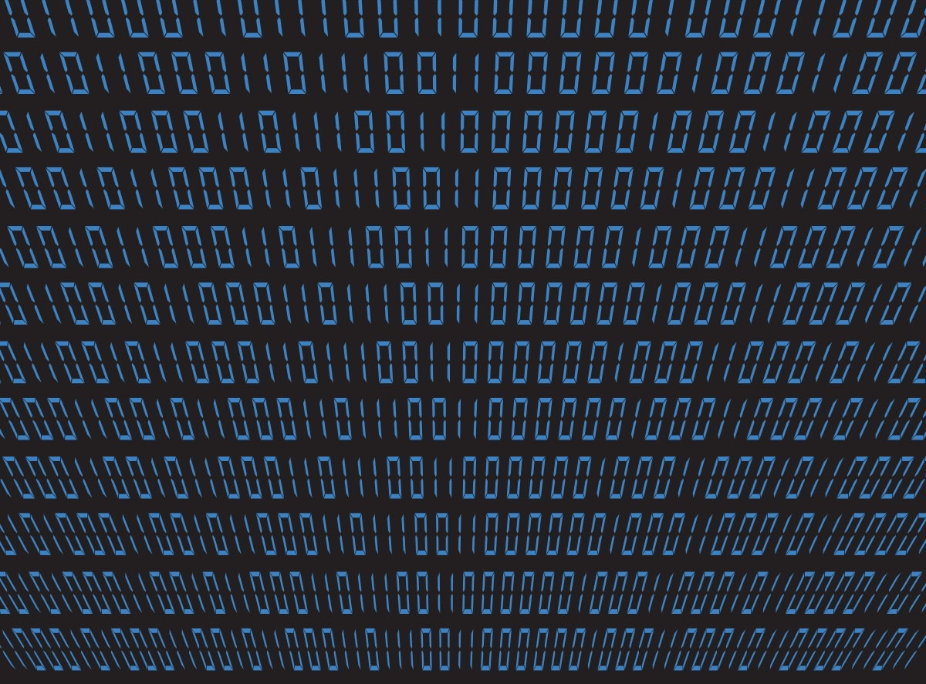
We don’t do the easy stuff well, and the hard stuff is getting harder.

Slide 8
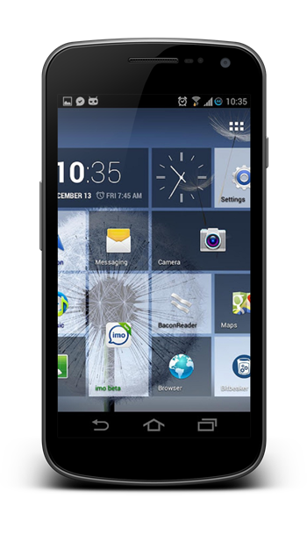
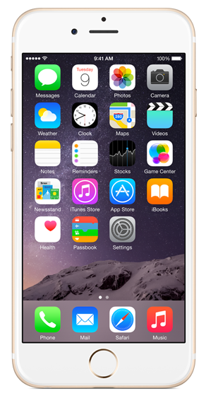
Mobile: Android and iOS
71%
of Android devices out of date
50%
of iOS devices
out of date
Android < 5.5.1, or < 6.0.1
iOS < 9.2
Duo Security Trusted Access Report

Slide 9
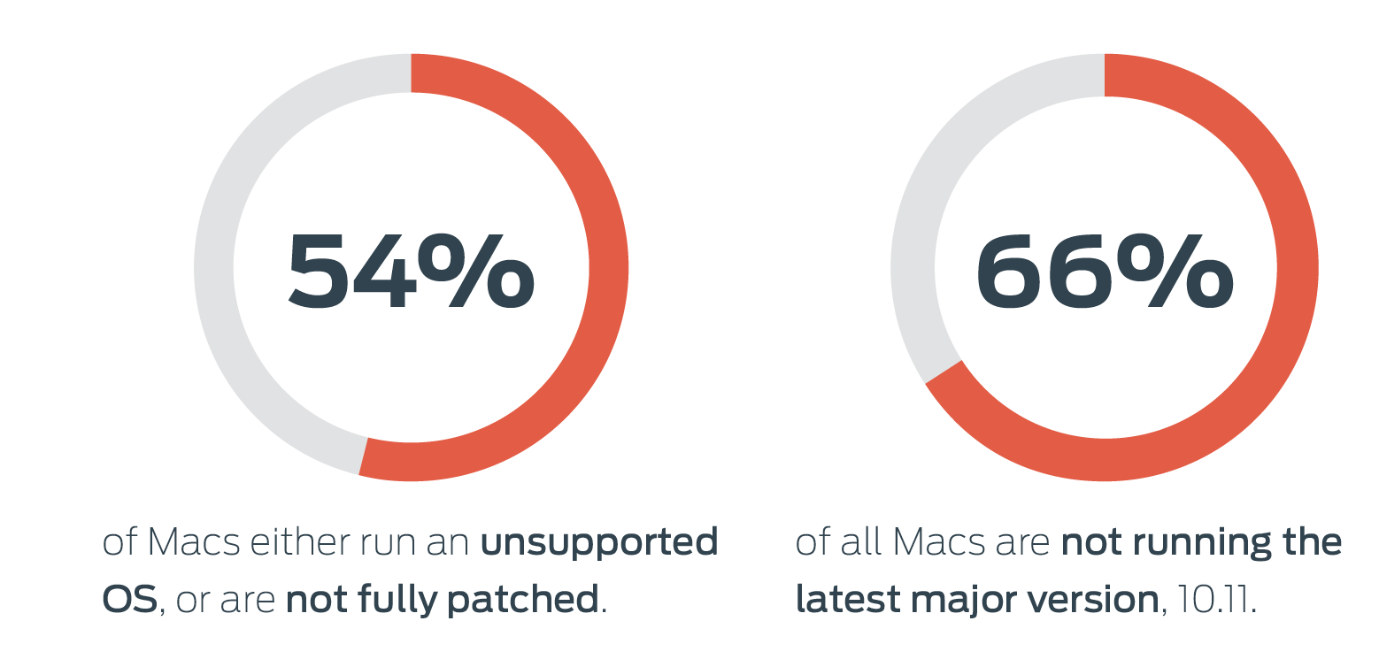
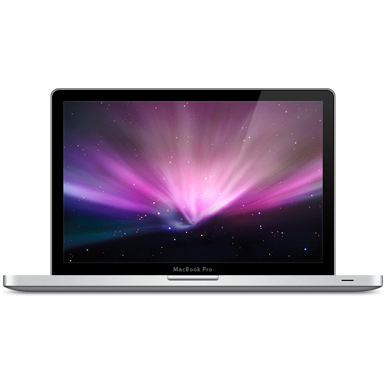

Operating Systems: OS X
8% of Apple users are running unsupported versions of OS X (10.8 and earlier) that cannot receive security updates.
Duo Security Trusted Access Report

Slide 10
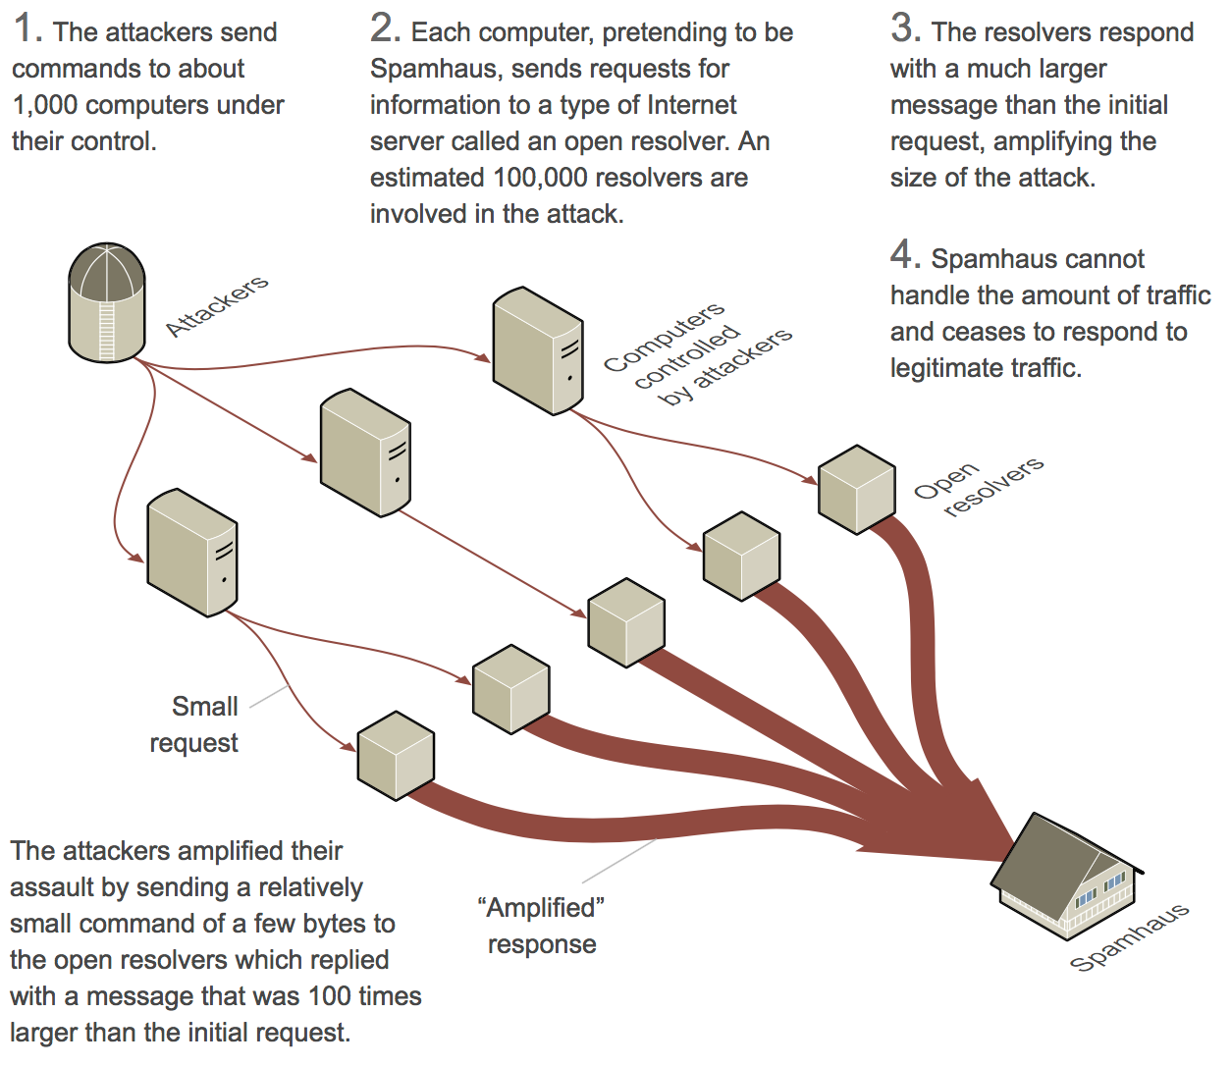

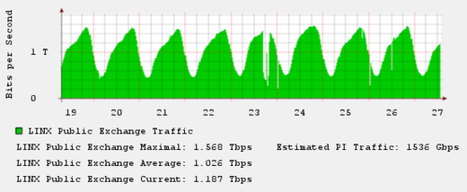
How the amplification attack on Spamhaus Unfolded [March 2013]
Open DNS Resolvers
Lack of egress filtering
Source: New York Times

Slide 11
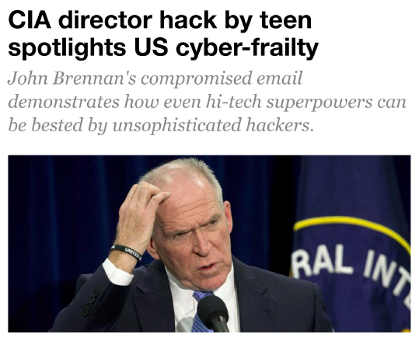

Using social-engineering techniques to pull information from Verizon tech support

Slide 12
Future security
challenges will continue to follow technology trends and Internet adoption patterns.

Slide 13


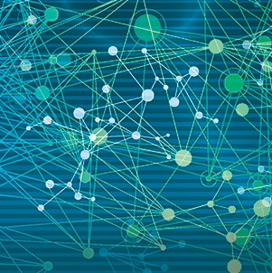
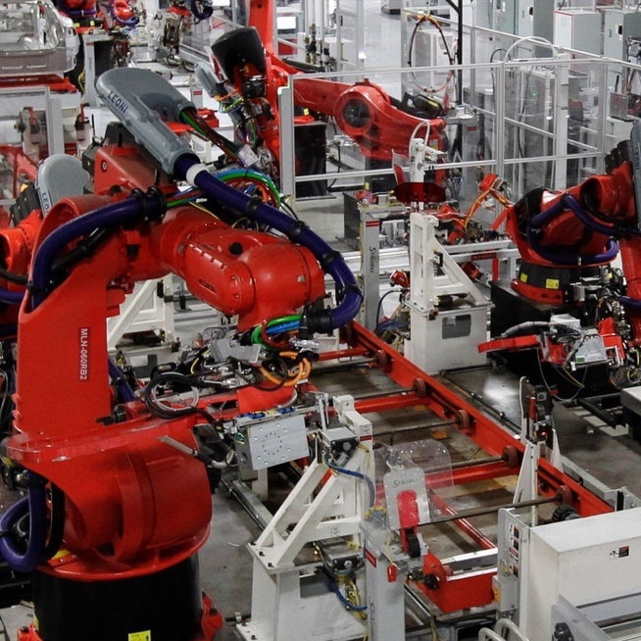
Three Emerging Trends
Data Explosion and Analytics
Smart Systems
and IOT
Autonomy and Robotics

Slide 14
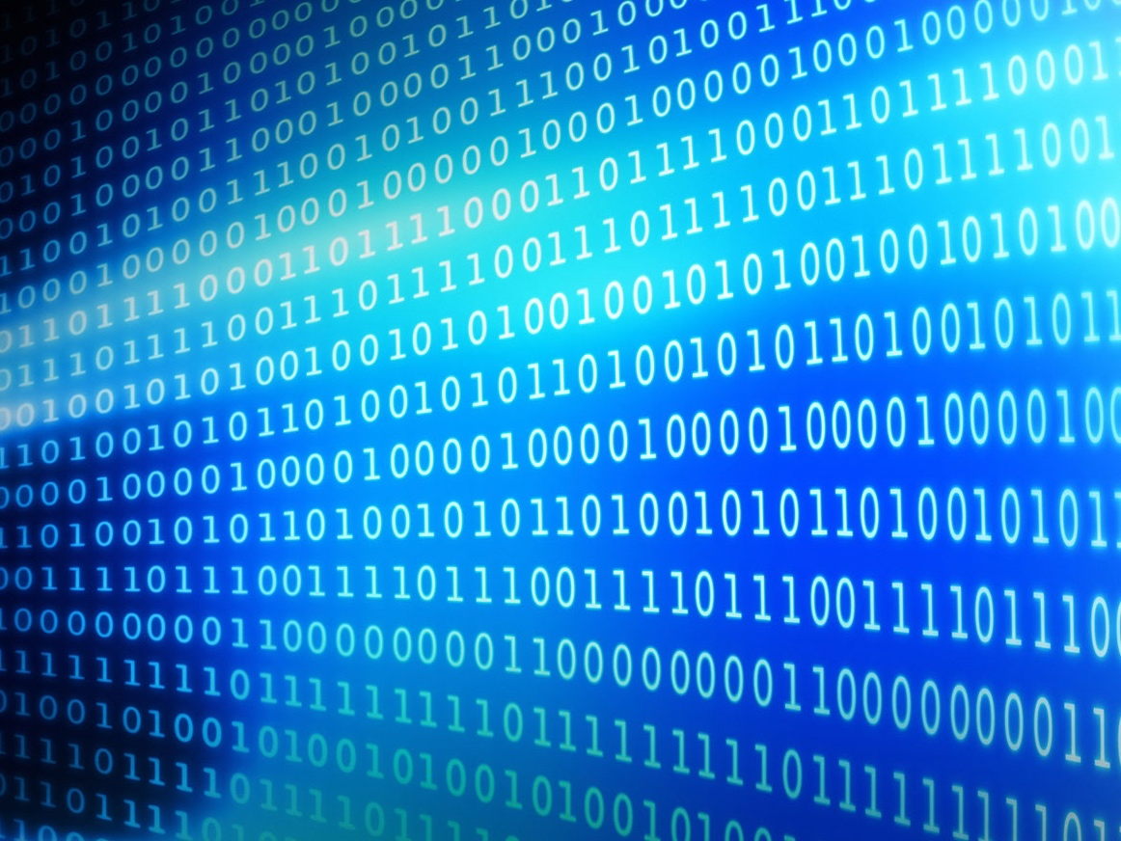






Easy Stuff?
Machine Learning & Security
Big data is a big security target:
  Apple has 500+ million customer credit cards on file
  Facebook has over 1.75 billion users sharing 1+ billion pieces of content every day (2016)
No longer about protecting internal data
Impact of platforms and ecosystems:
  More than 2 million apps in the AppStore
  How secure are partner platforms and third-party apps?
Big Data and Security
The need for research on the adversarial machine learning problem
Data or analysis may be manipulated directly or indirectly (e.g. impact of fake news in changing public opinion)
Data provenance
An adversary can “game” the system to evade detection or create false alarms
Can machine learning techniques be applied to cyber security problems?
Not a silver bullet, but may help to provide context for better decision making

Slide 15
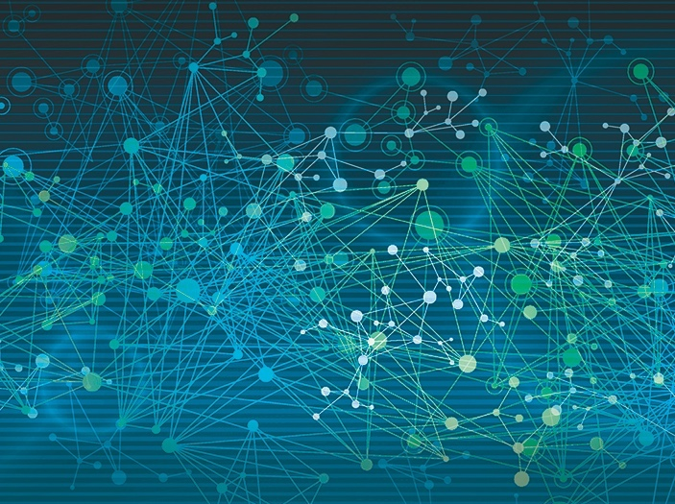
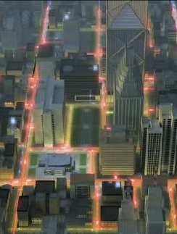
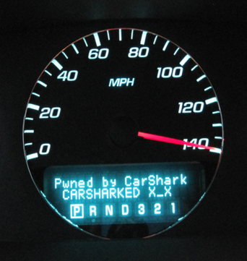
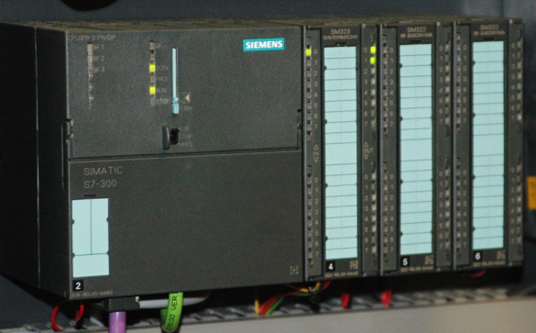
Security of Cyber Physical Systems: Leap from Digital into Physical Realm
Embedded Medical Devices
Smart Grids
Industrial Control
Automobiles

Slide 16

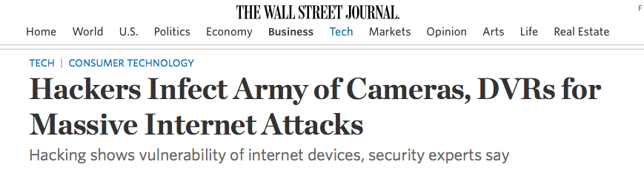



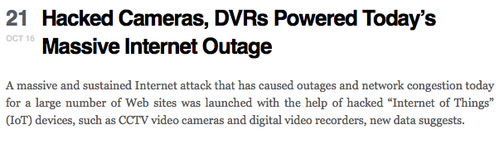

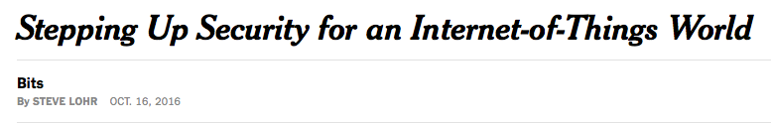

Digital Makeover of Physical Things: The Internet of (Unsafe) Things
Mirai Malware

Slide 17
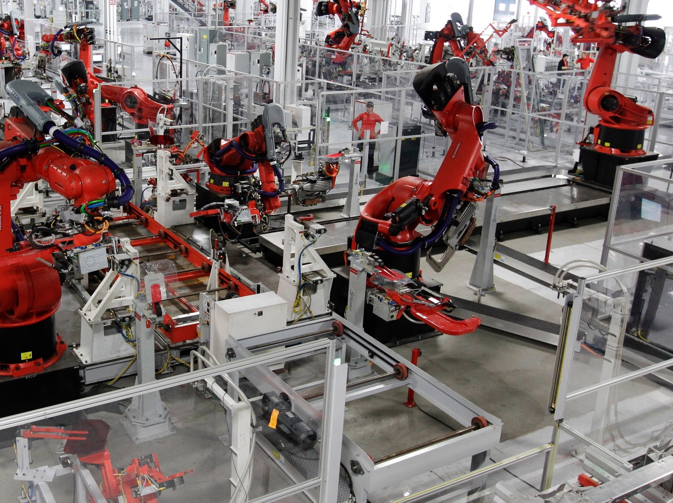

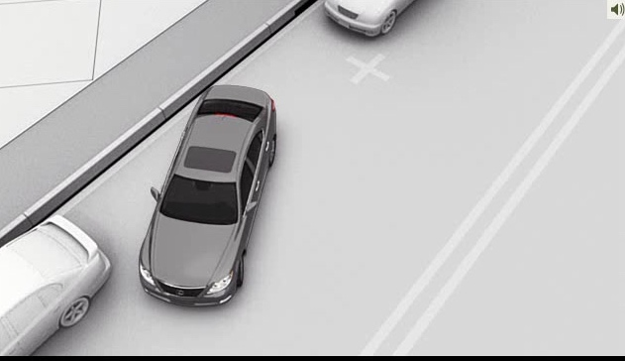

The Future is Here: Automation, Robotics and AI
Lane departure warning
Self-parking
Adaptive cruise control

Slide 18
Thank You!

