Slide 1
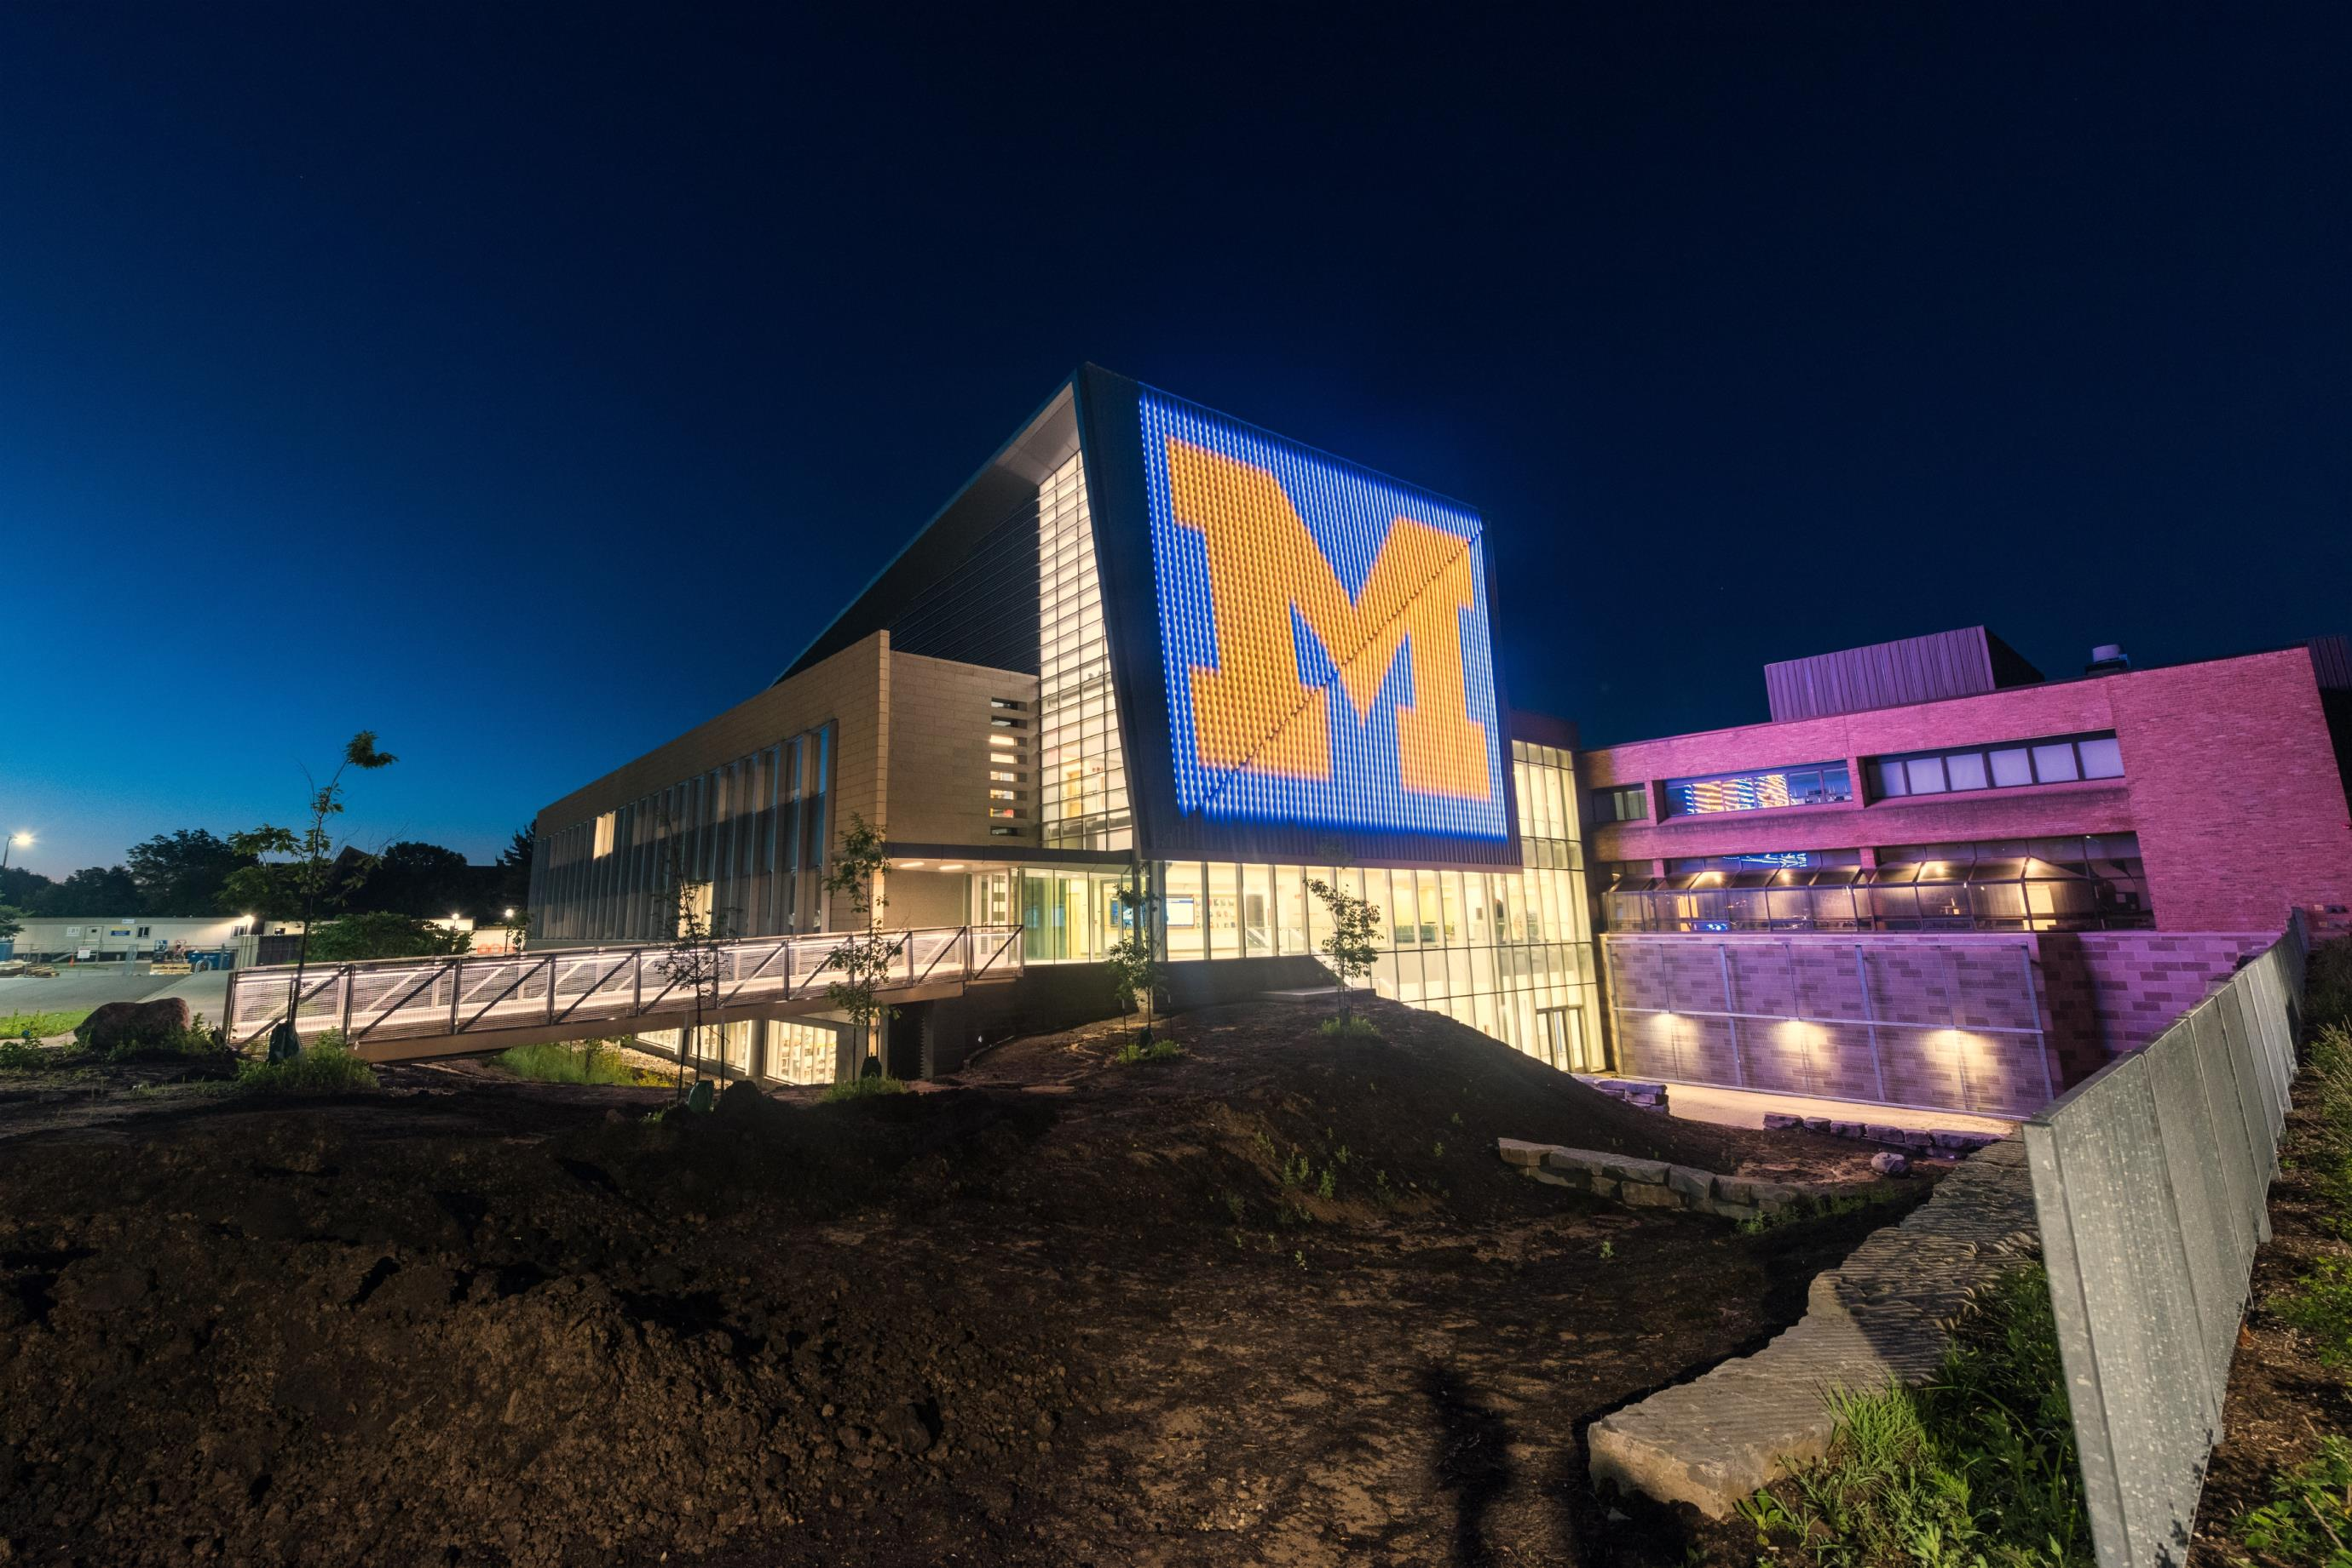
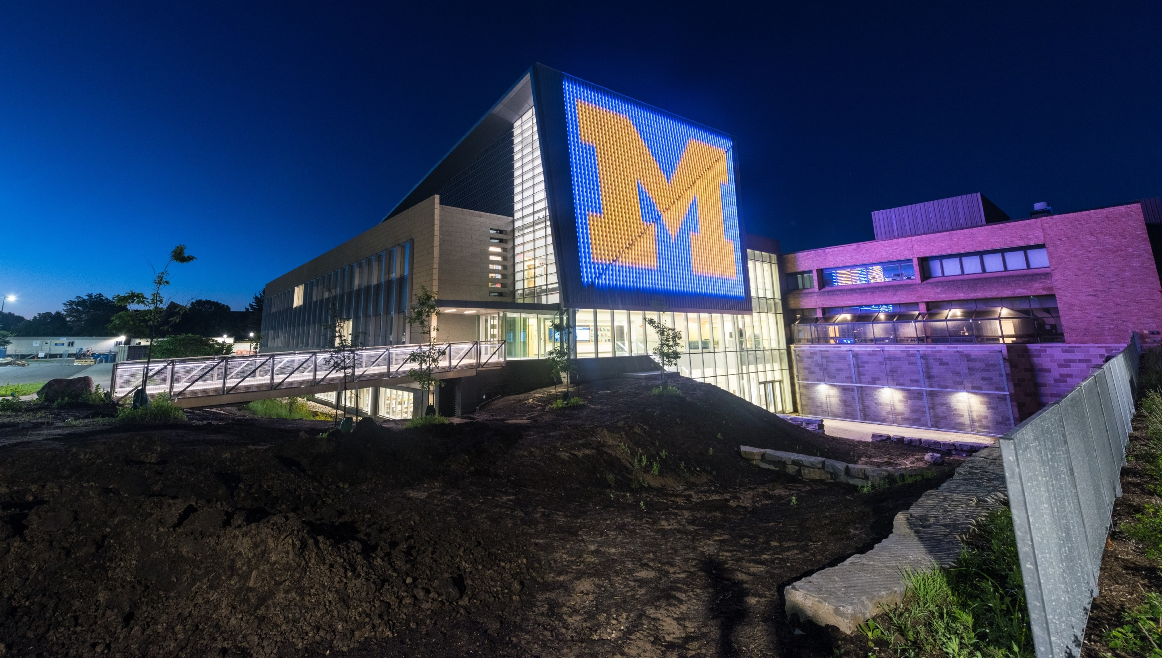
Scholarship Program Overview
UIDP Fall Meeting, September 2017
Detroit
Notes:
Excited to have you back with us for this fall meeting and our initial subcommittee meetings.

Slide 2
Agenda
The Basics: Student Support from Industry
Program Management: Two Options
Summary
Notes:
We’re so pleased to have the following new members on the board.
1)Kim Hammonds—unable to be with us today
Deutsche [DOYSHA] Bank member of the managing board and group chief operating officer.
Previously, she served as CIO at Boeing.
Kim has served as a University alumni/campaign event host in London, where she is based.
2)Don Kania
Former president and CEO of FEI Company.
He holds five U-M degrees.
A dedicated alumnus, Don’s engagement at the College has included serving on the Nuclear Engineering and Radiological Sciences advisory board, presenting at a departmental colloquium and advising current students.
He resides in Ashland, Oregon.
3)Steve McLaughlin—unable to be with us today
Georgia Tech’s (GT) Steve Chaddick School Chair and professor in the School of Electrical and Computer Engineering (ECE).
Beginning a week from today, he will become Dean in the GT College of Engineering and Southern Company Chair.
Steve is a passionate Wolverine alumnus.
We sit on each other’s boards and his board is also meeting today.
4)Elizabeth Moje
Dean (since earlier this year), George Herbert Mead Collegiate Professor of Education, and Arthur F. Thurnau Professor
in the U-M School of Education.
Her work in literacy earned the Provost’s Teaching Innovation Prize at the University of Michigan.
She is a member of the National Academy of Education, where she chairs the Professional Development Committee.

Slide 3
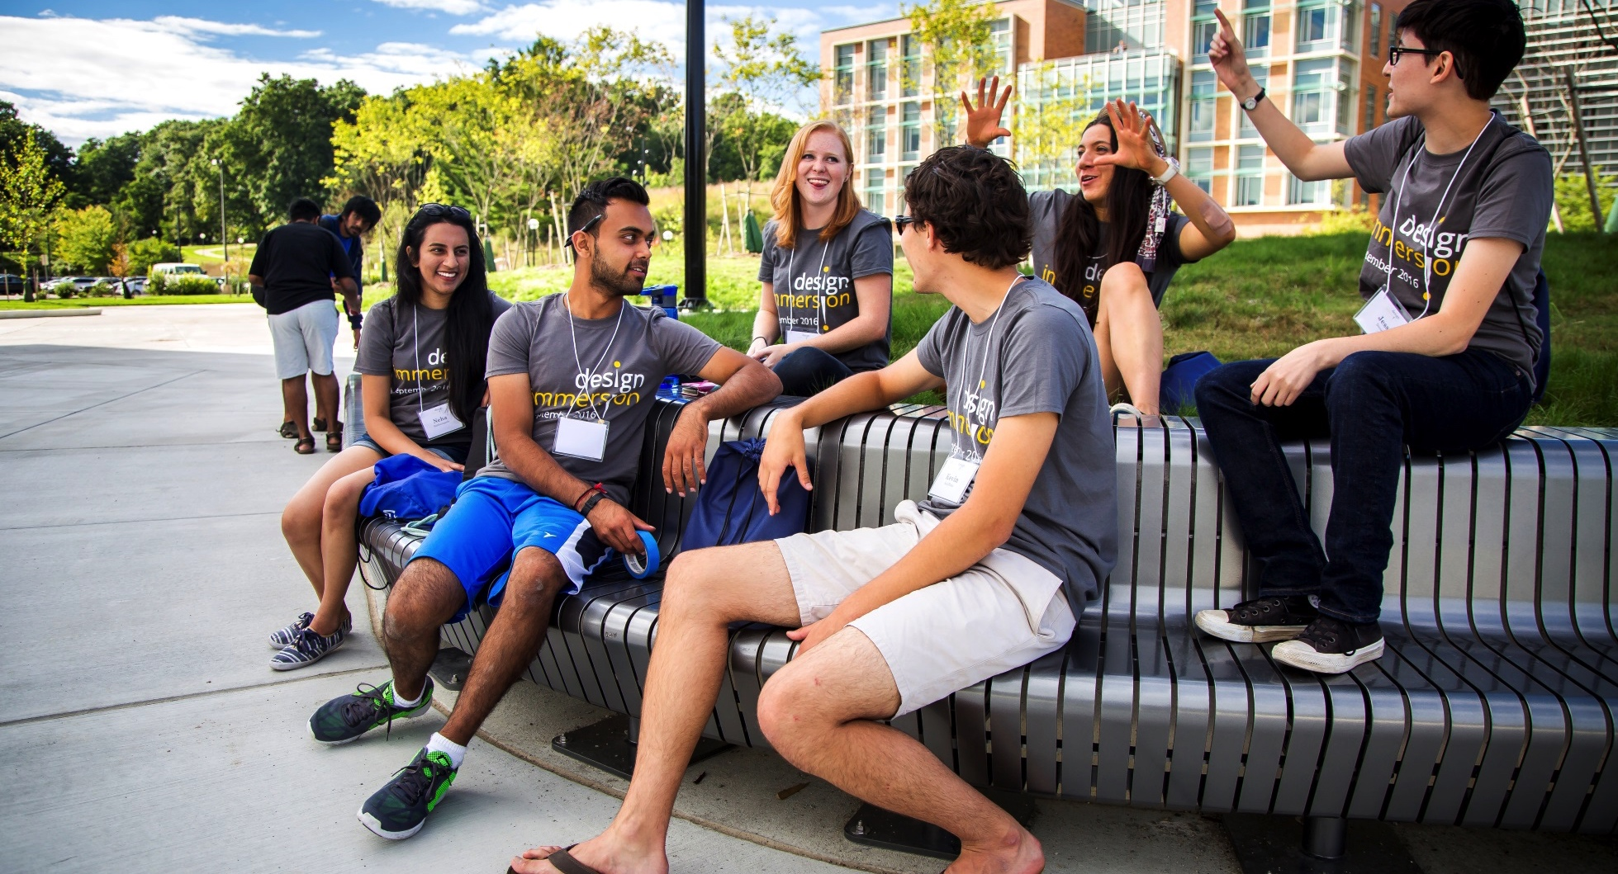
The Basics
Student Support from Industry
Recruiting tool
Relationship building opportunity
Financial aid

Slide 4
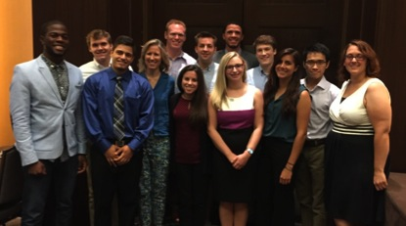
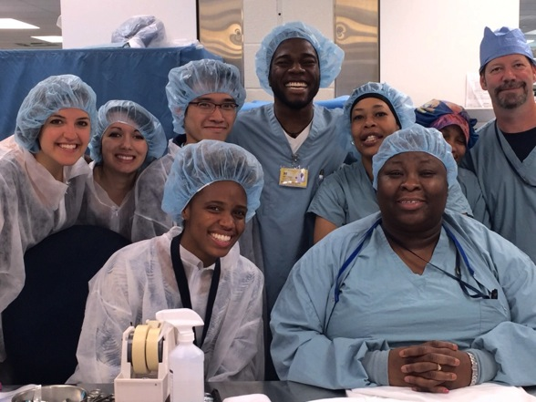
The Basics
Types of Student Support
Scholarships
Fellowships
Notes:
The individuals shown have served the board over the last few years.
We thank them for all they have done for the College.
Although they are not here today, let me take this moment to acknowledge them.
1)Betty Chao
President/CEO of Westech International, Inc.
She has served on the LAB (EAC) since 2014.
2)Gary May
Chancellor of the University of California, Davis.
Former Dean at Georgia Tech.
He has served on the LAB (EAC) since 2013.
3)Lynn Kelley
SVP at Union Pacific Railroad.
Lynn has served on the LAB (EAC) since 2014.
4)Sanjay Correa
VP at GE (retiring after more than 30 years).
Sanjay has served on the LAB (EAC) since 2014.
Let’s give them a round of applause.

Slide 5
The Options
Industry
+ University does all the work
+ University often has better information about
students; can maximize applicant pool
- Sponsor has less direct control
University
+ Ability to direct funds with fidelity to sponsor
criteria & student needs
+ Integration with financial aid packages
+ Publicity
Program Management Options
Run through the University
        -- University selects recipients using
        guidance from the sponsor
        -- University facilitates sponsor/student
        interaction
        -- Treated as charitable gift
        -- Can be endowed or expendable
Notes:
The individuals shown have served the board over the last few years.
We thank them for all they have done for the College.
Although they are not here today, let me take this moment to acknowledge them.
1)Betty Chao
President/CEO of Westech International, Inc.
She has served on the LAB (EAC) since 2014.
2)Gary May
Chancellor of the University of California, Davis.
Former Dean at Georgia Tech.
He has served on the LAB (EAC) since 2013.
3)Lynn Kelley
SVP at Union Pacific Railroad.
Lynn has served on the LAB (EAC) since 2014.
4)Sanjay Correa
VP at GE (retiring after more than 30 years).
Sanjay has served on the LAB (EAC) since 2014.
Let’s give them a round of applause.

Slide 6
The Options
Industry
+ Maximizes flexibility
- Sponsor typically has less access to
University marketing channels
- Selections often made with less information University
+ Student support always aligns with mission
- Lack of integration with financial aid
- Corporate relations officers often
rewarded for gift production
Program Management Options
Run by an external entity
        -- Sponsor selects recipients
        -- Treated as non-gift payment
        * Funds can be transferred to a student’s account
        * Funds can be paid directly to the student
Notes:
The individuals shown have served the board over the last few years.
We thank them for all they have done for the College.
Although they are not here today, let me take this moment to acknowledge them.
1)Betty Chao
President/CEO of Westech International, Inc.
She has served on the LAB (EAC) since 2014.
2)Gary May
Chancellor of the University of California, Davis.
Former Dean at Georgia Tech.
He has served on the LAB (EAC) since 2013.
3)Lynn Kelley
SVP at Union Pacific Railroad.
Lynn has served on the LAB (EAC) since 2014.
4)Sanjay Correa
VP at GE (retiring after more than 30 years).
Sanjay has served on the LAB (EAC) since 2014.
Let’s give them a round of applause.

Slide 7
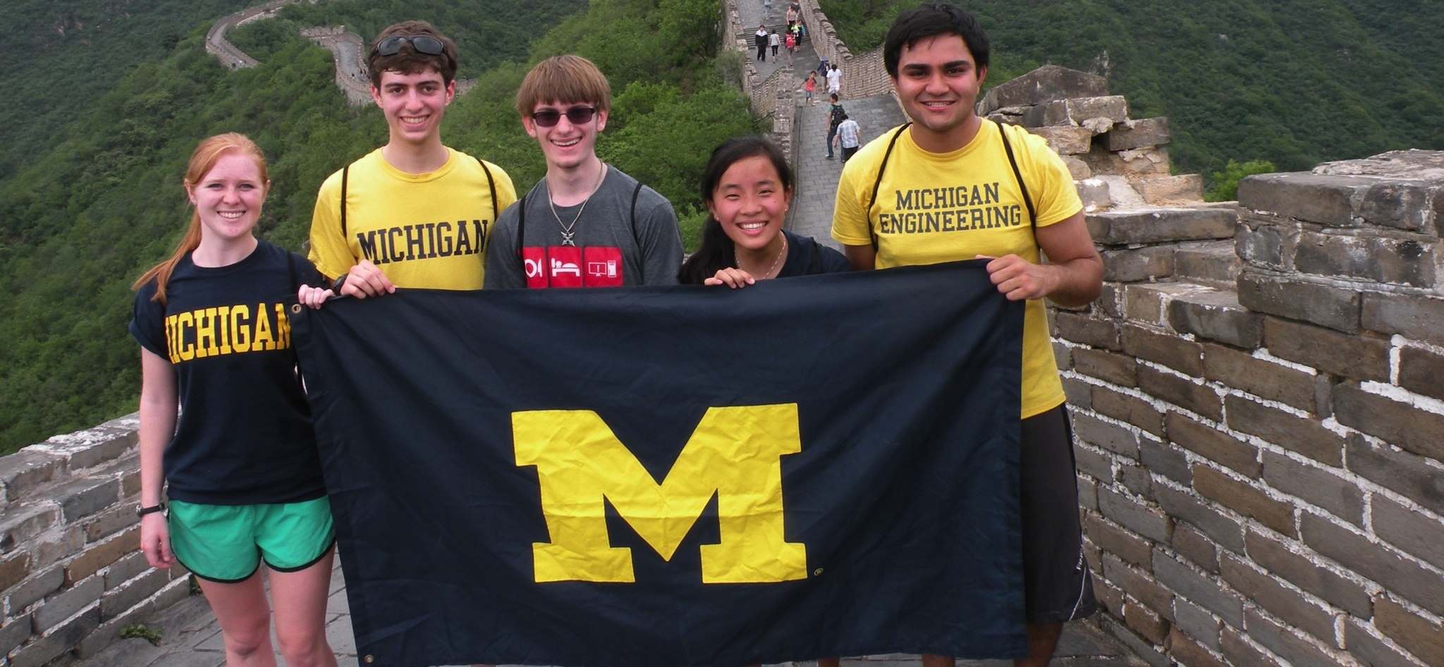
Summary
Summary
Scholarships & fellowships are a great tool as part of a broader campus engagement strategy
There are several ways to structure student support; each has benefits and drawbacks
Engagement of students is critical to success

Slide 8
QUESTIONS?

