Slide 1
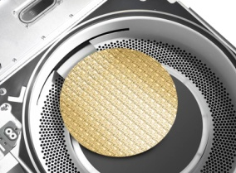
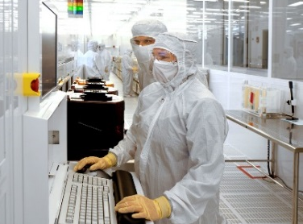
Lam Research Overview
Key Facts
Our Vision
A global leader in wafer fabrication equipment and services since 1980
~8,200 employees in 16 countries
Manufacturing and suppliers worldwide
~$6.4B in revenue in CY 2016
More than $2.5B invested in R&D over the last three years
Number one in customer trust
Number one in market share
A company where successful people want to work
Best-in-class products and services
Financial performance to
Fund solutions our customers require
Provide return our shareholders expect
Core Products
Deposition
Etch & Strip
Clean
Service & Support
Notes:
1/25/17:
Updated headcount per QDec’17 results (was ~7,800)
Updated revenue for CY 2016
Updated 3-year R&D for CY 2014-2016
12/7/16:
New slide/format refresh

Slide 2
Strategic pillars of University Engagement
Research
Recruiting
Fundamental research
Unique competencies
Quick, inexpensive feasibility testing of new ideas
Aligned
Disciplined
Measured
Identifying top talent
Partnership with HR
Research projects and on-campus events
Streamline communications and messaging
Build employment brand
Align university activities across the global org
Reputation

